Slide 1
Gesture Coding Manual -Tina Chen

Slide 2

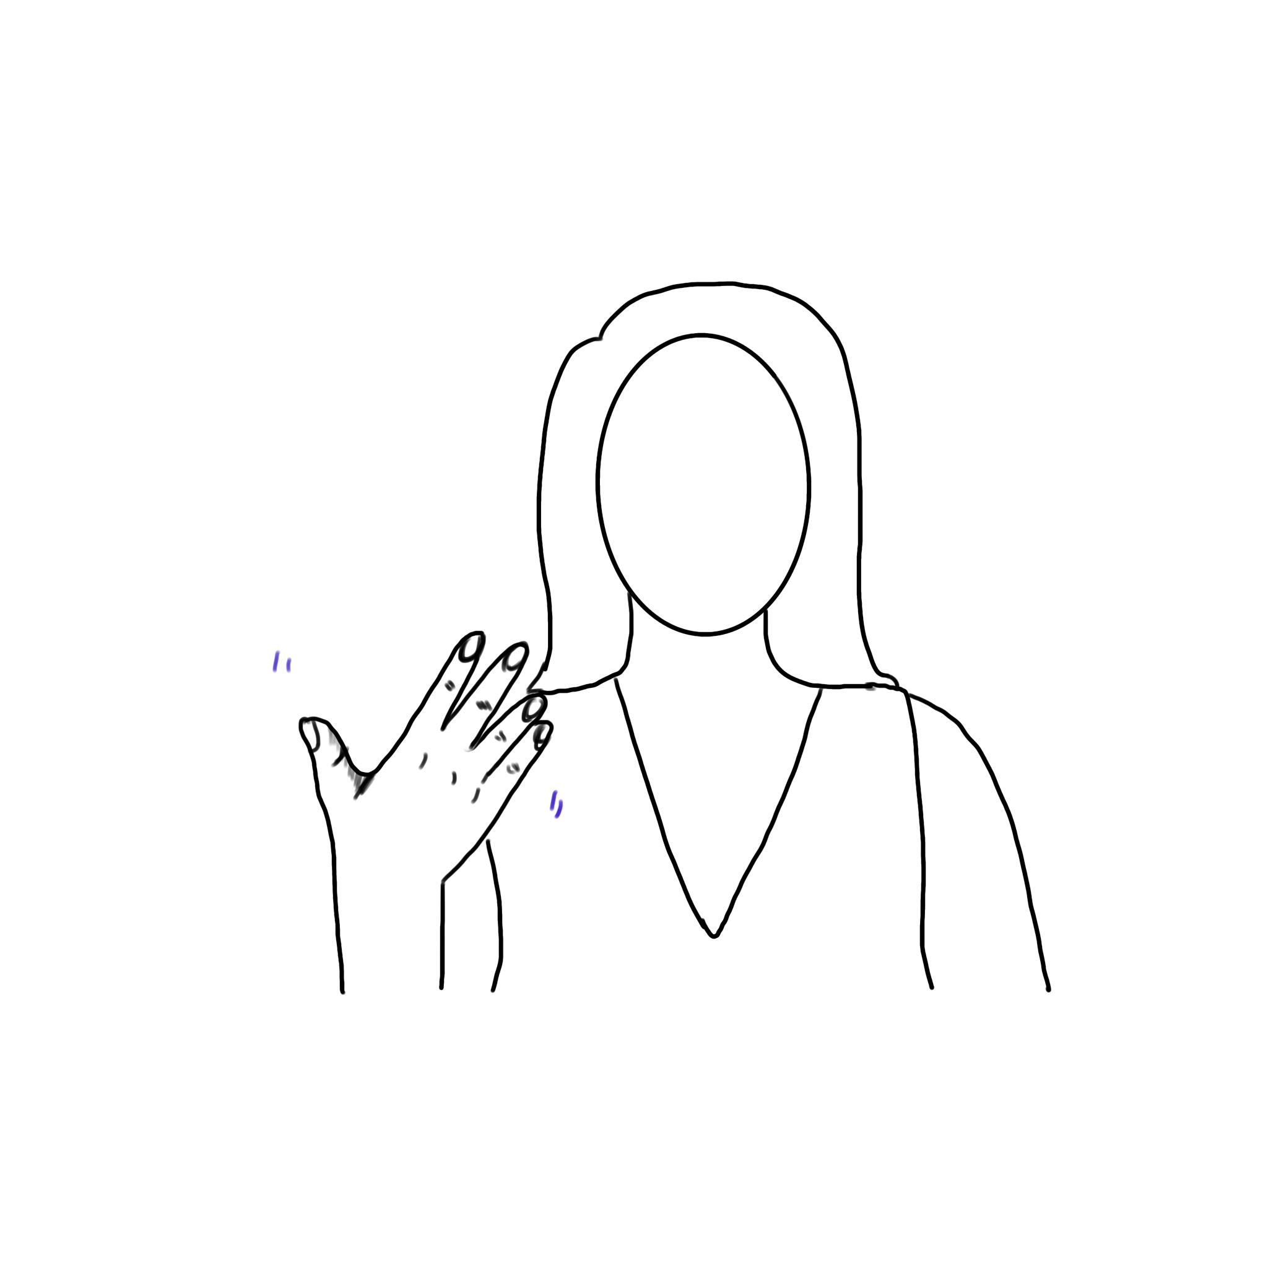
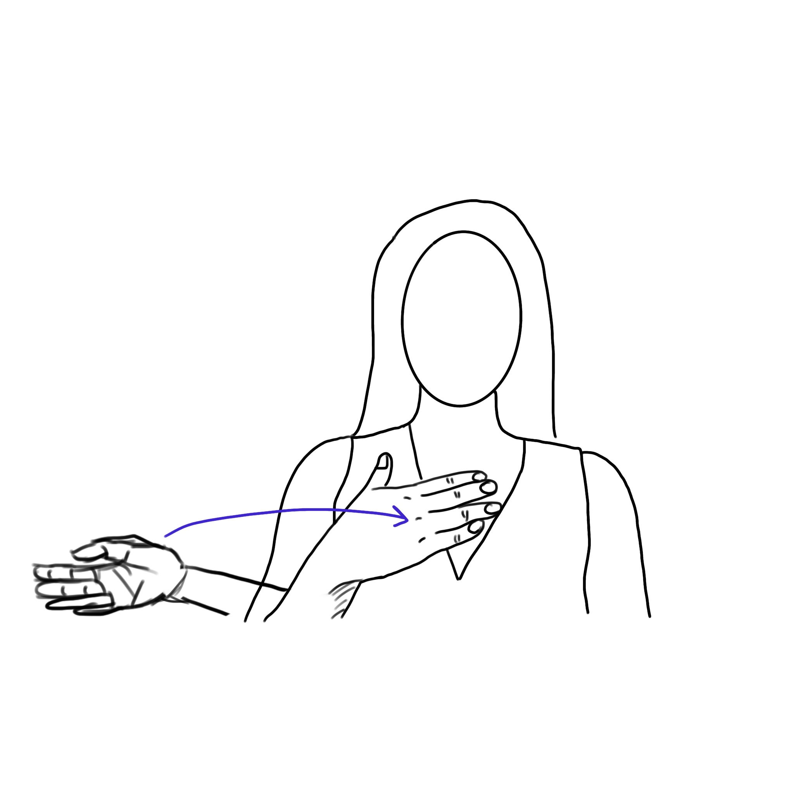
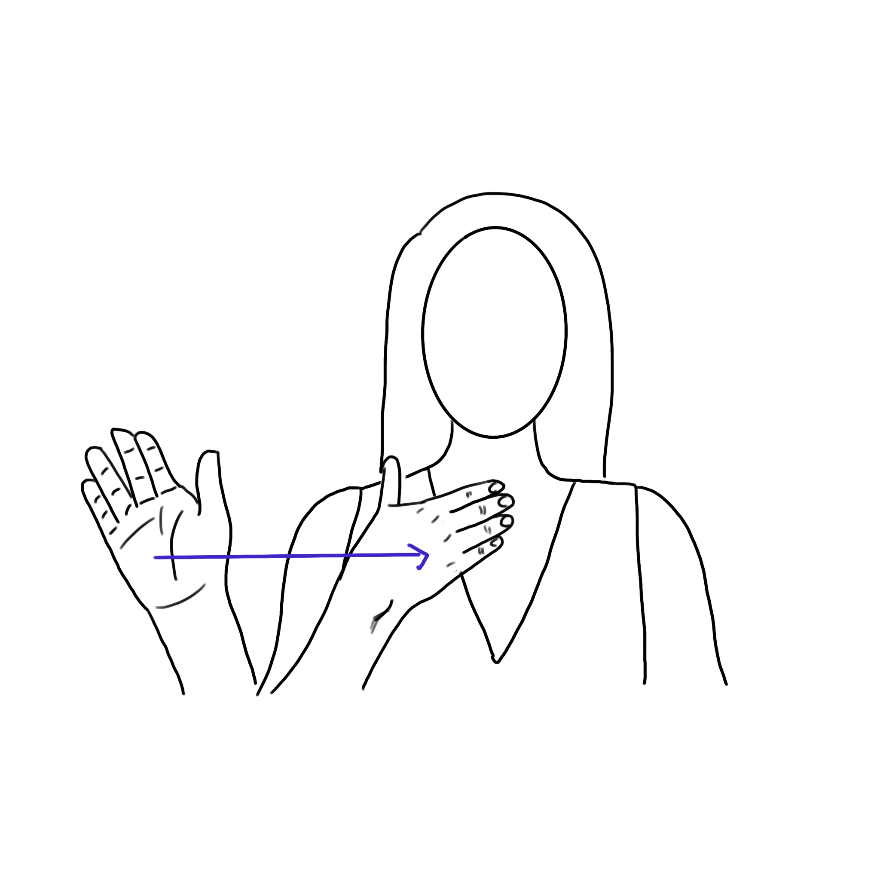
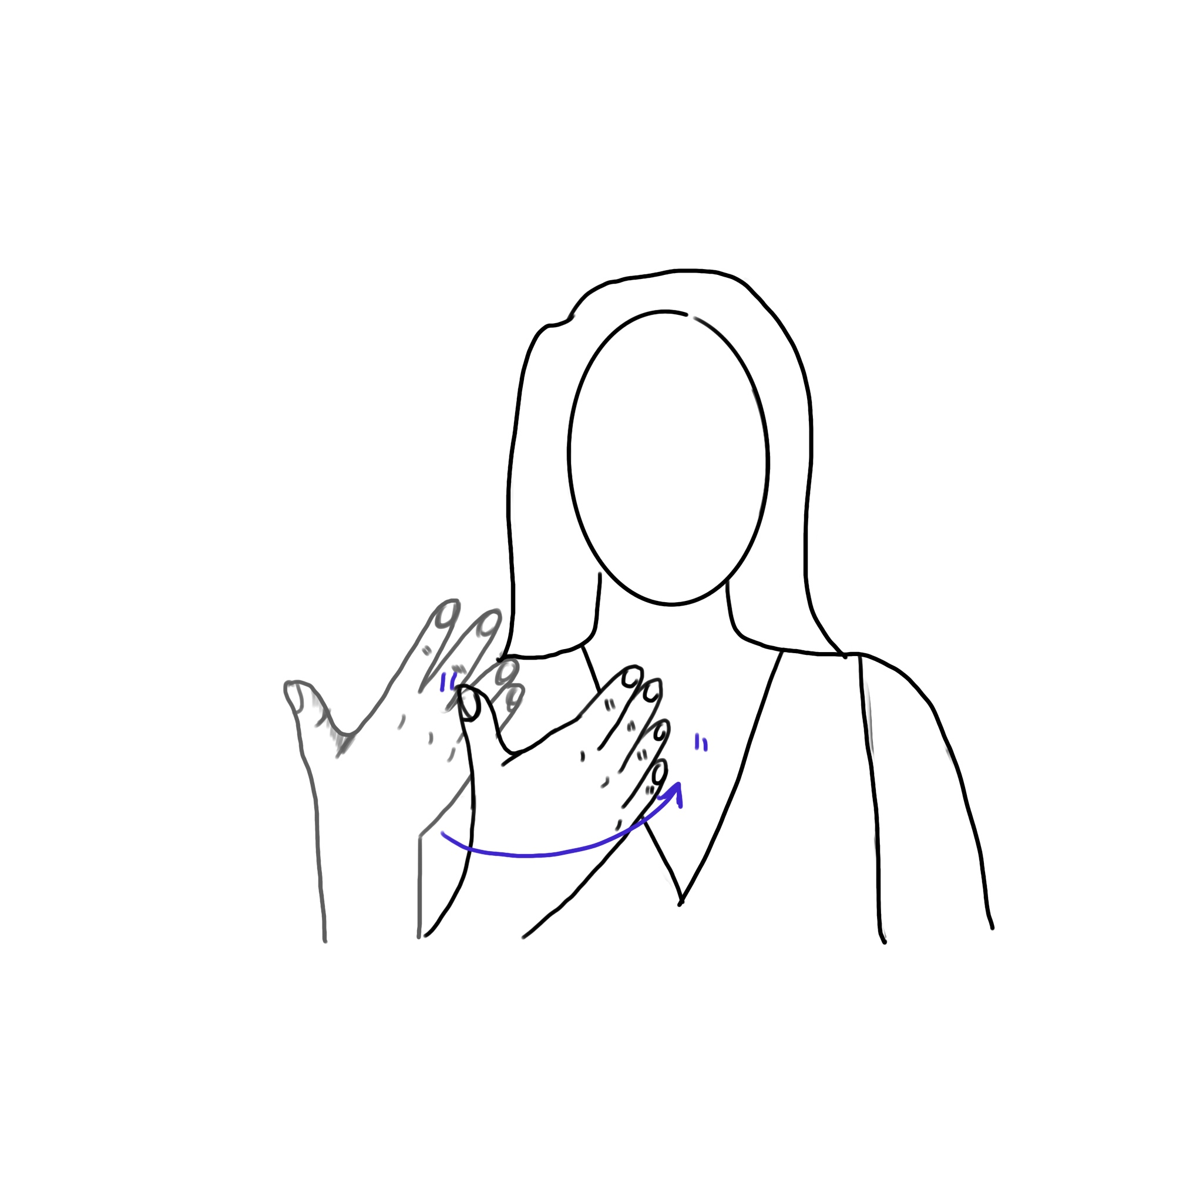
In
IN1
IN2
IN3
IN4
IN5

Slide 3
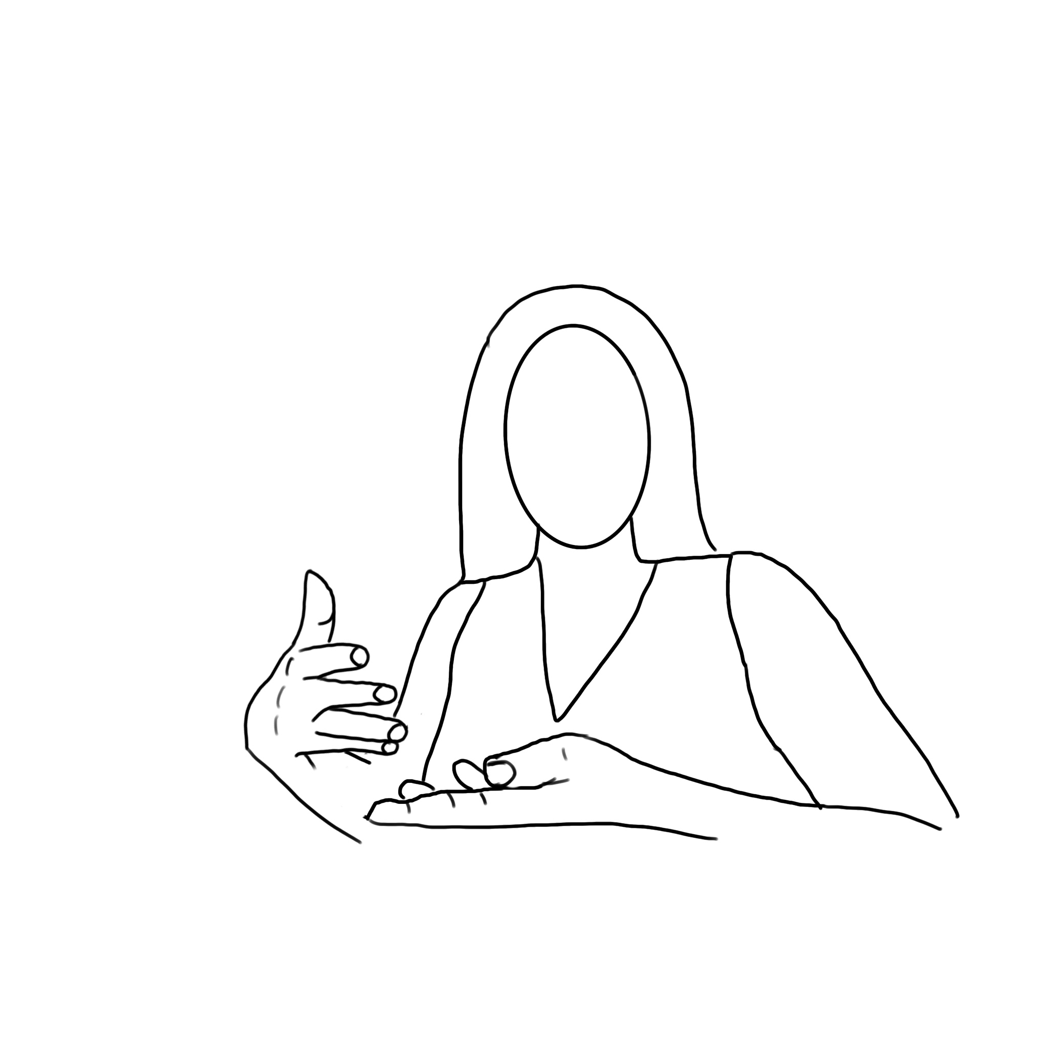
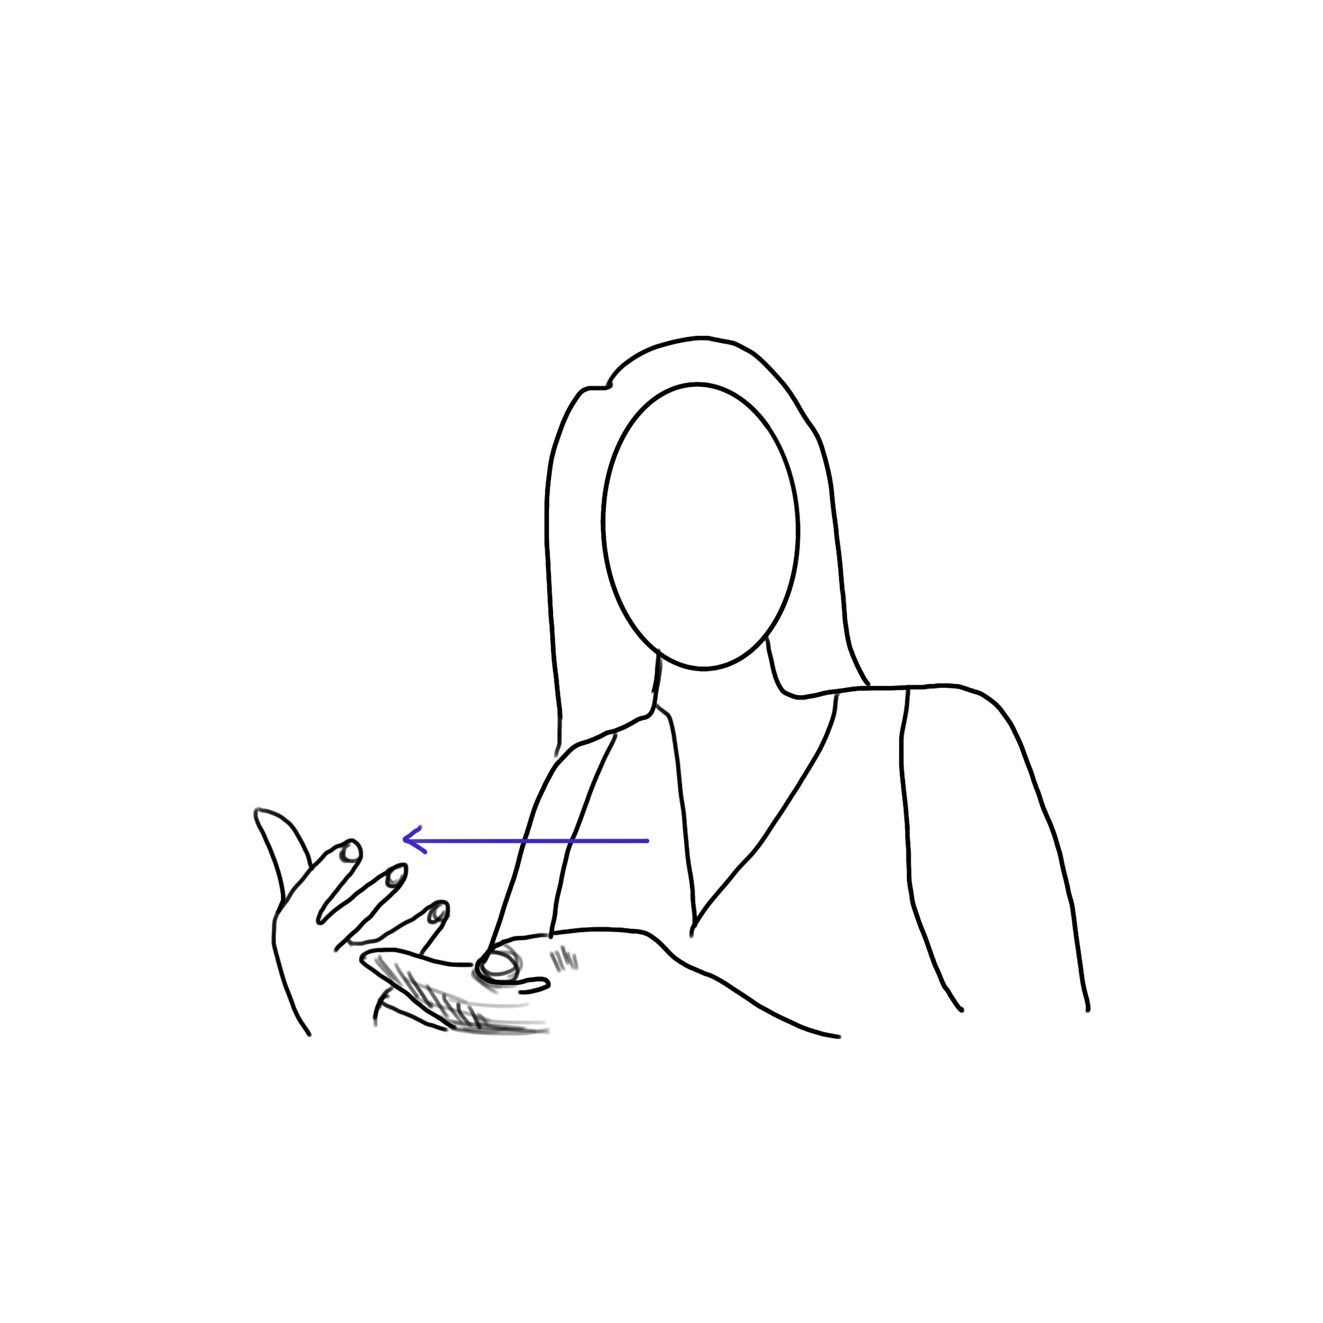
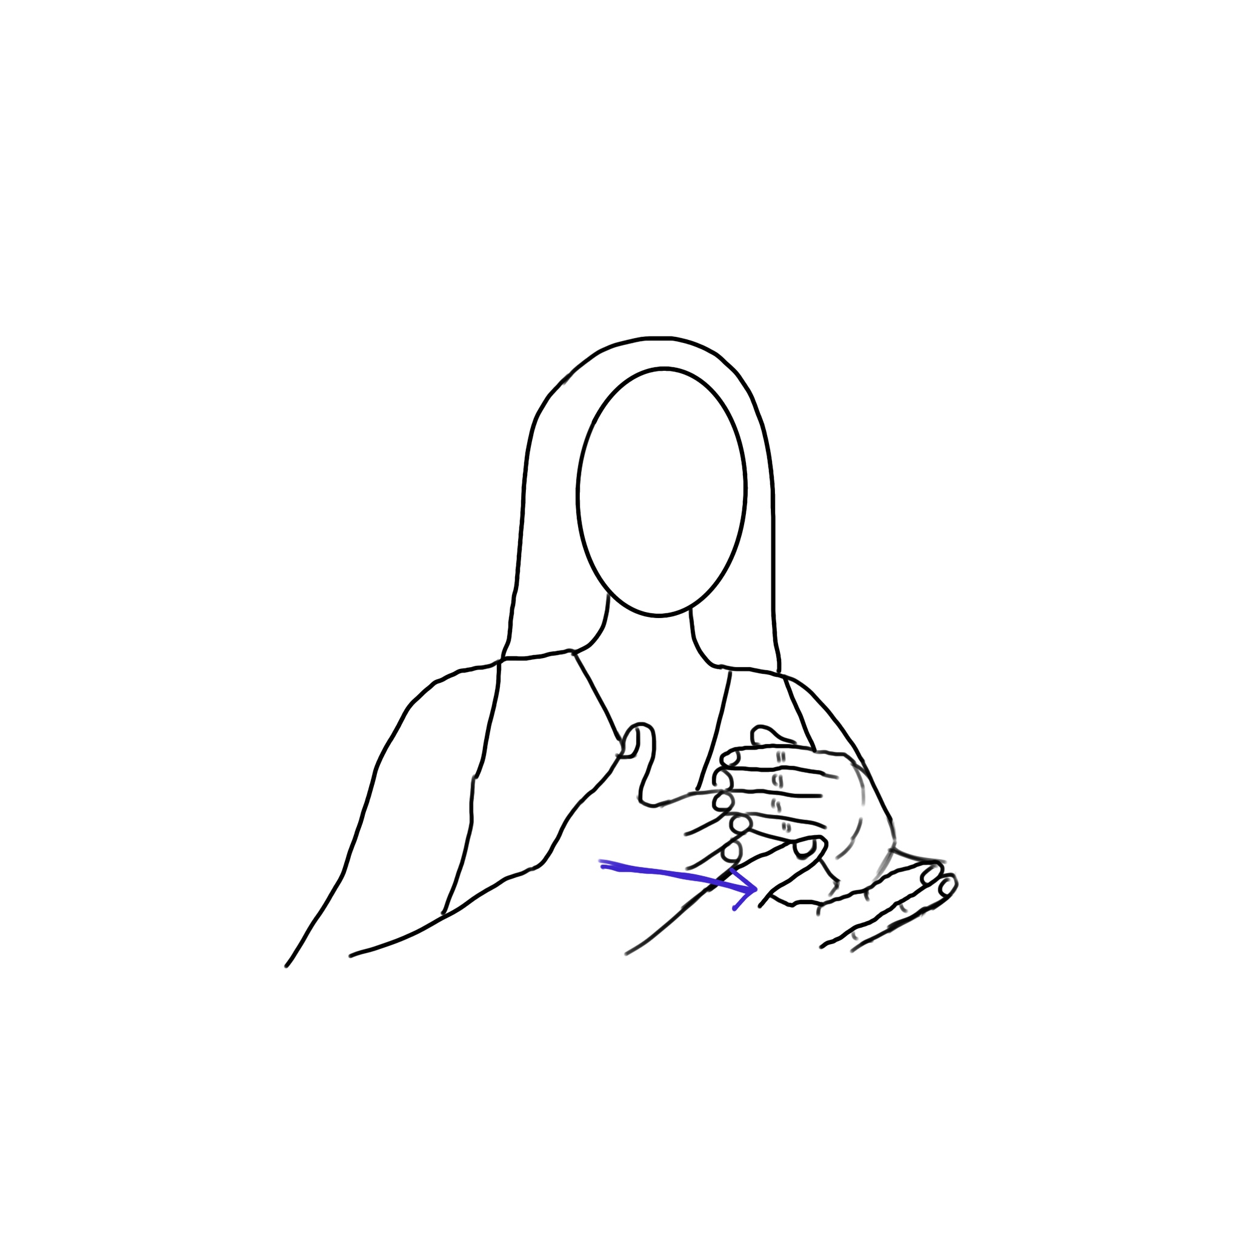
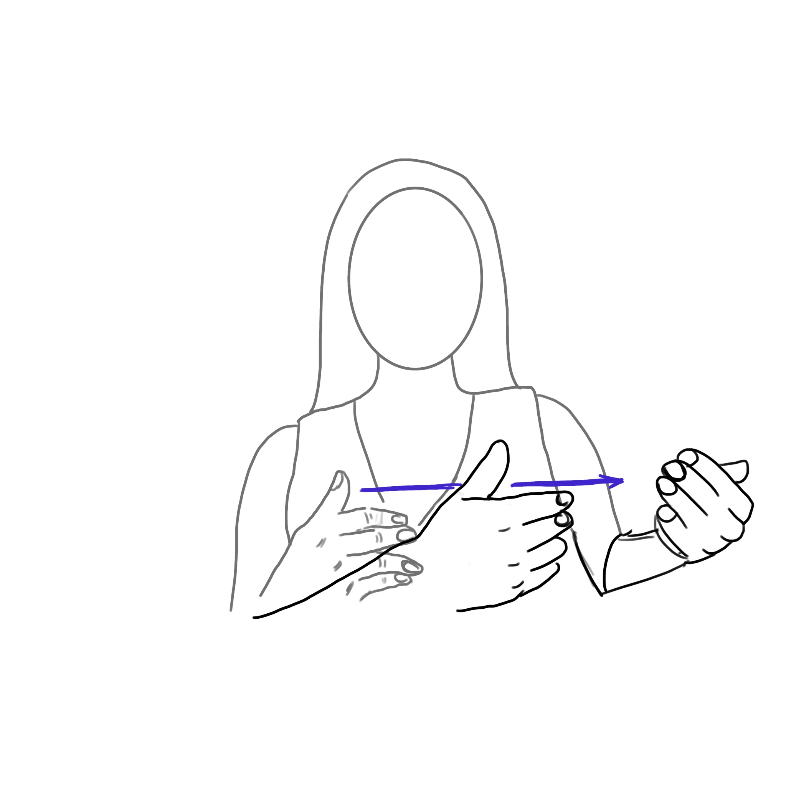
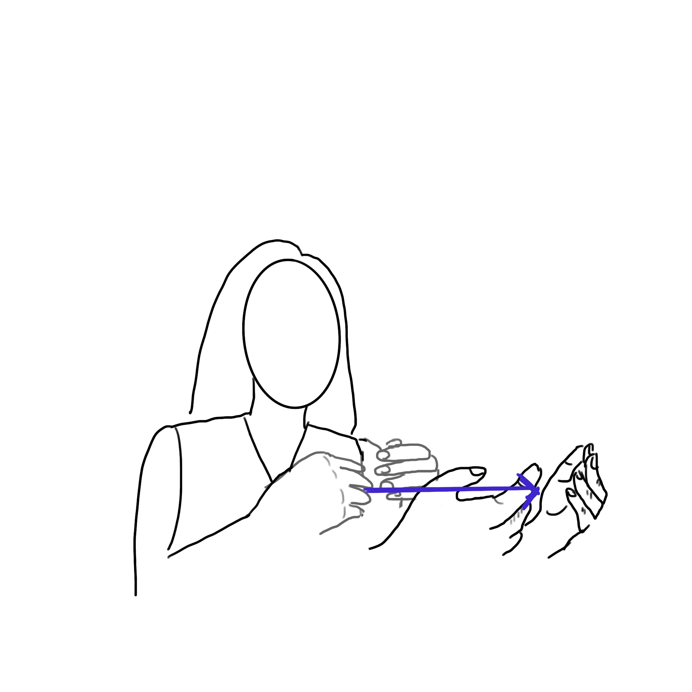
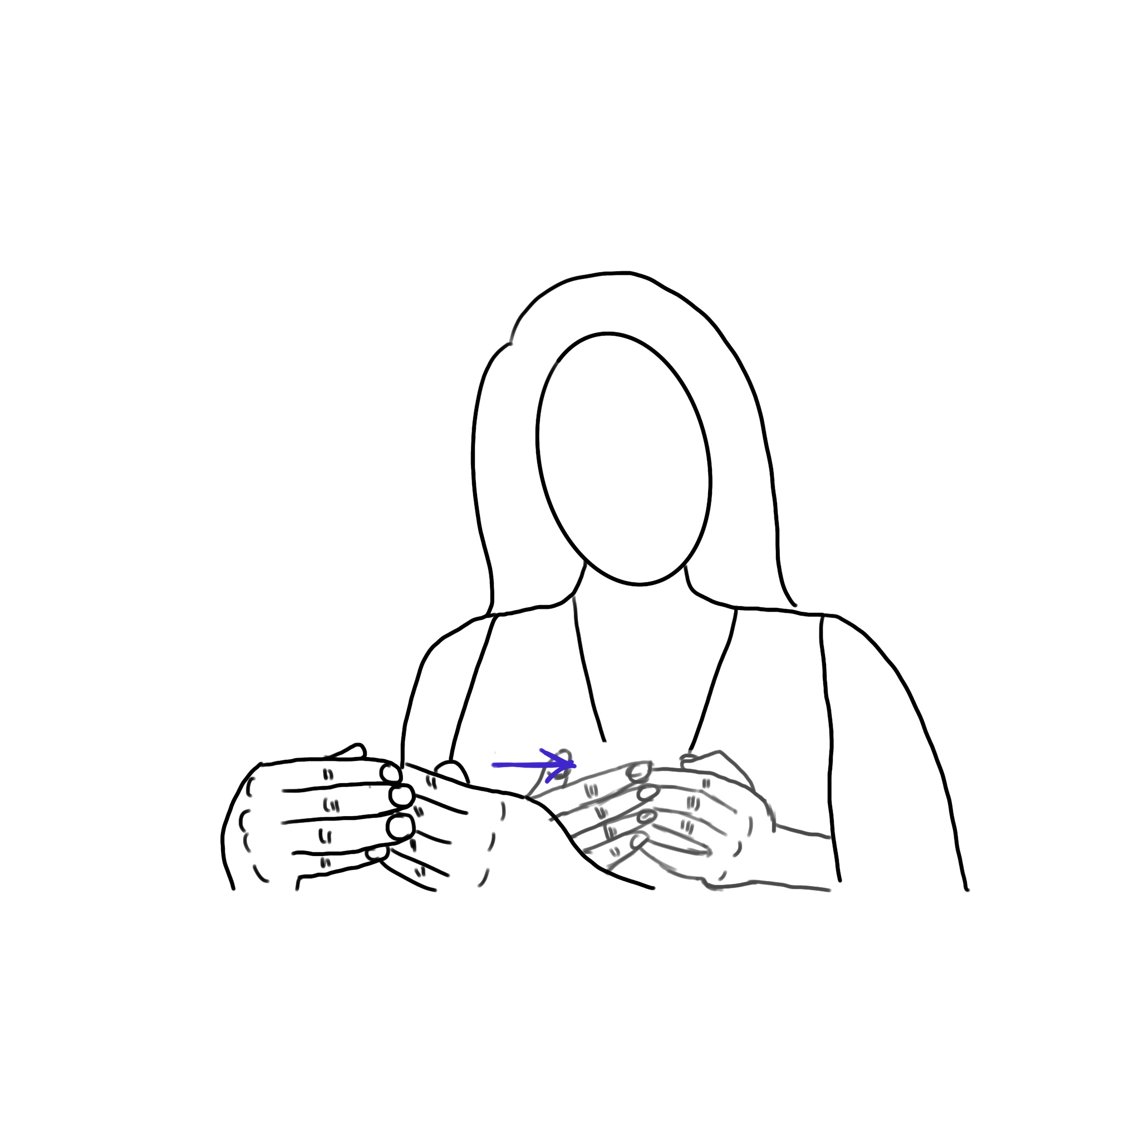
In(Cont.)
IN6
IN7
IN8
IN9
IN10
IN11

Slide 4
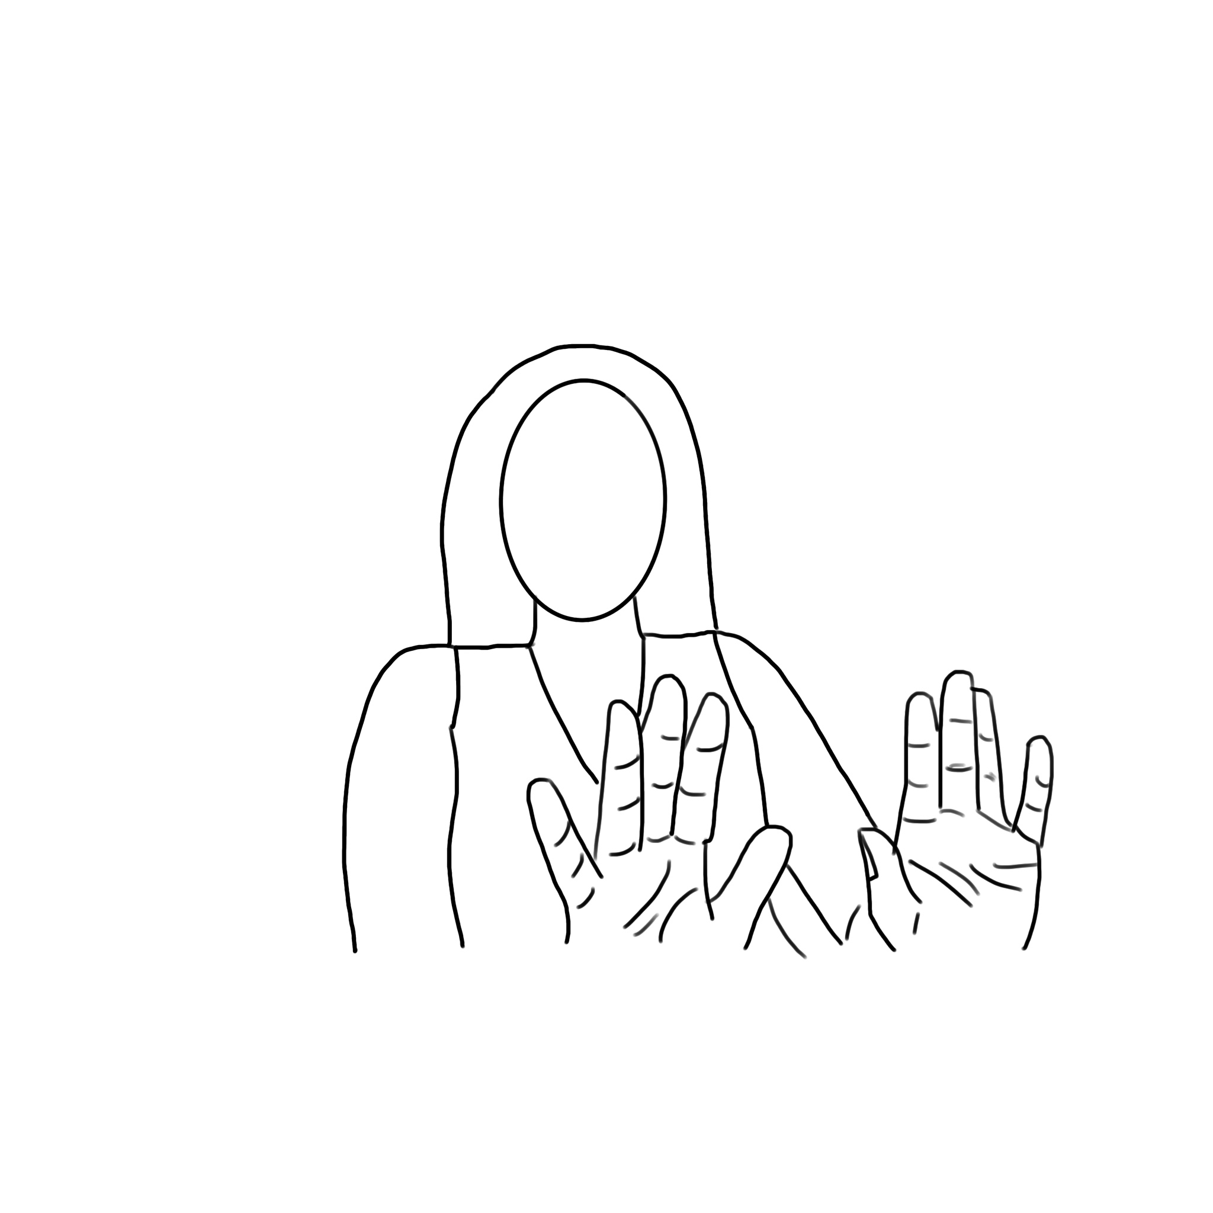
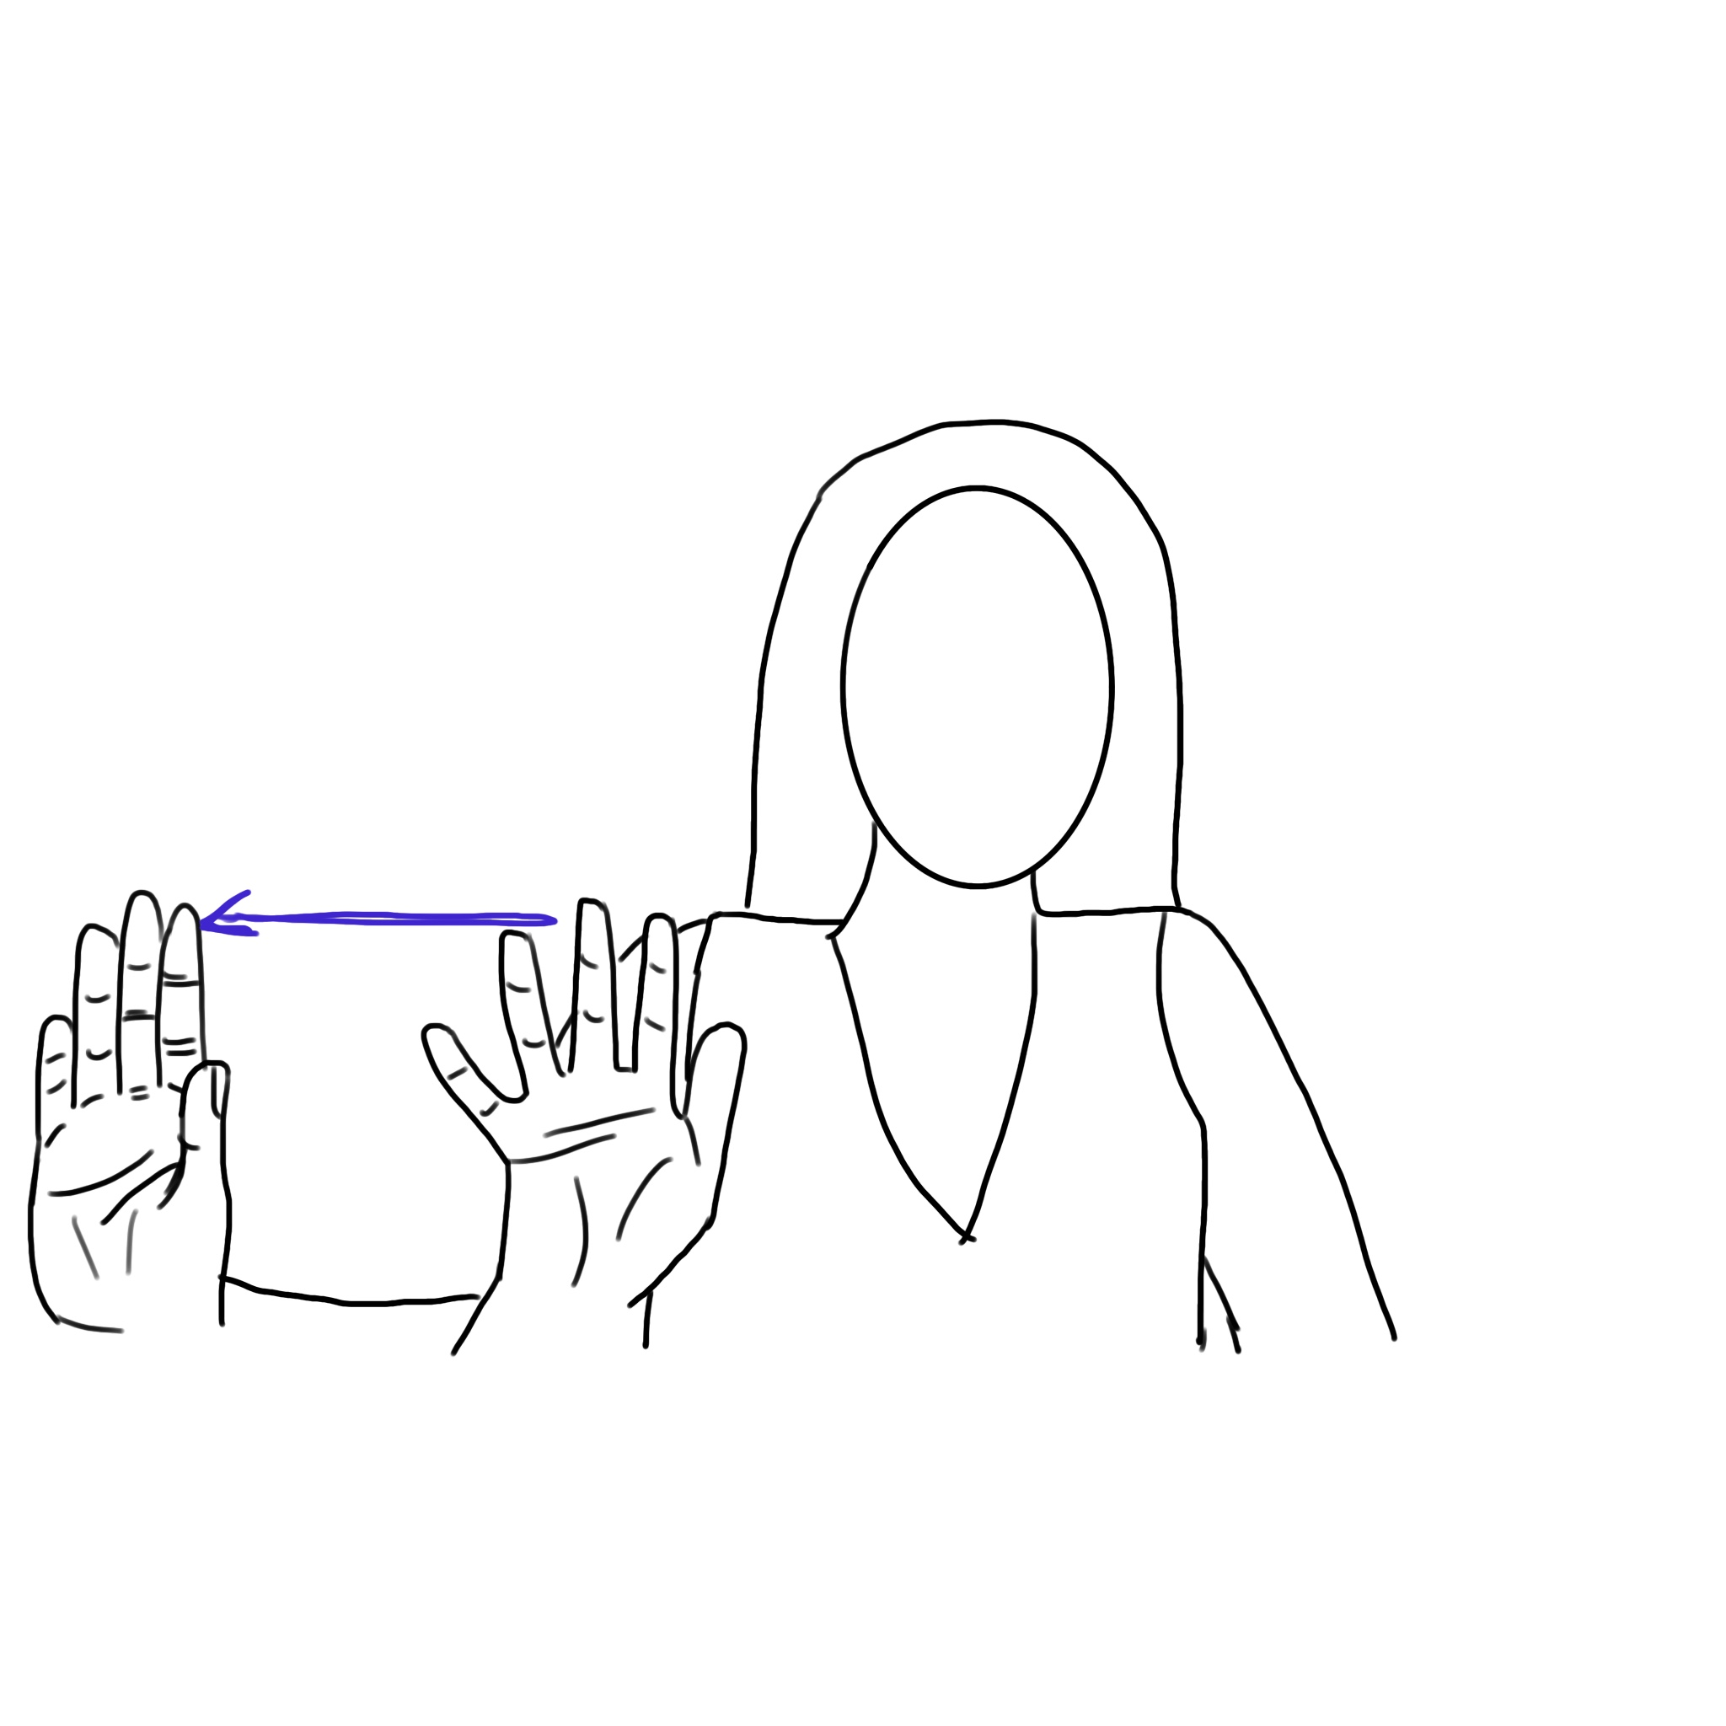
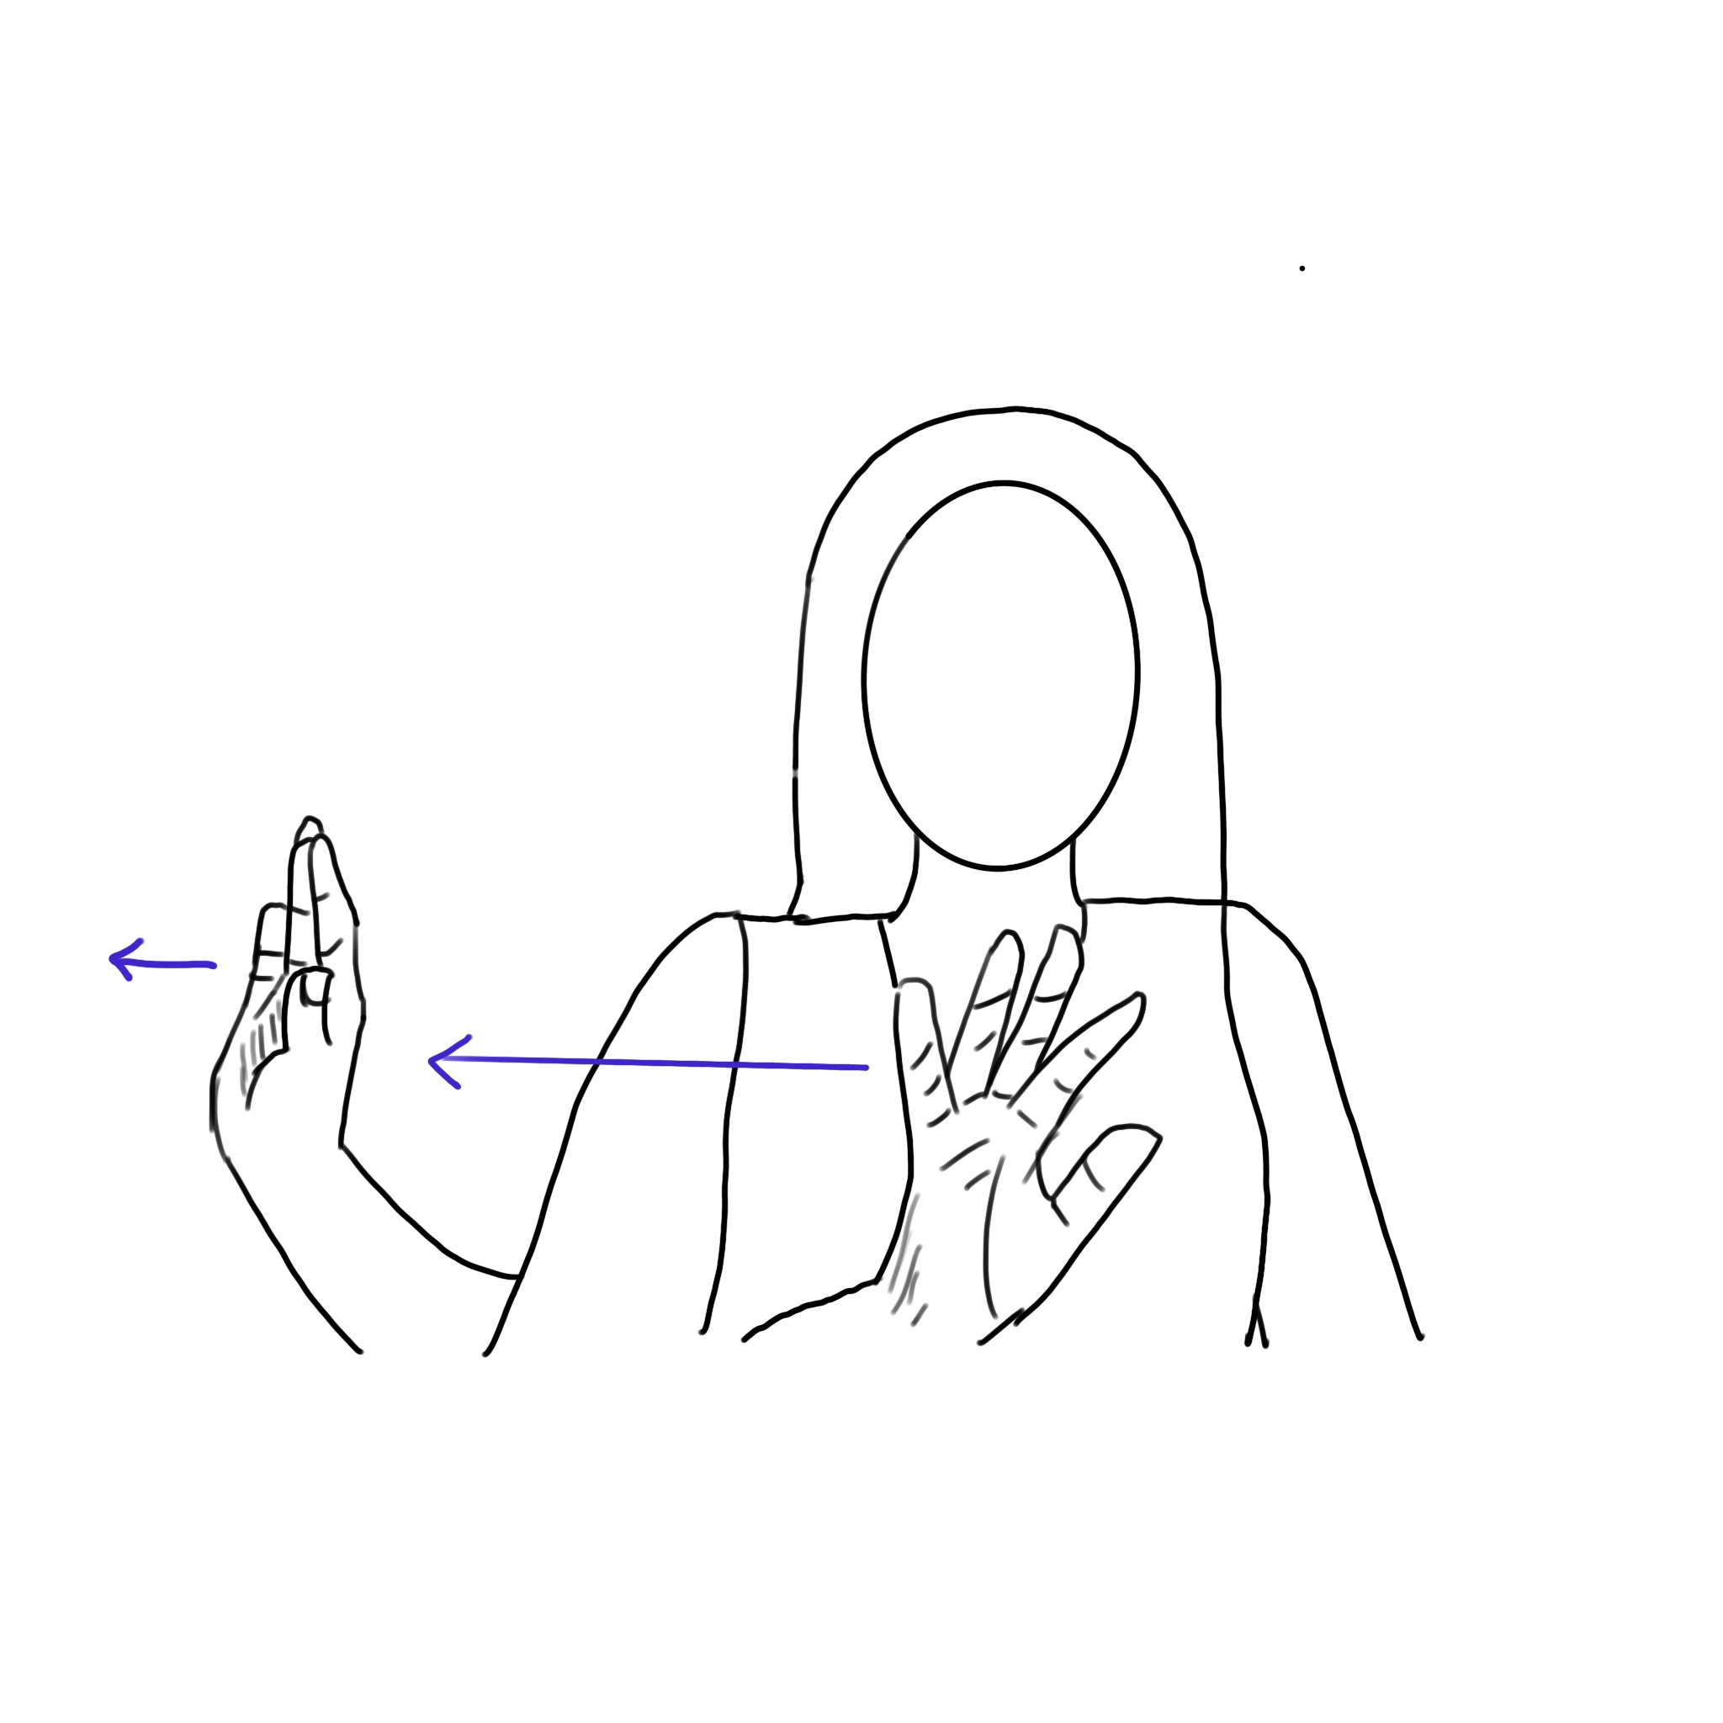

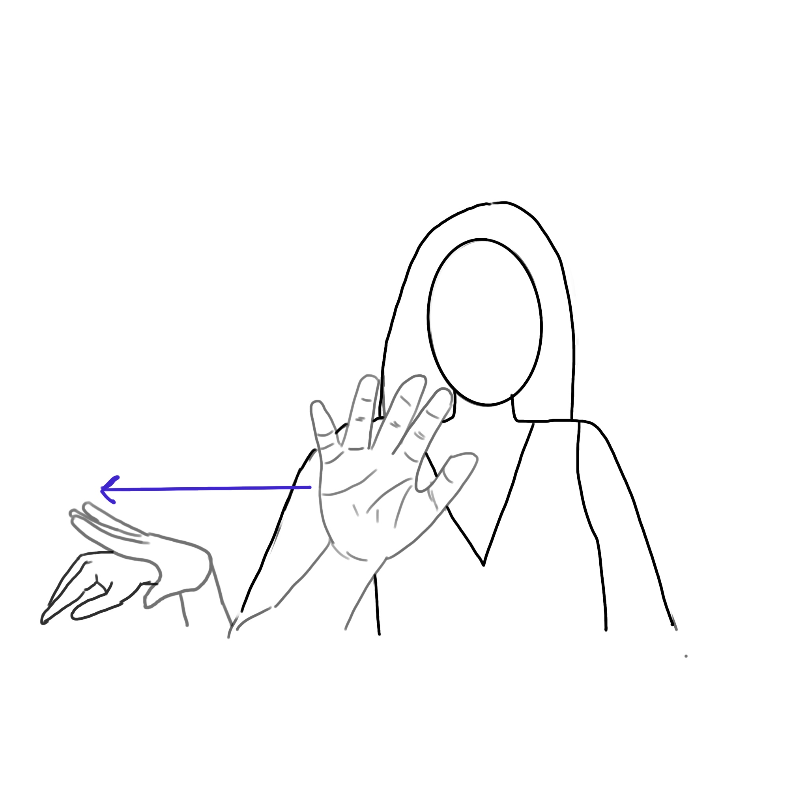
Out
OUT1
OUT2
OUT3
OUT4
OUT5

Slide 5
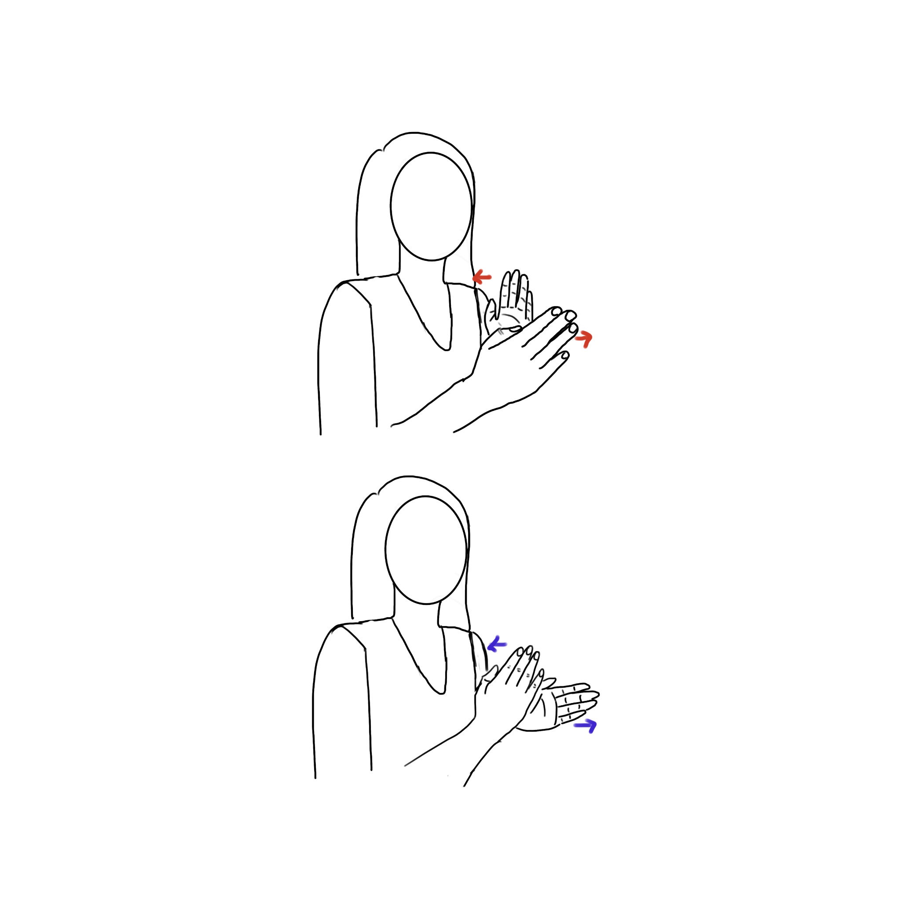
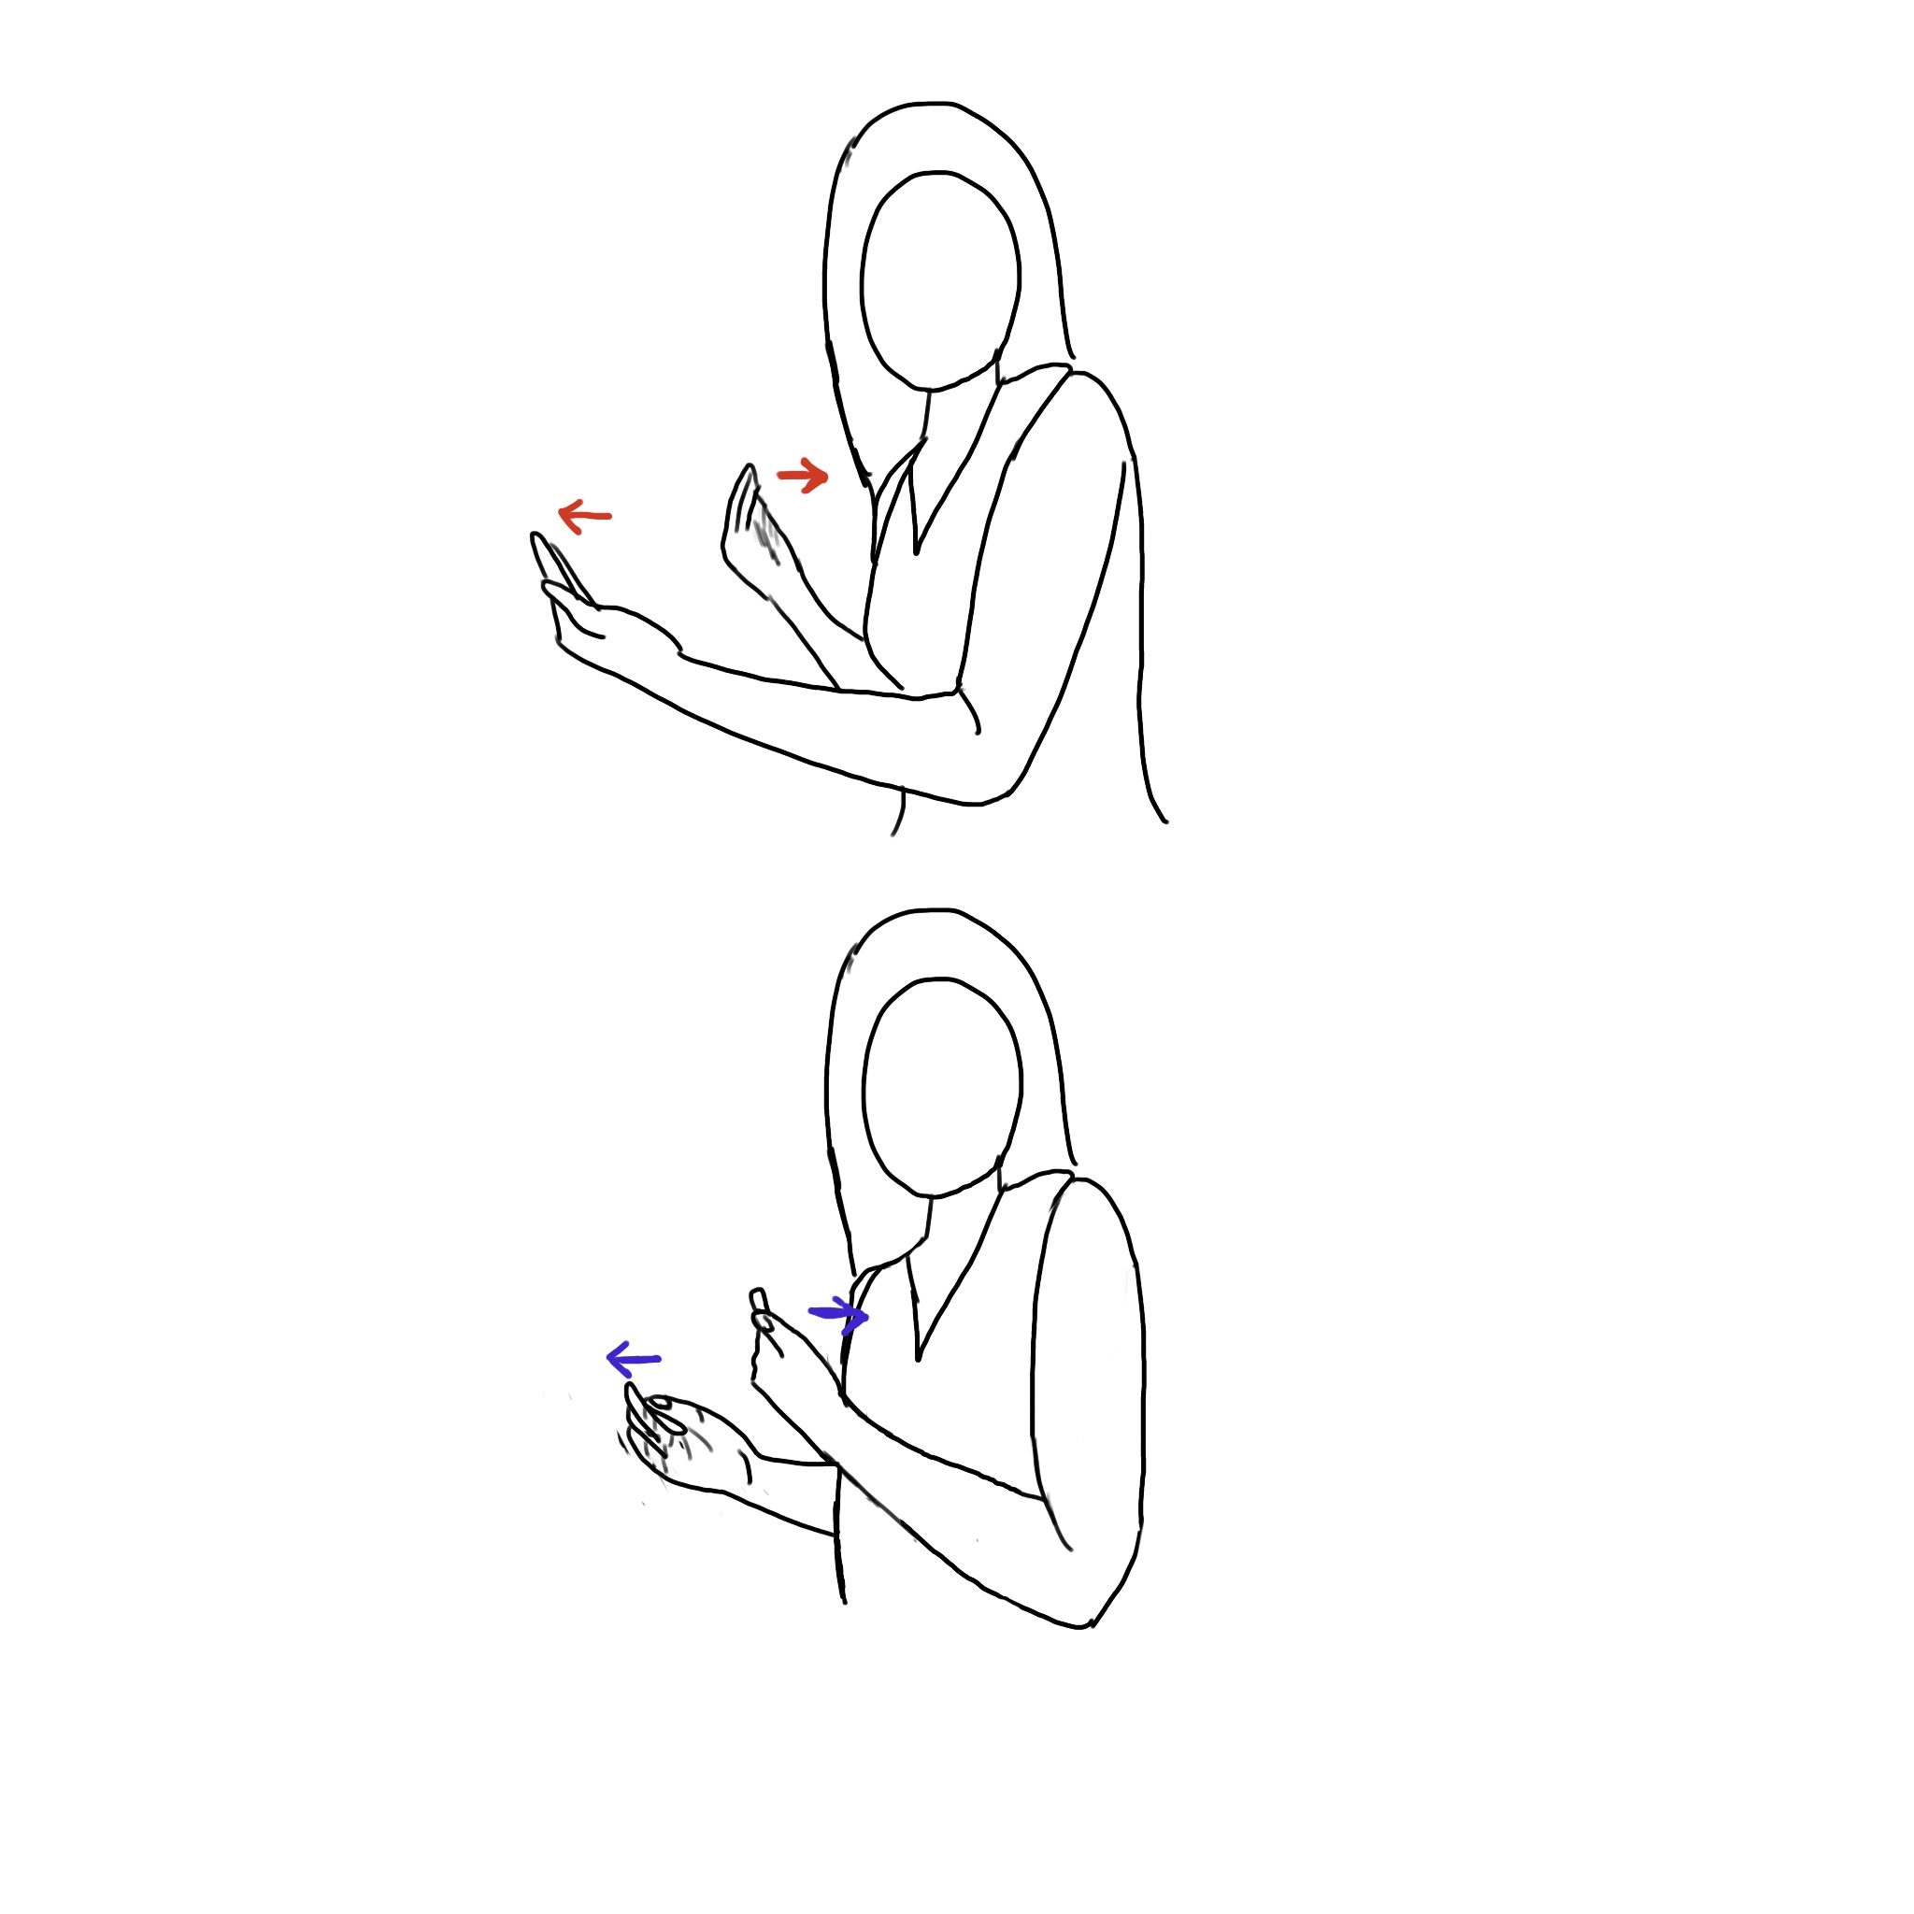
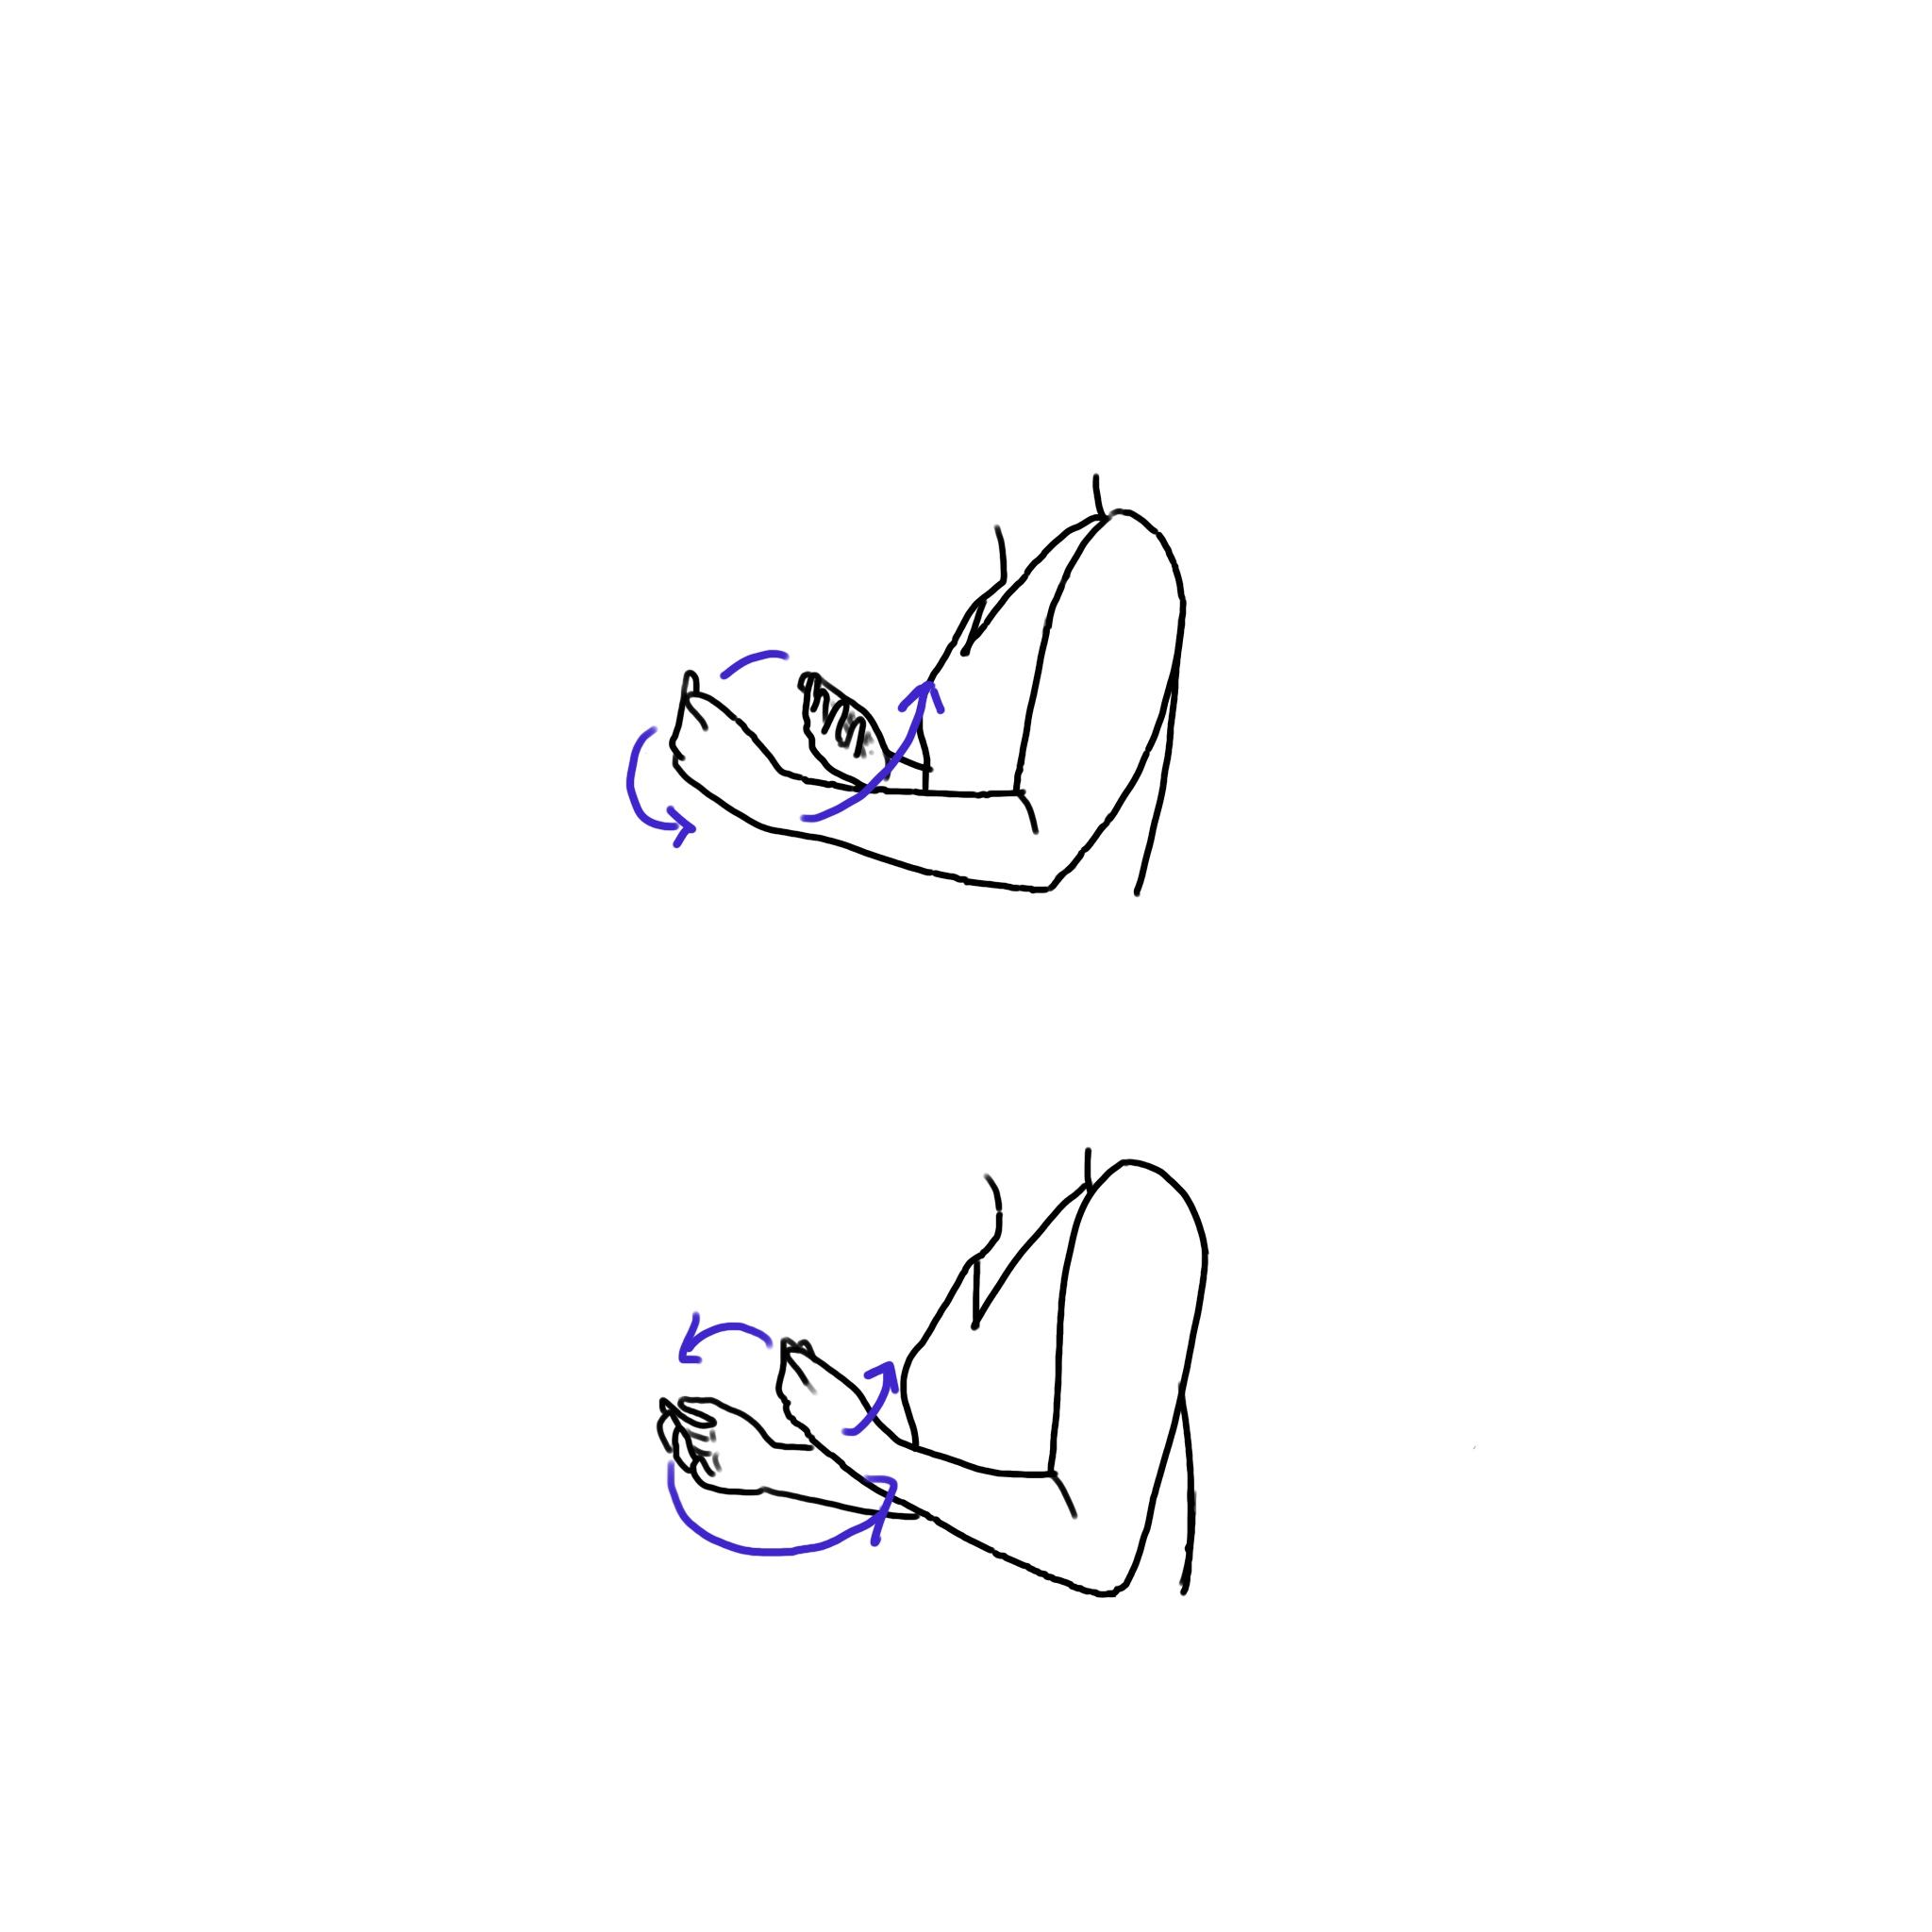
In and Out
INANDOUT1
INANDOUT2
INANDOUT3

Slide 6
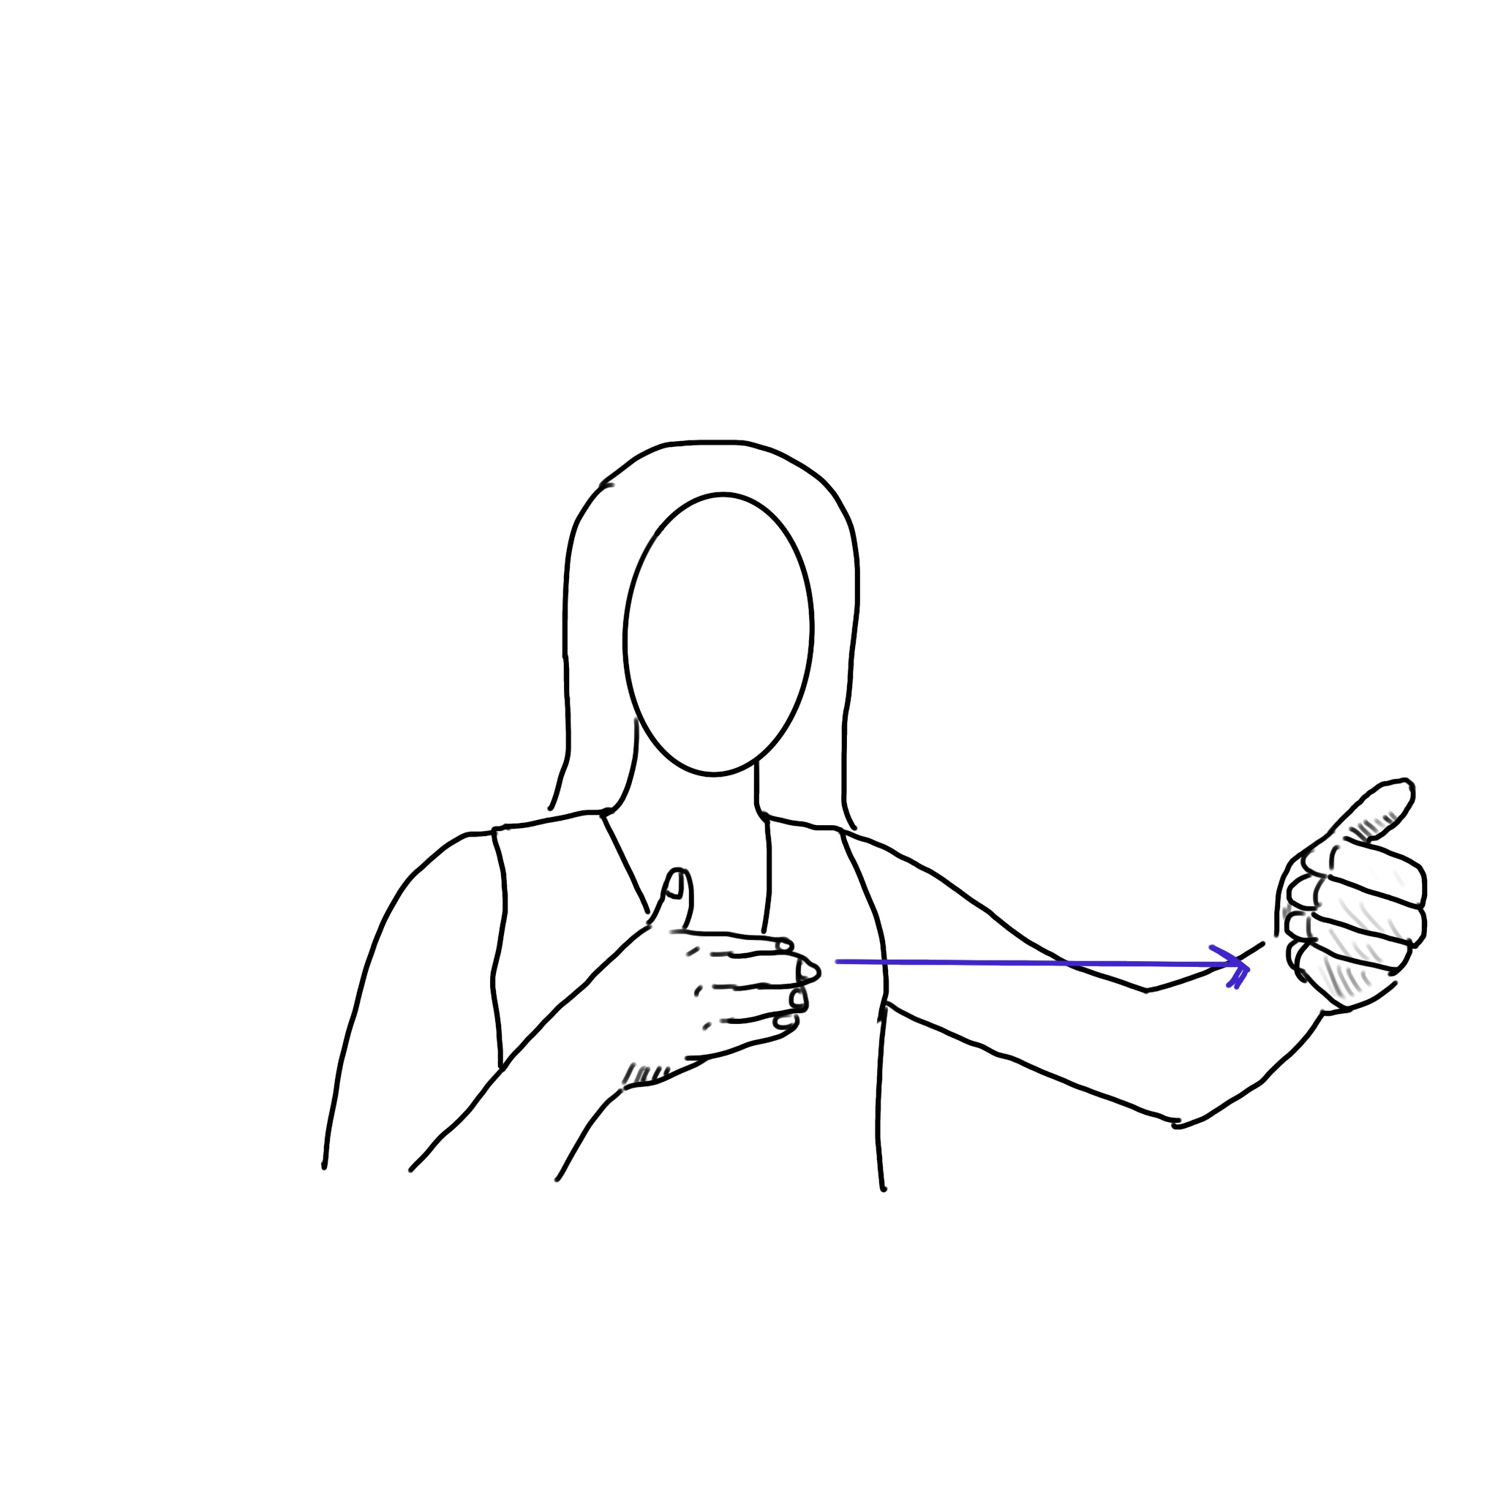
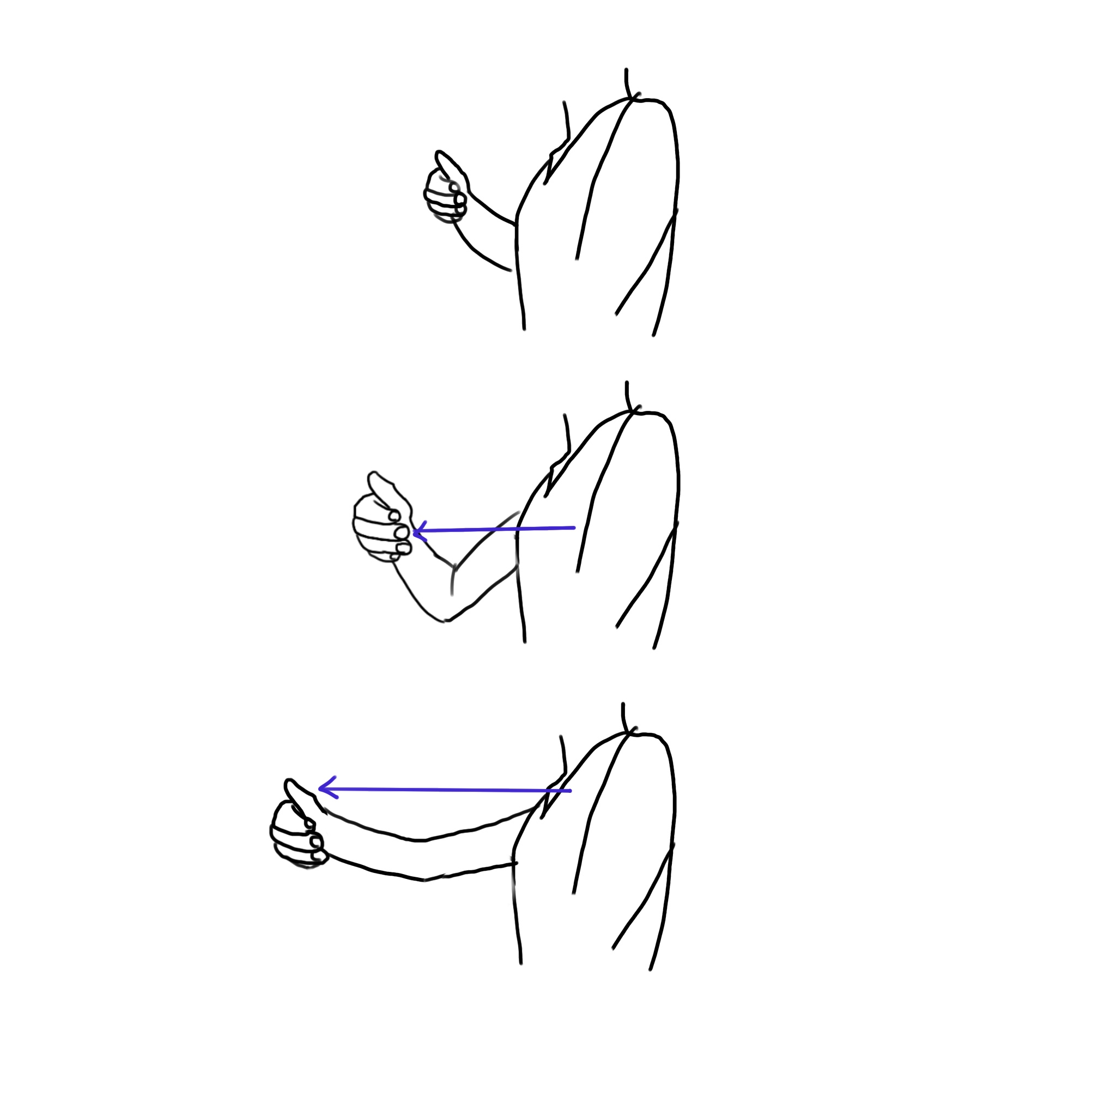
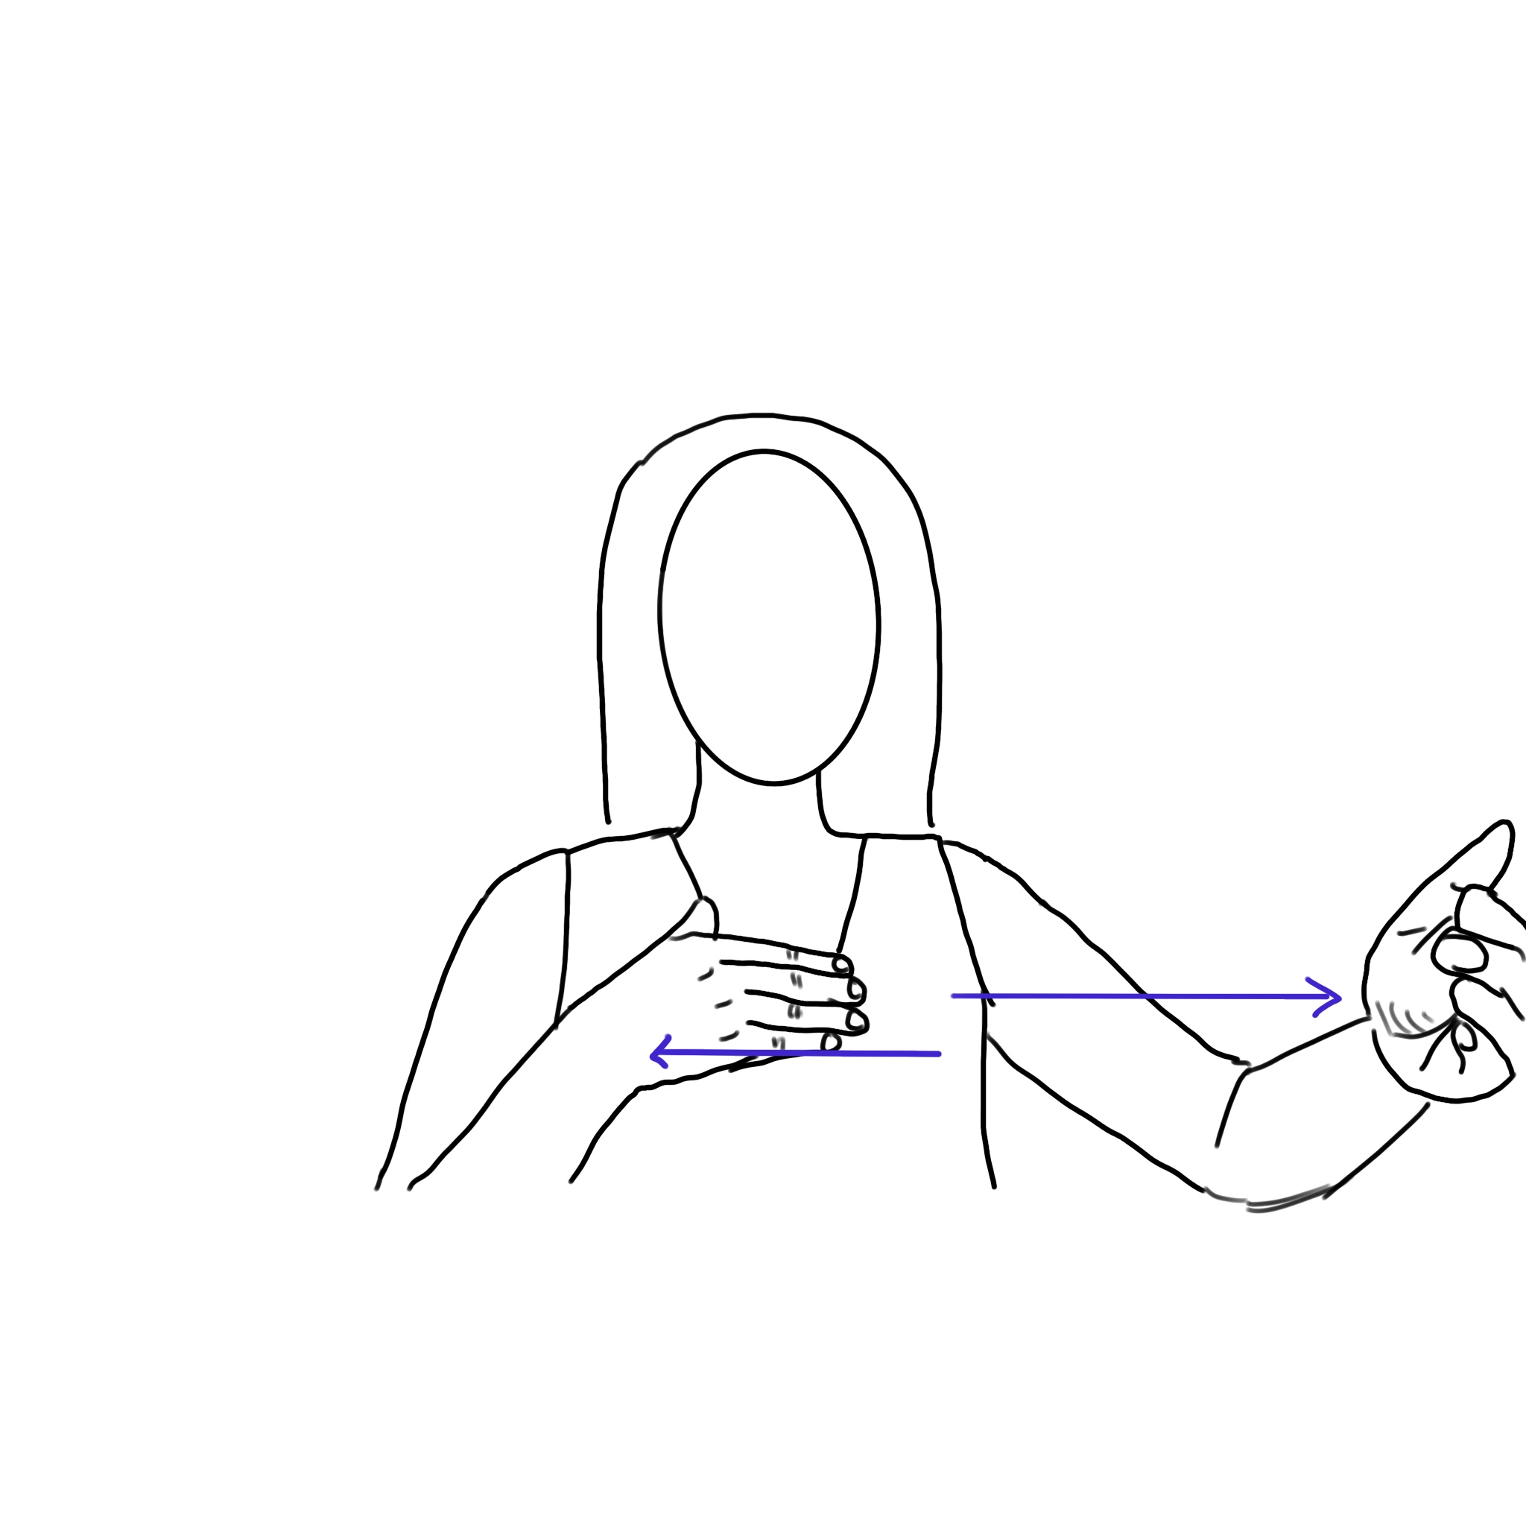
Sagittal Distance
SAGGITALD1
SAGGITALD2
SAGGITALD3

Slide 7
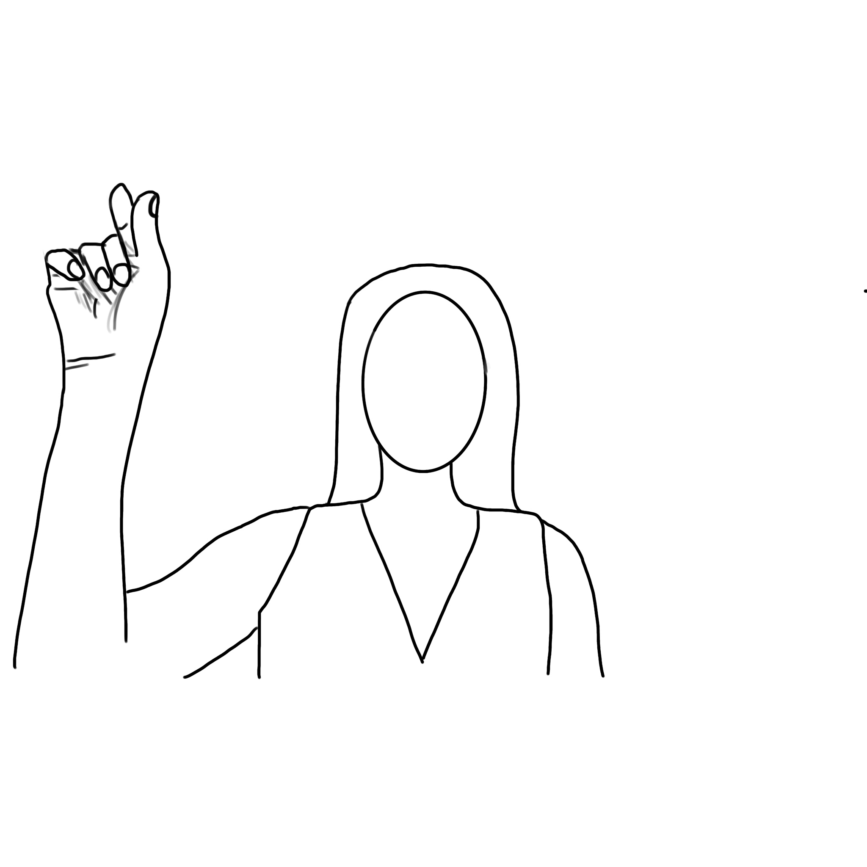
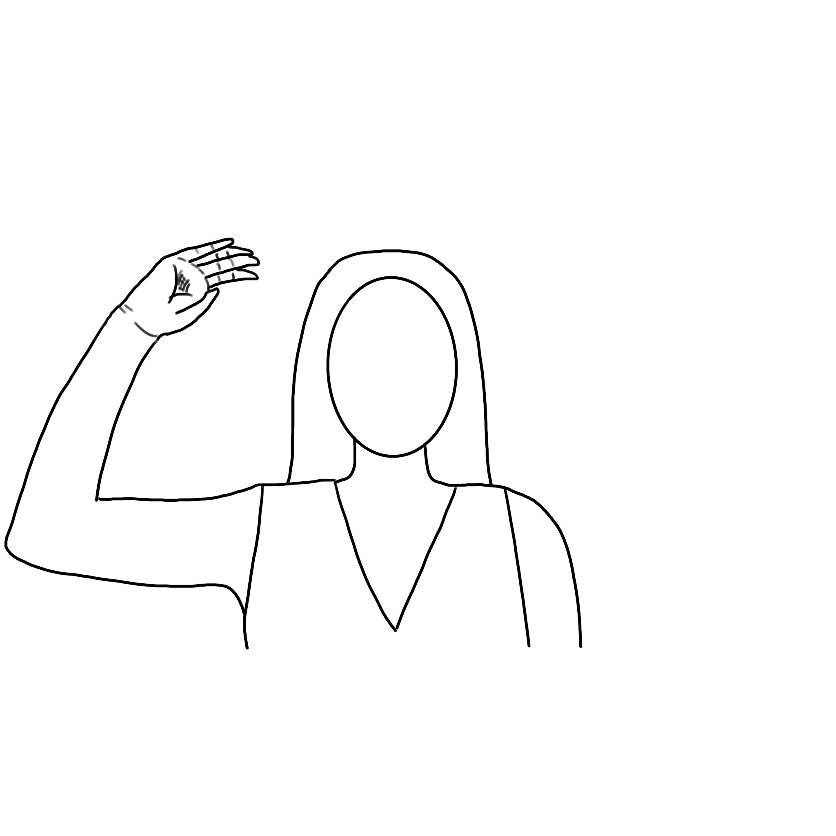
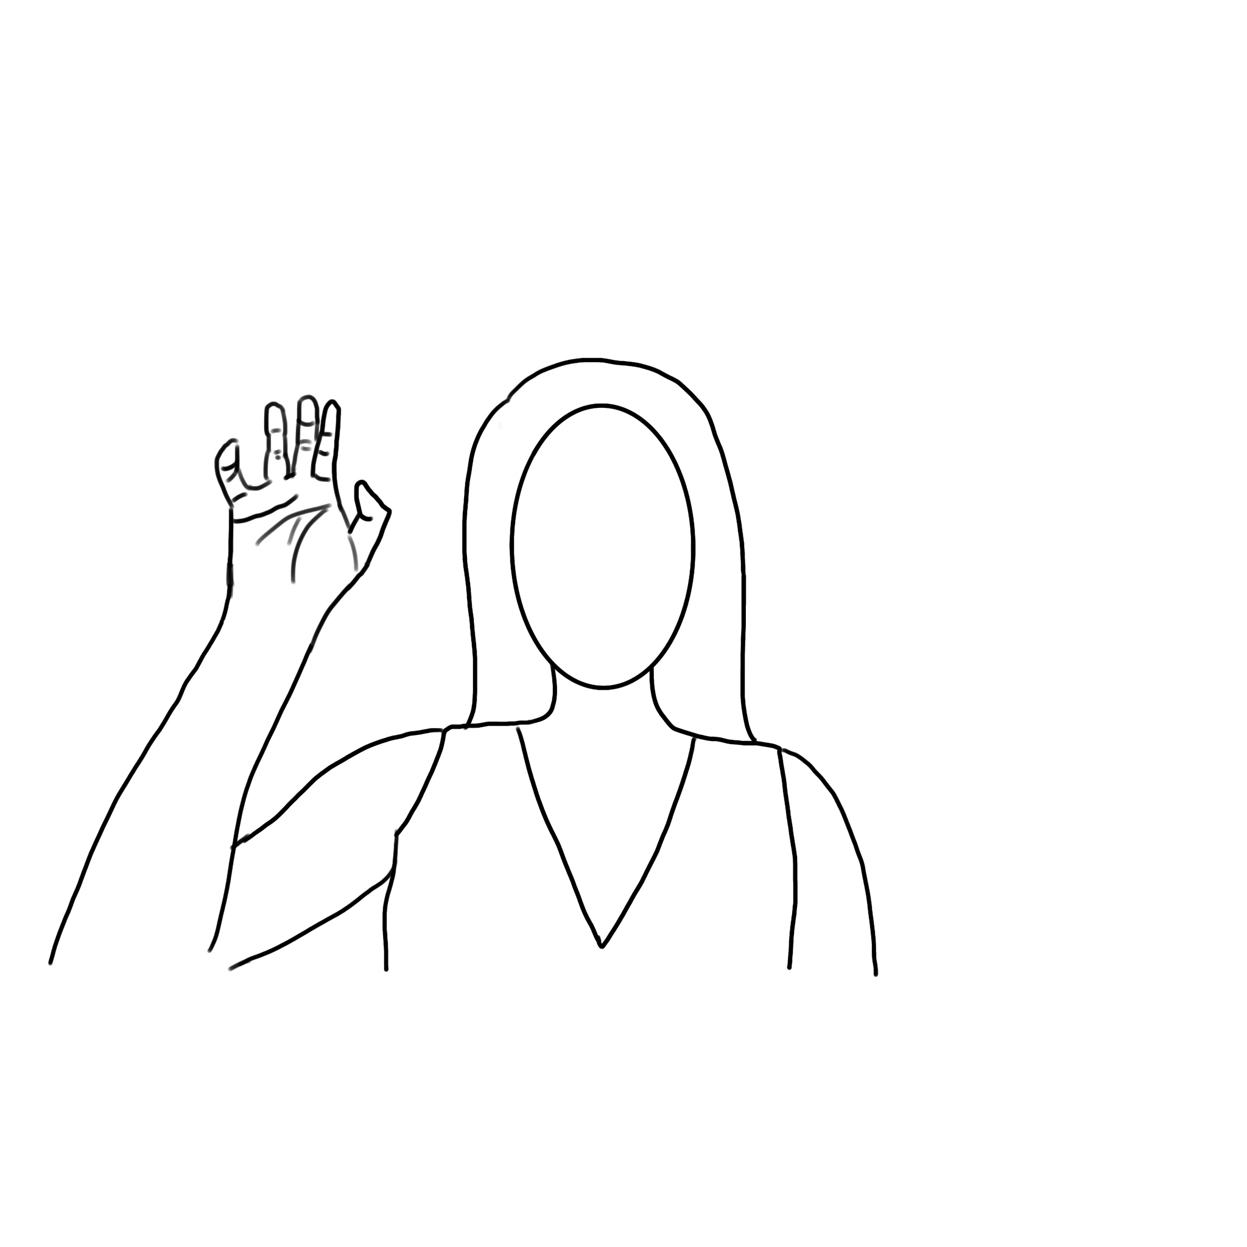
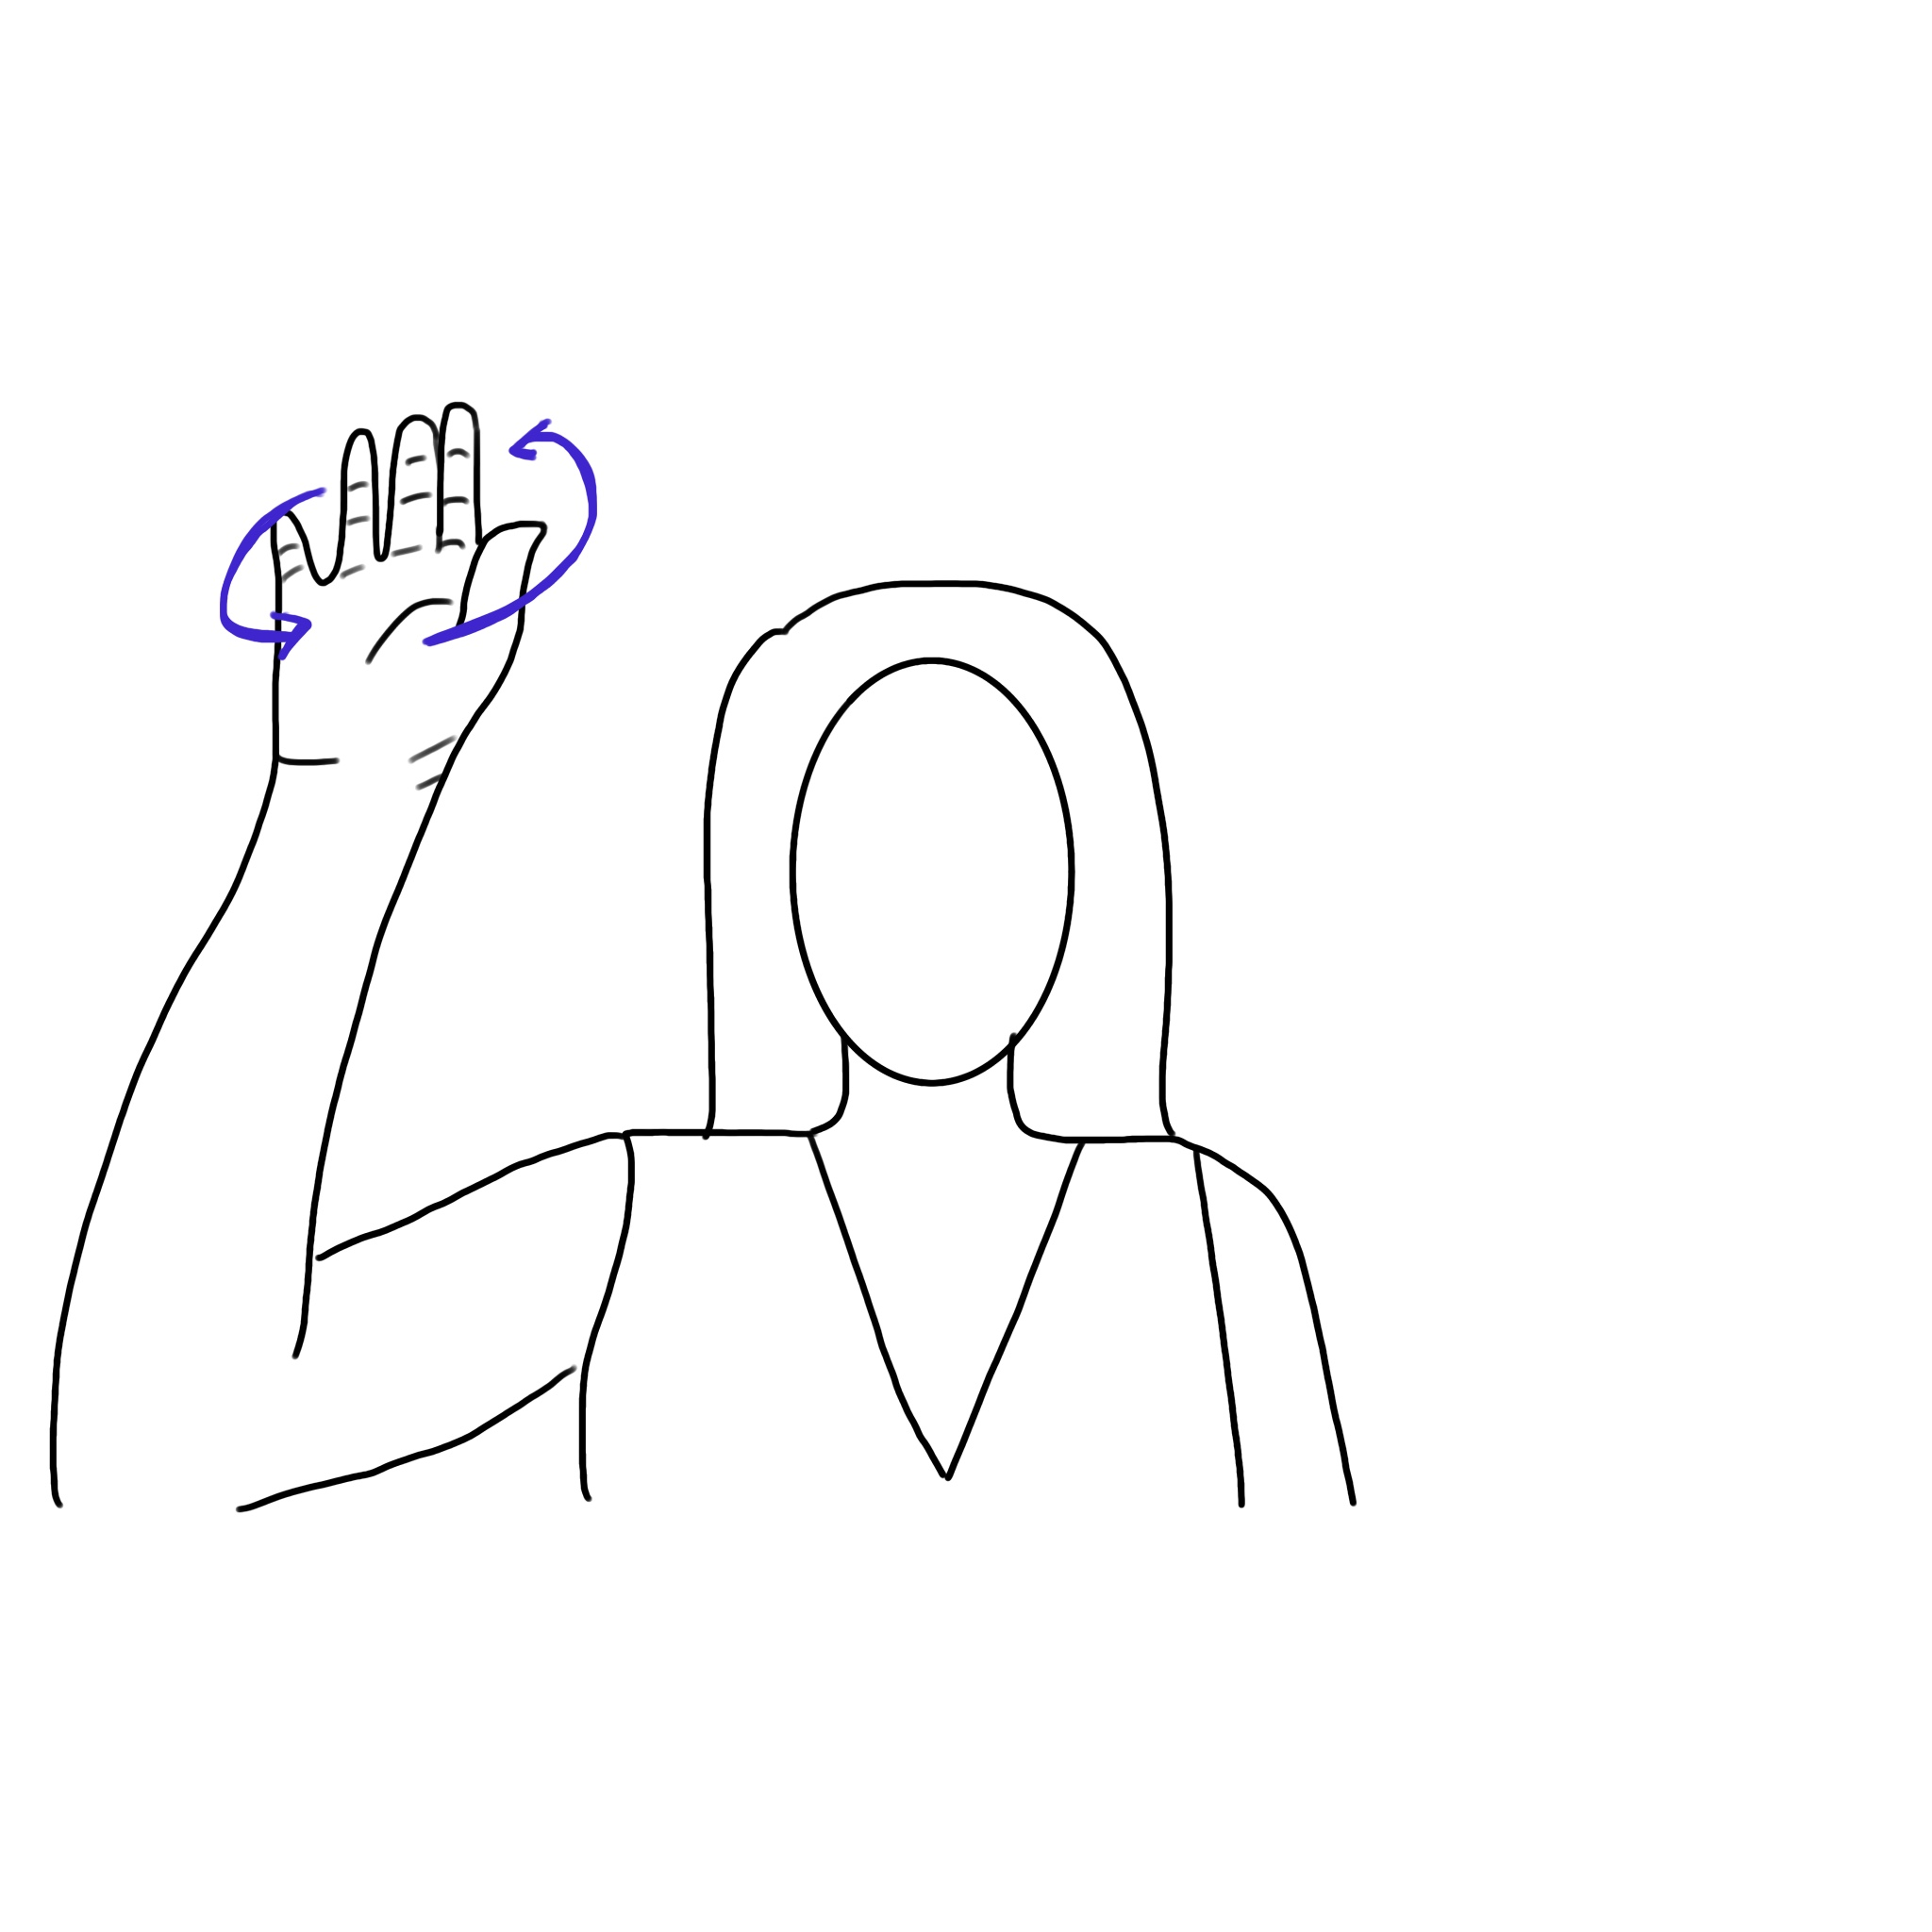
Up
UP1
UP2
UP3
UP4

Slide 8
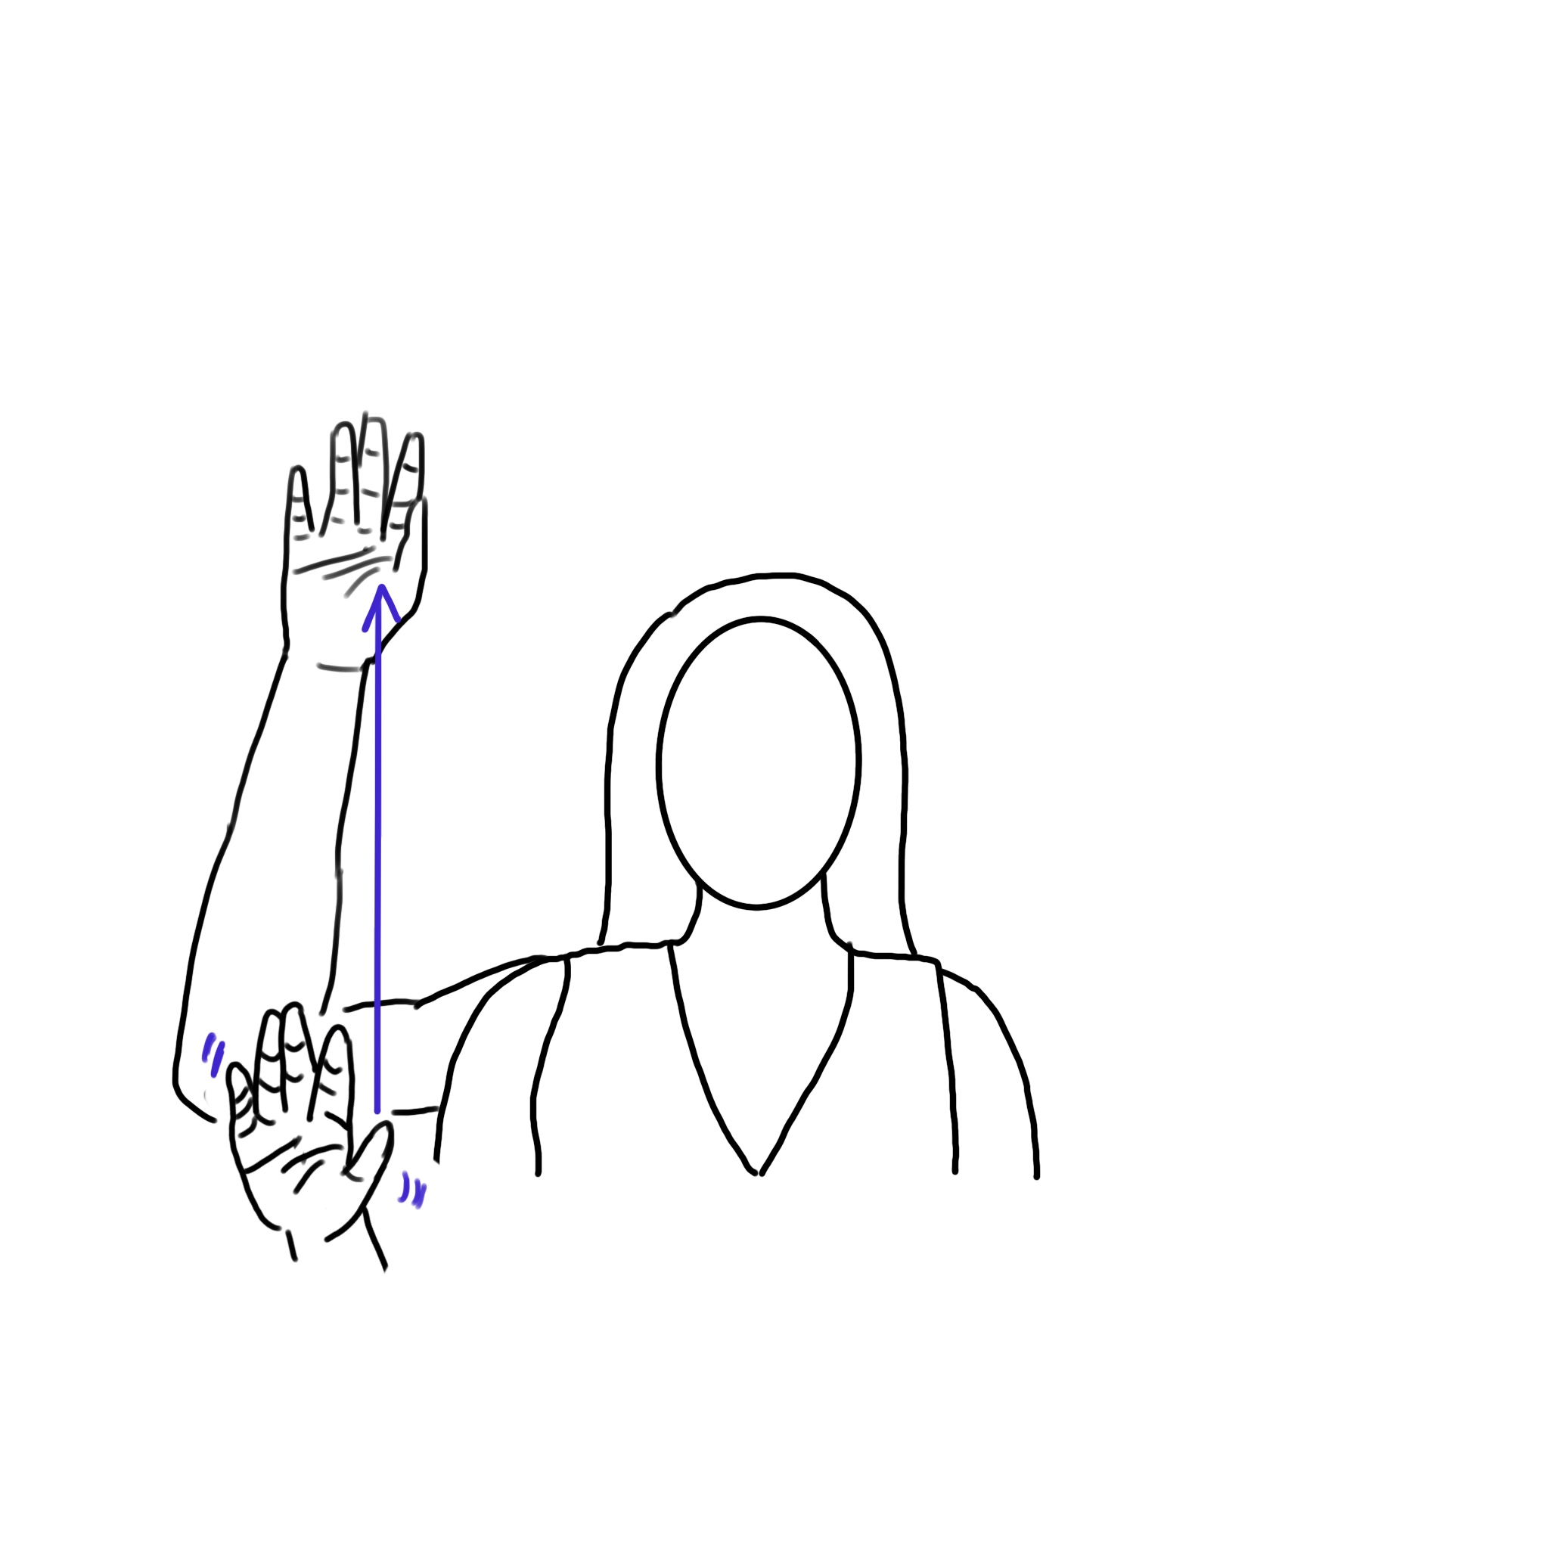
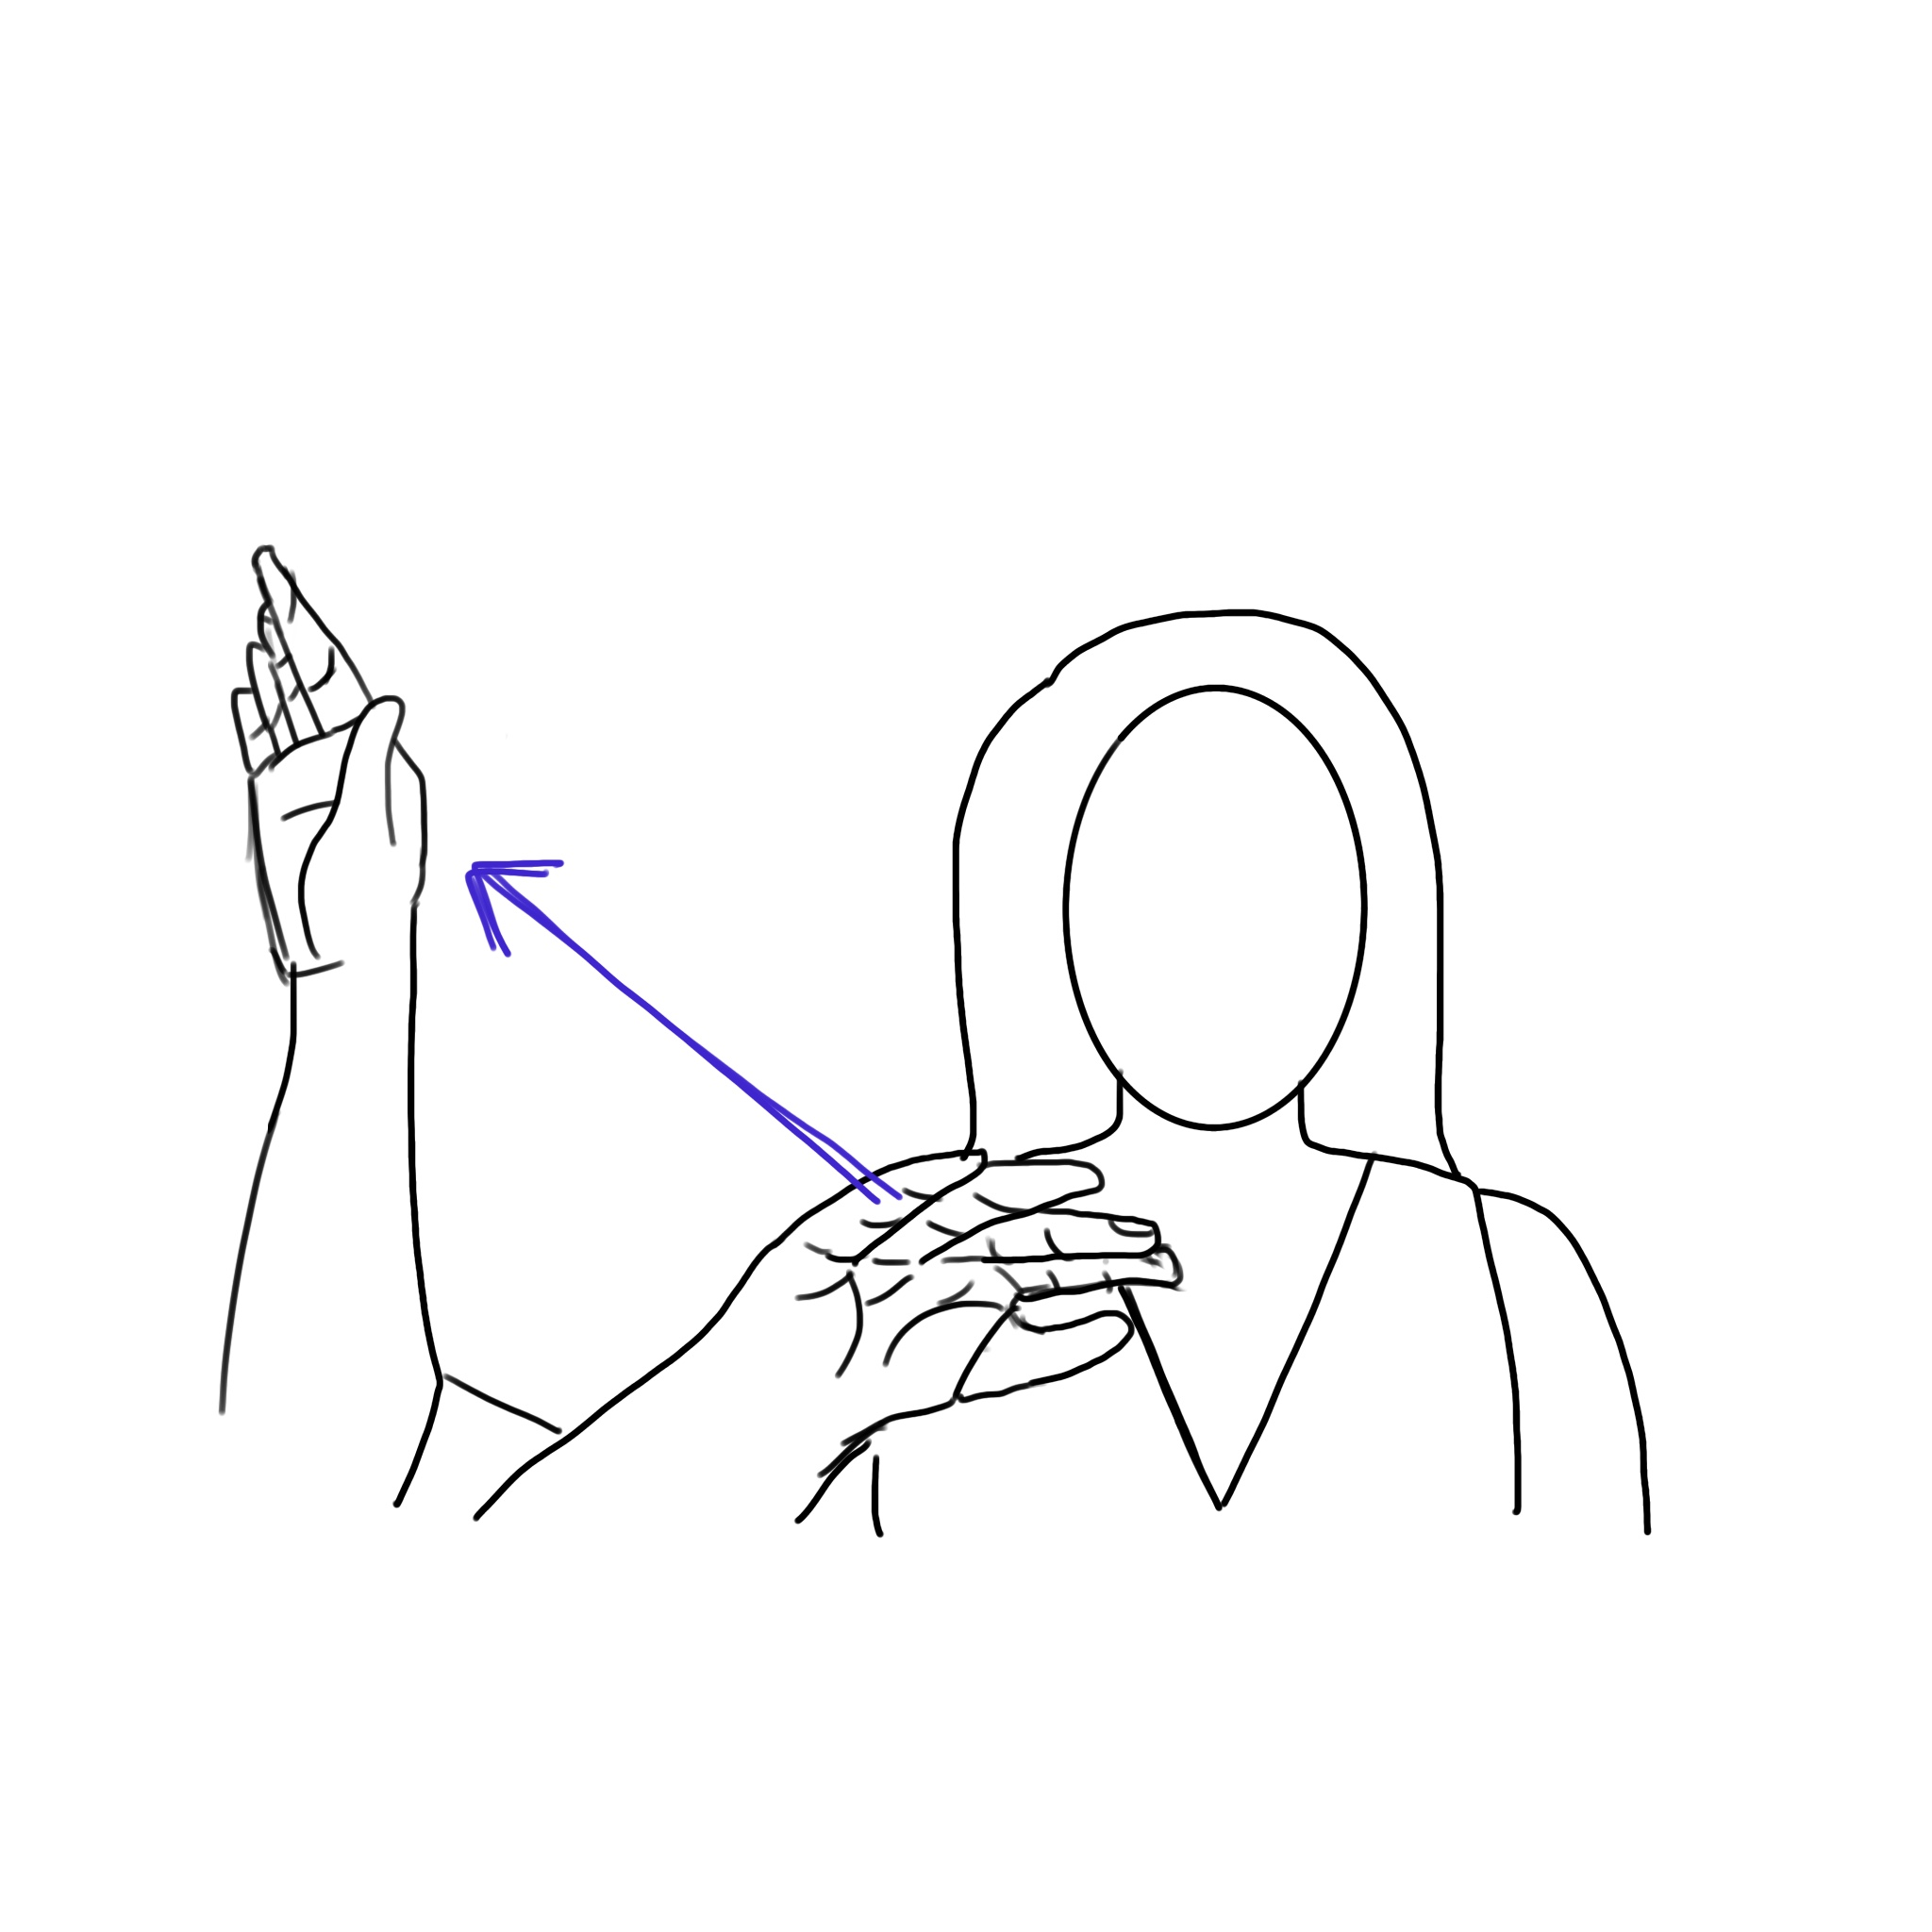
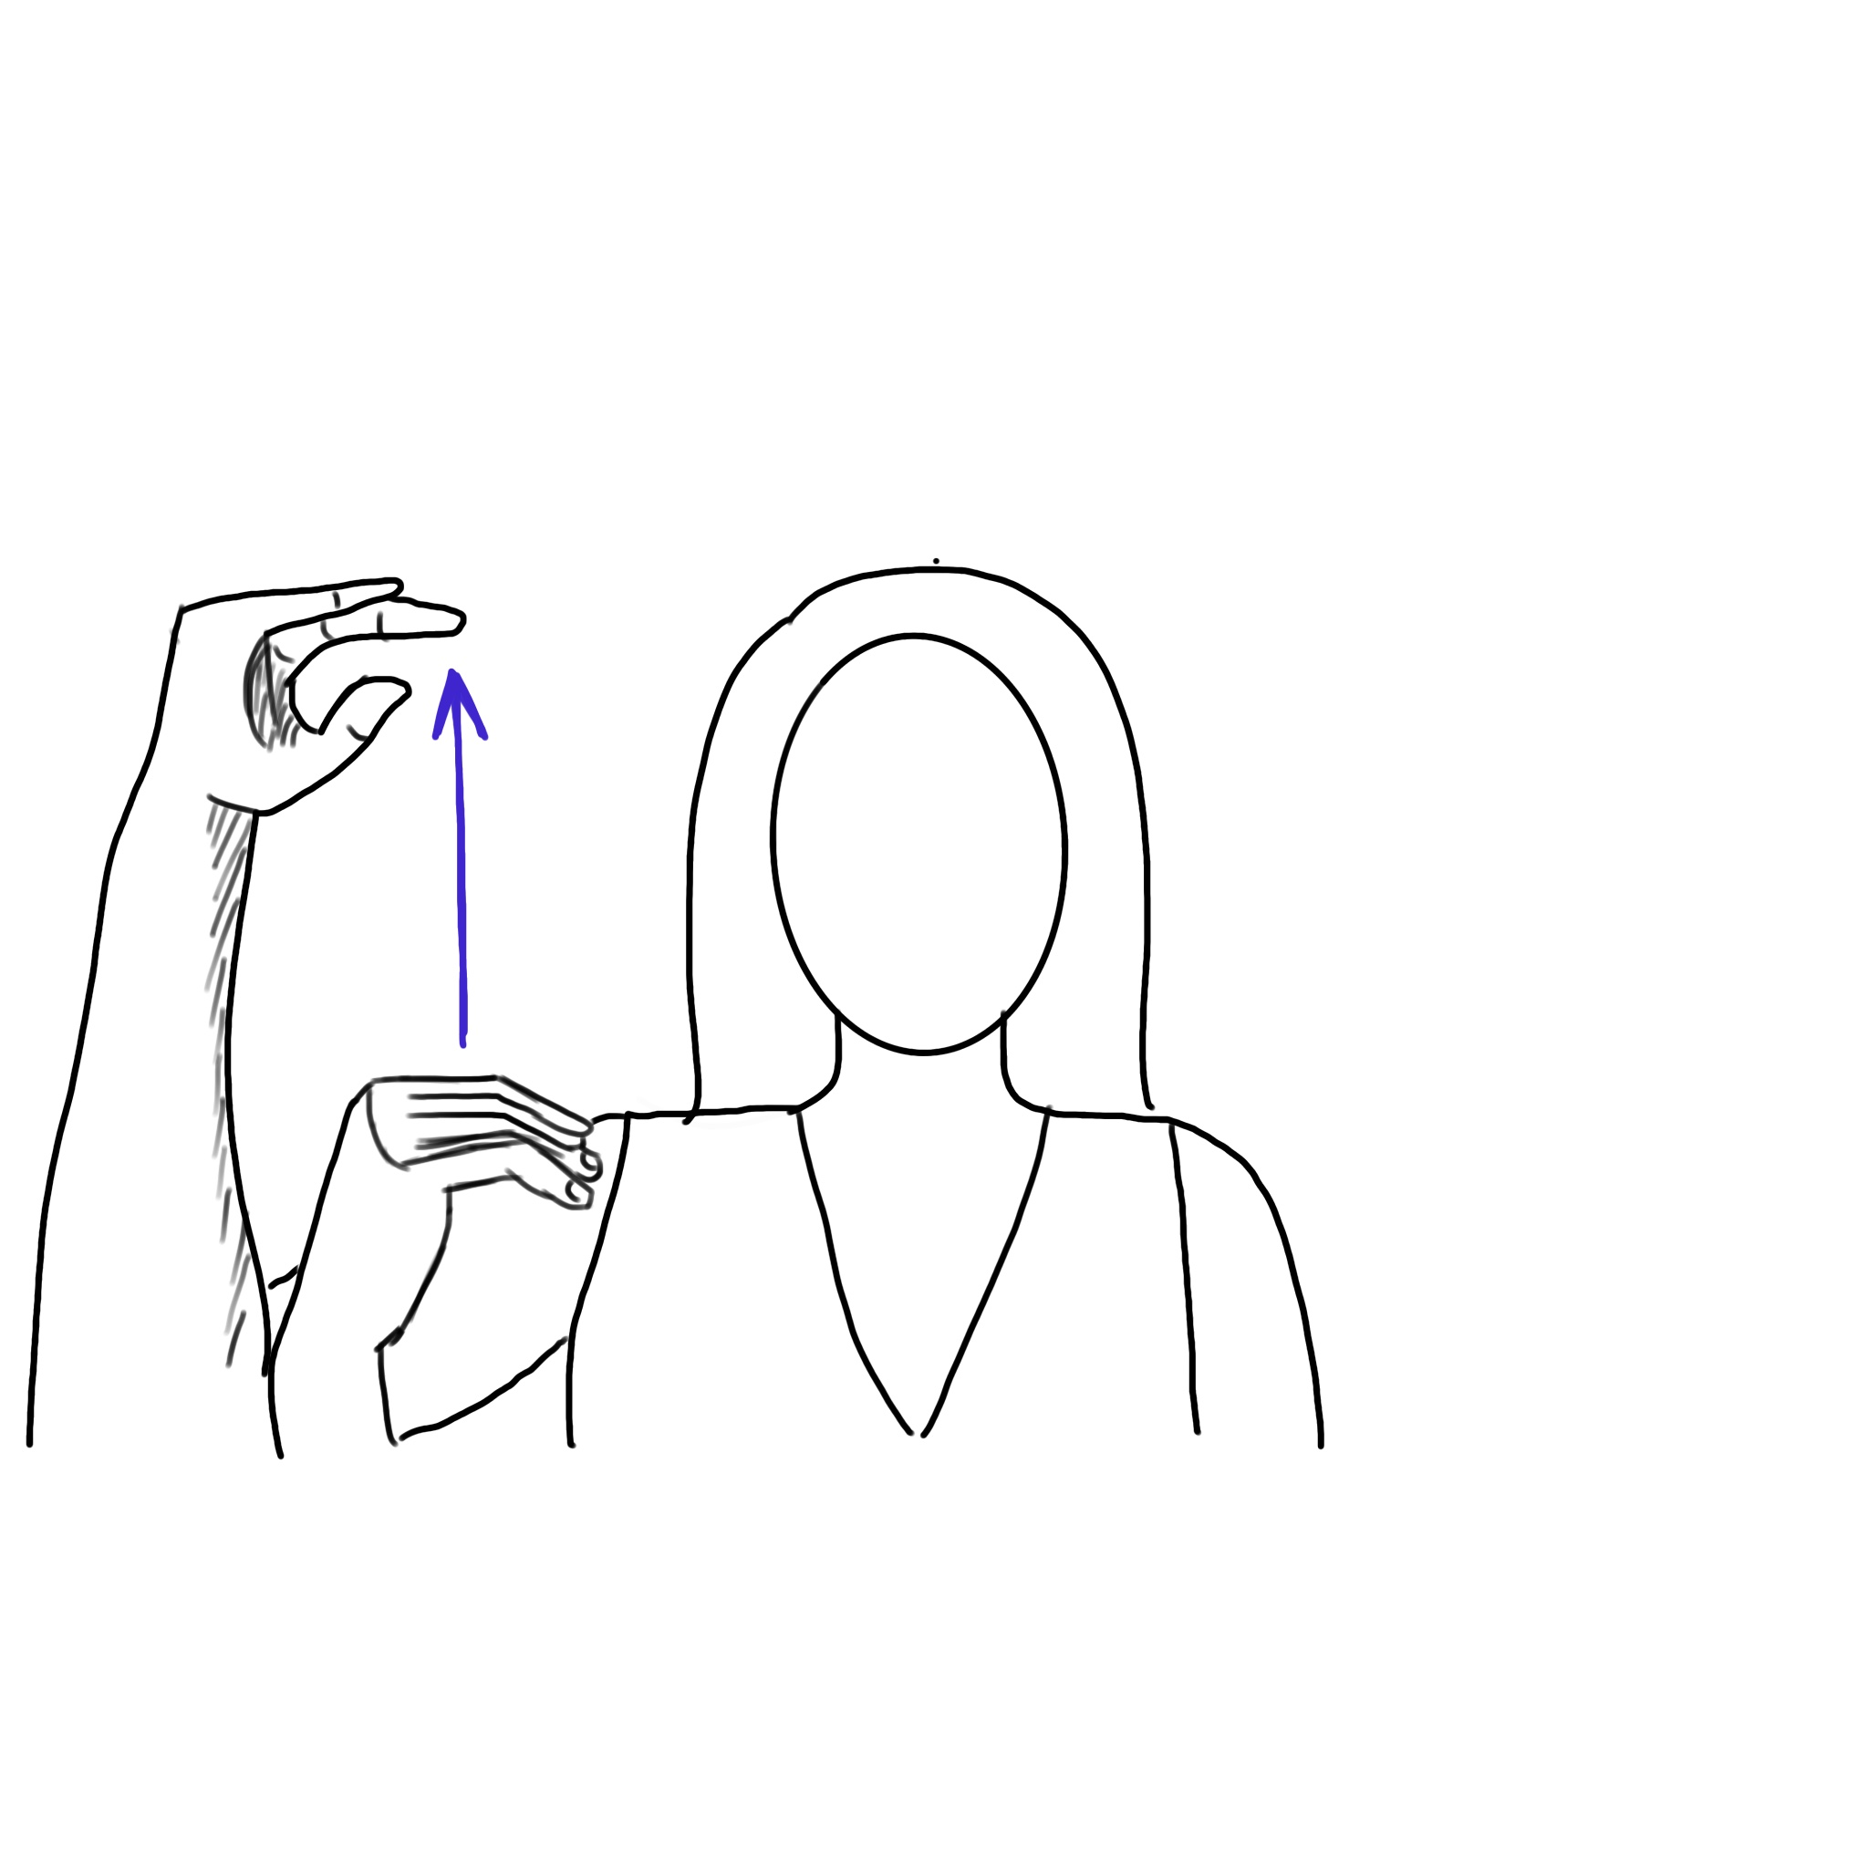
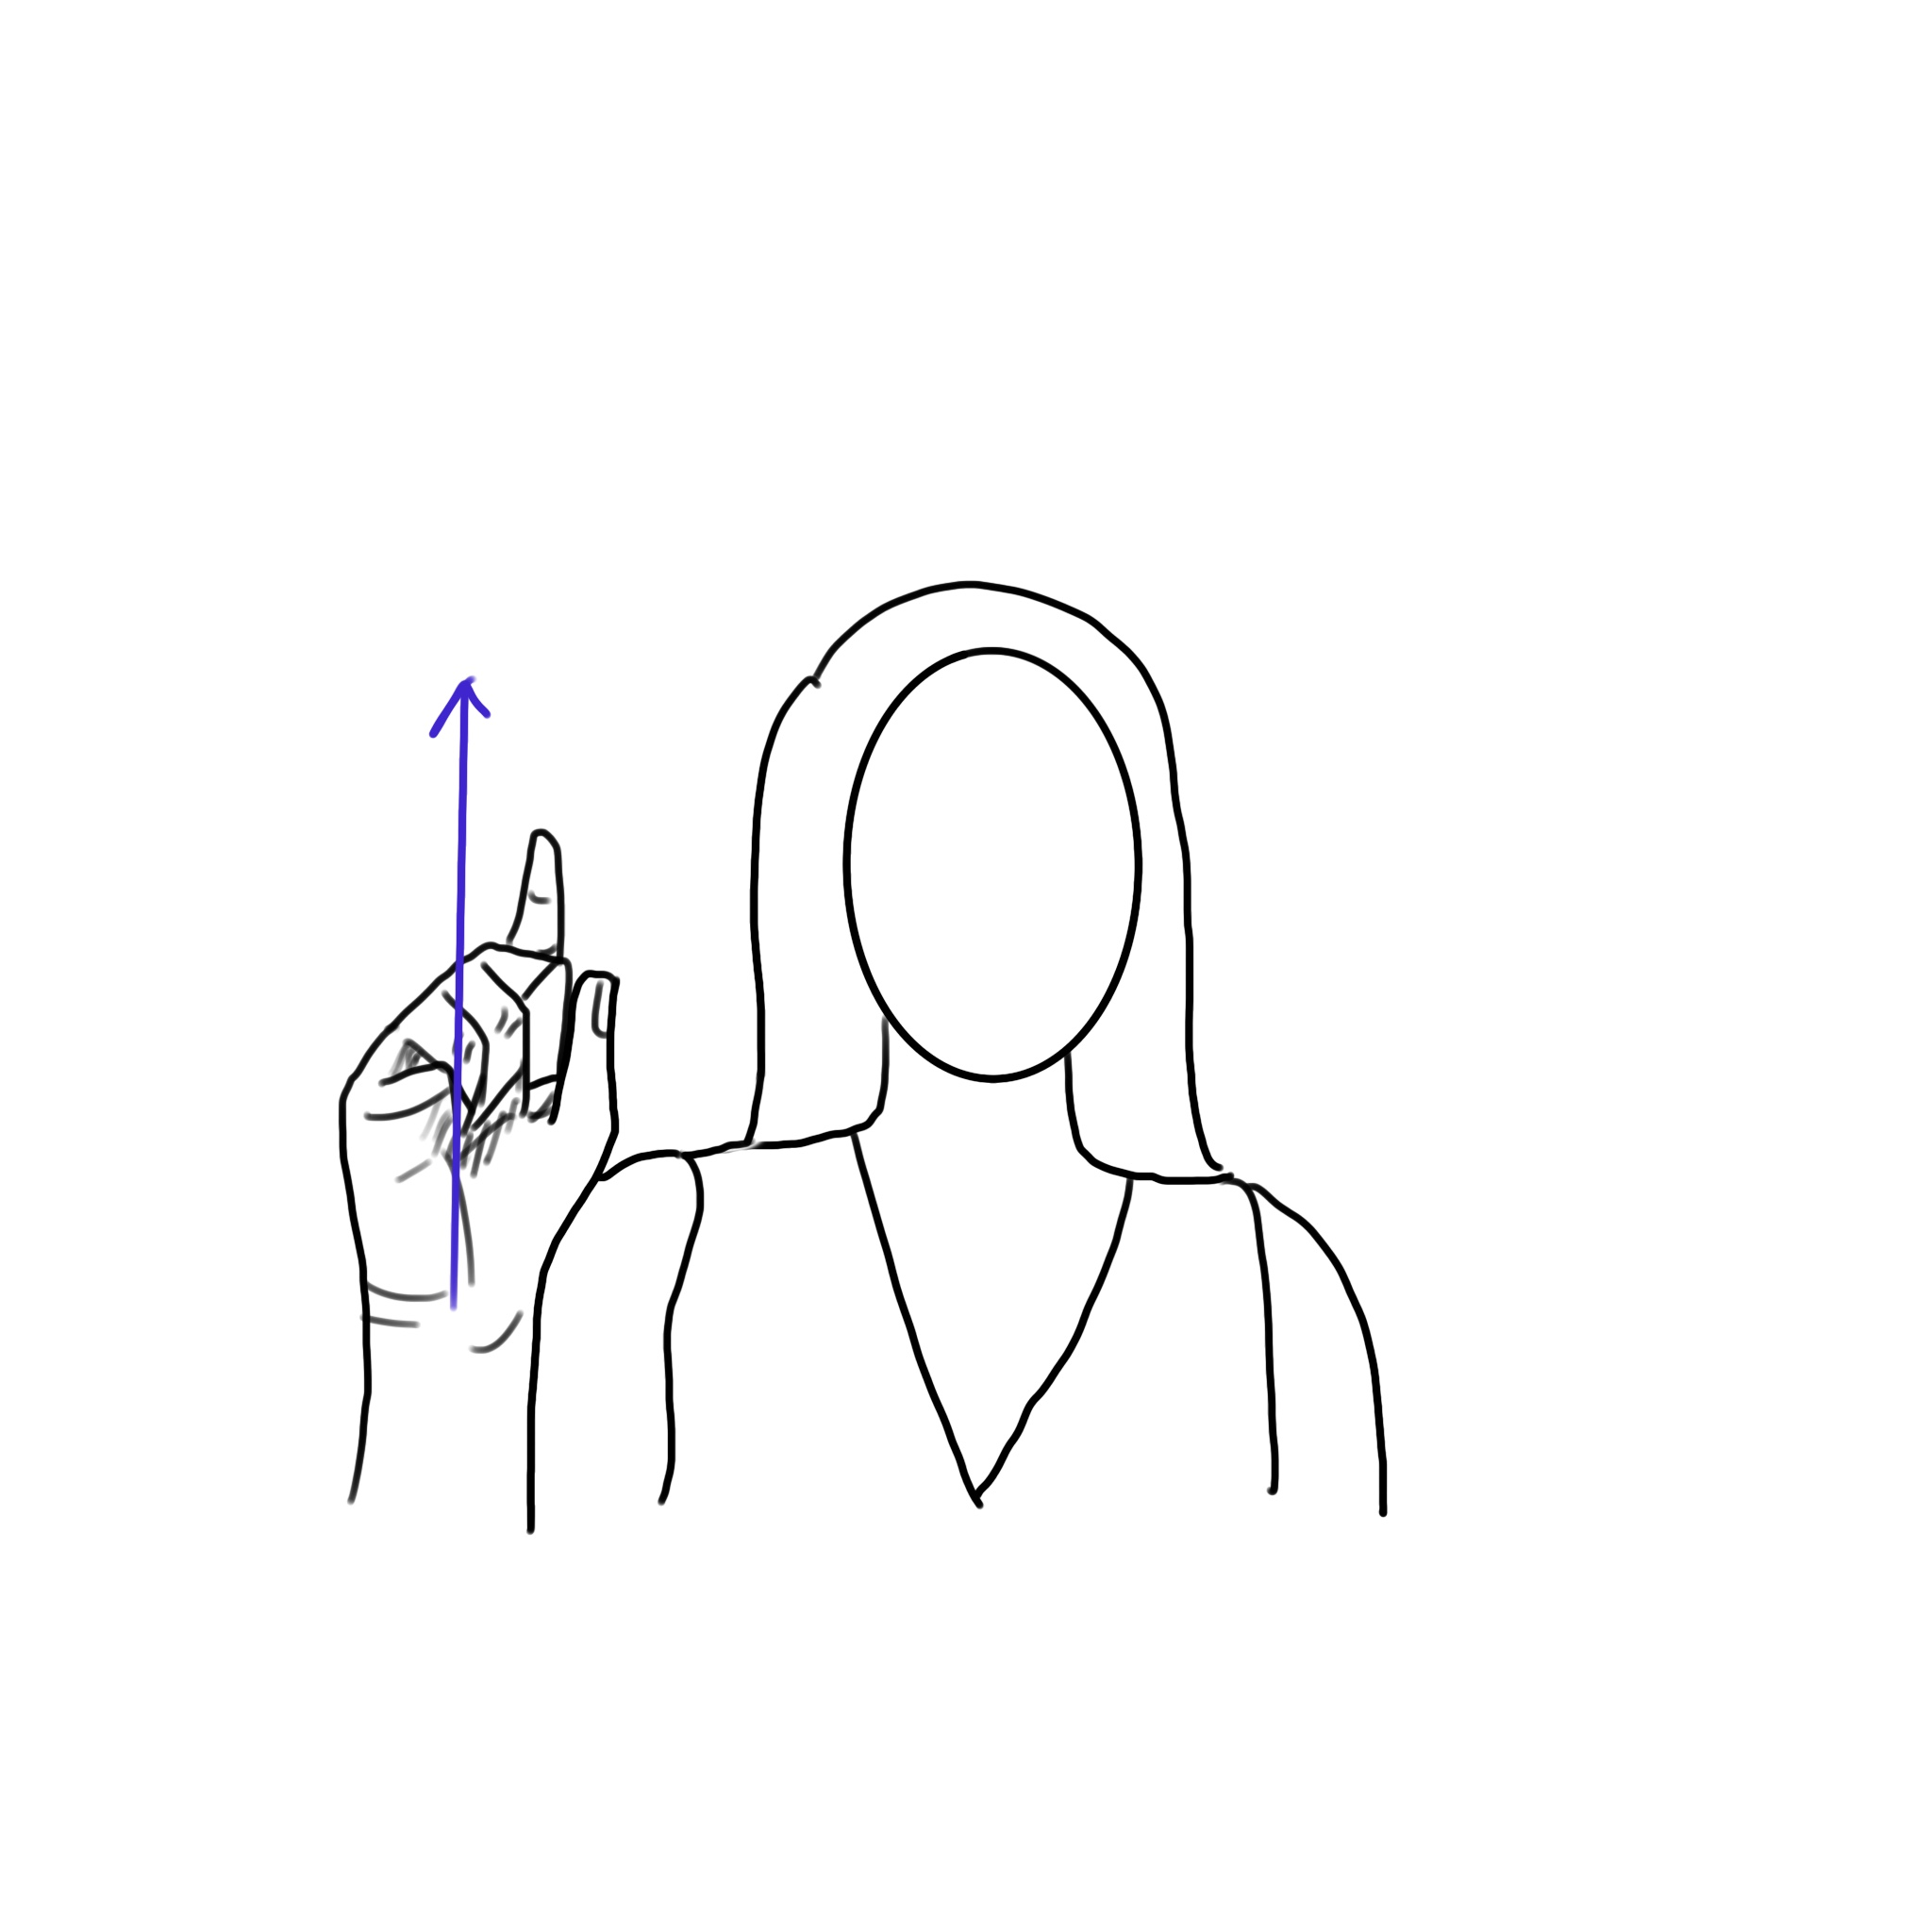
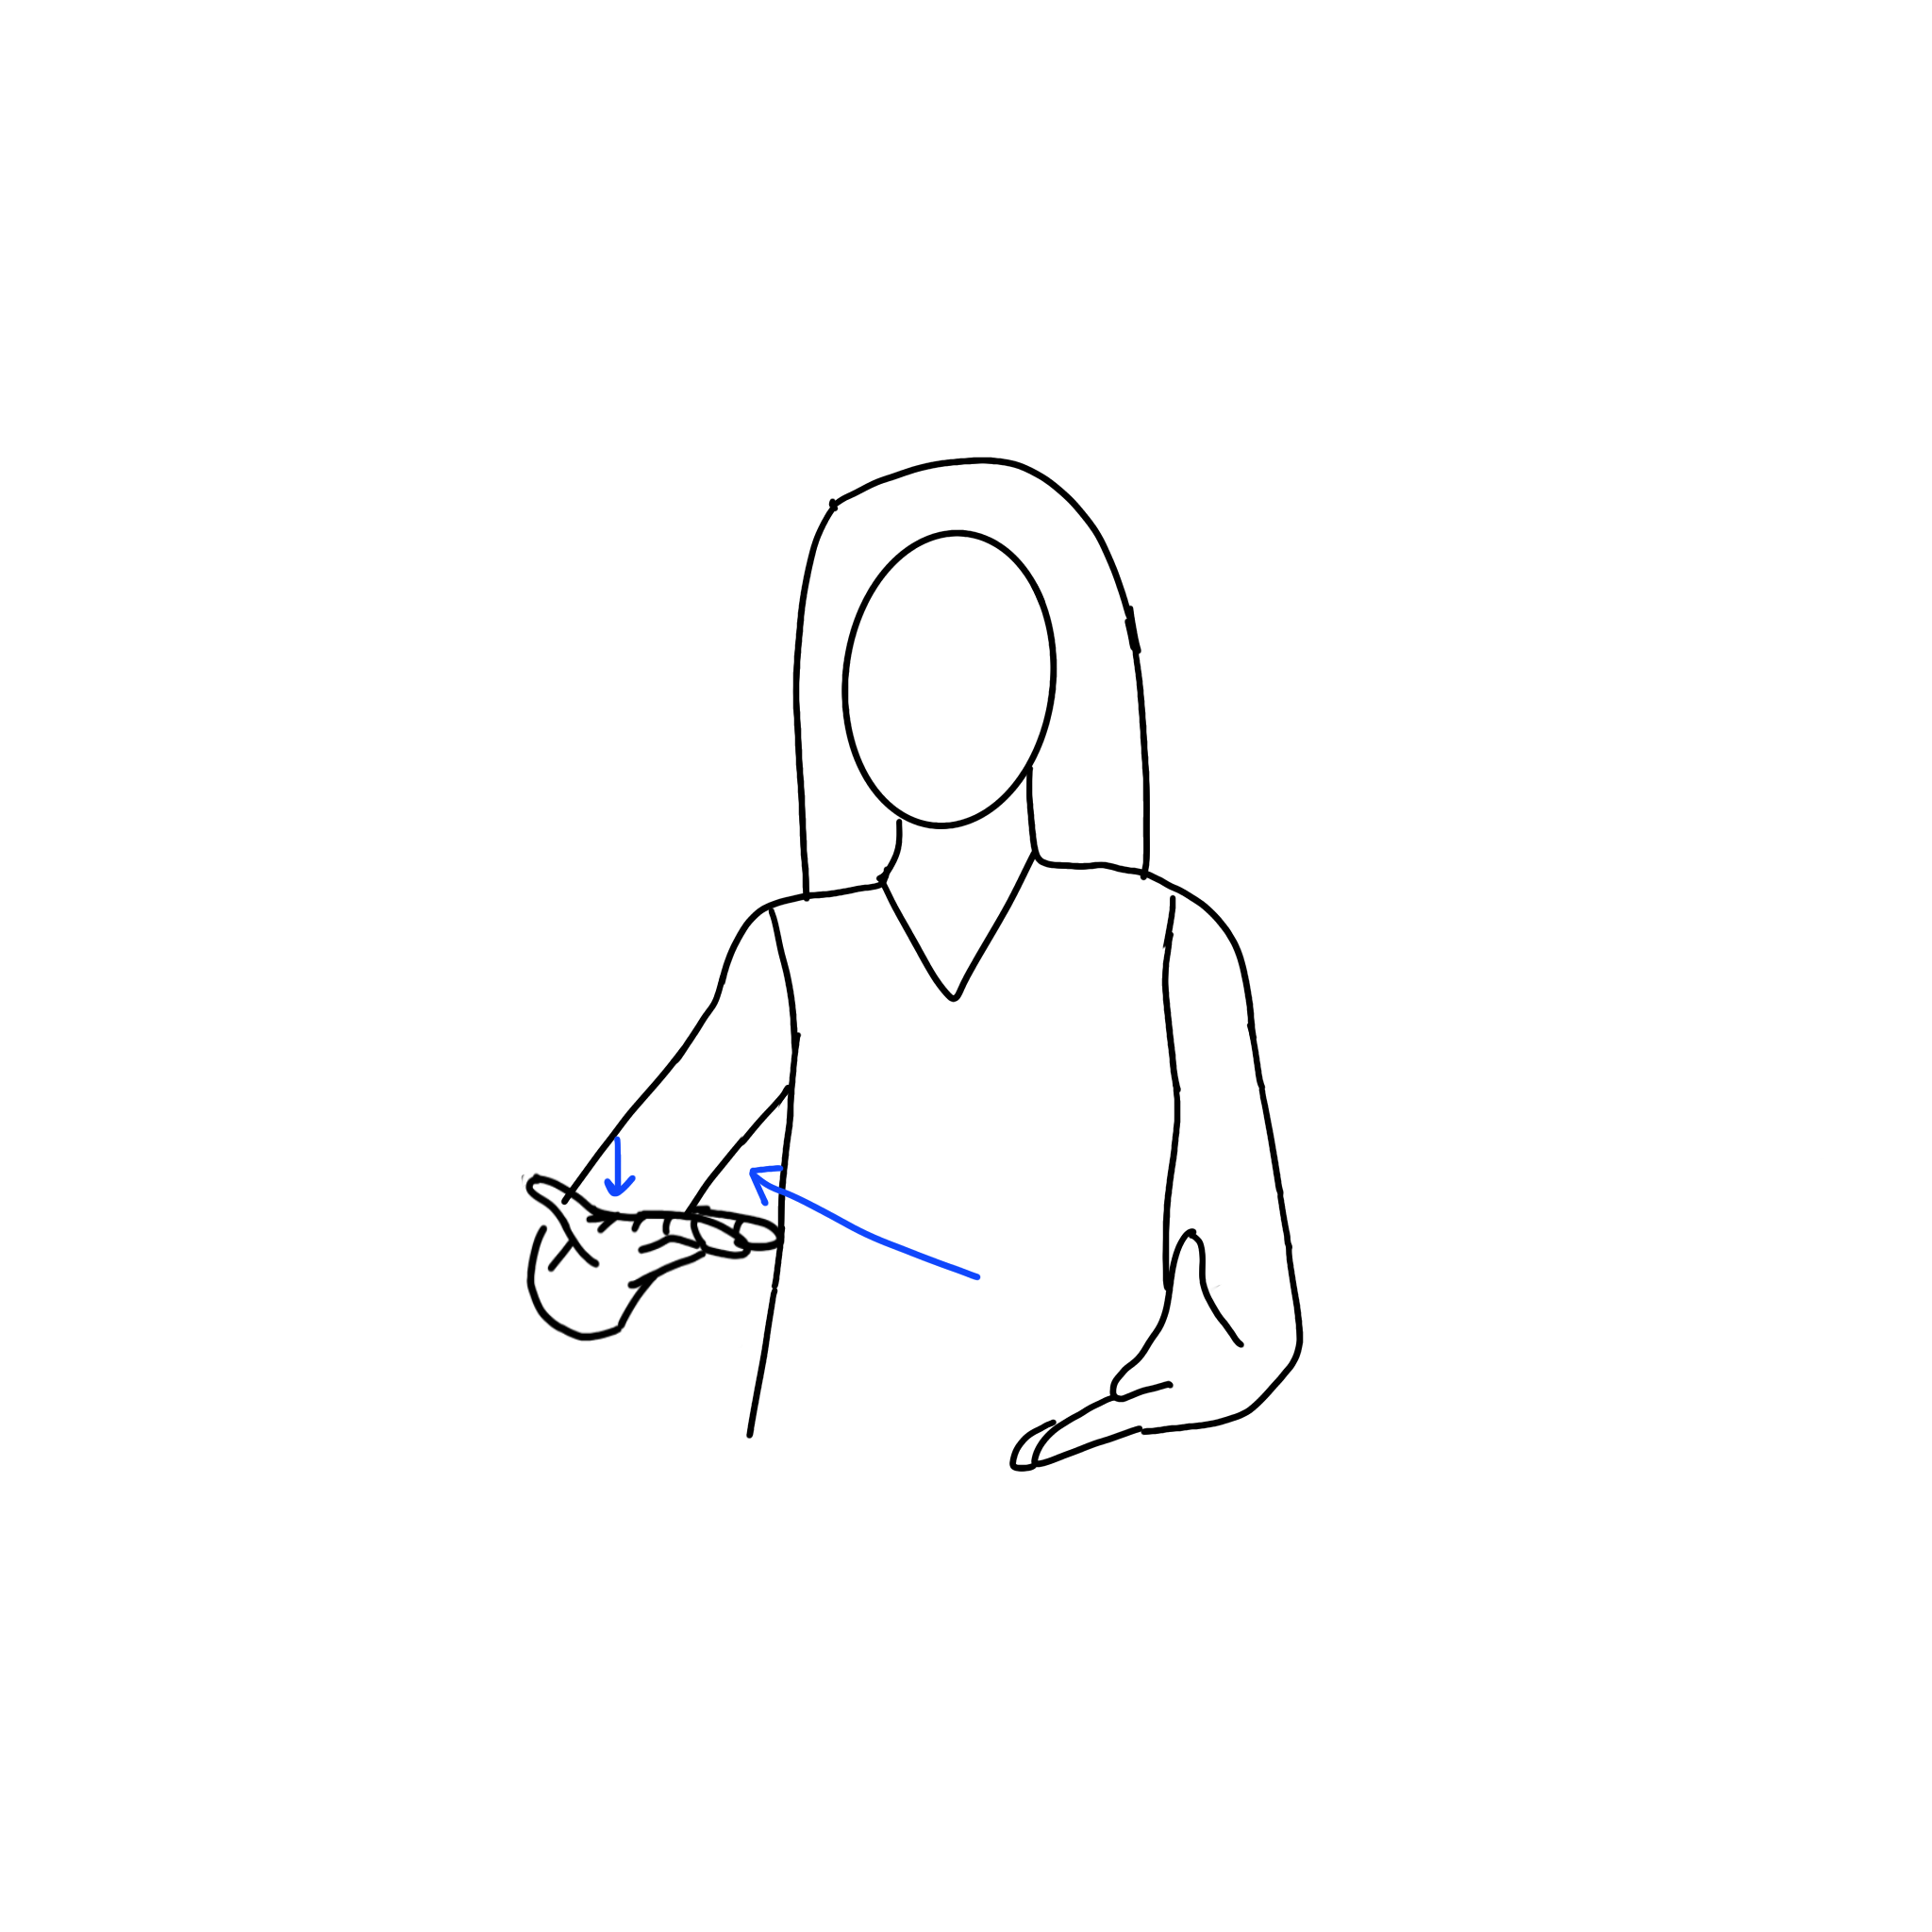
Up(Cont.)
UP5
UP6
UP7
UP8
UP9

Slide 9
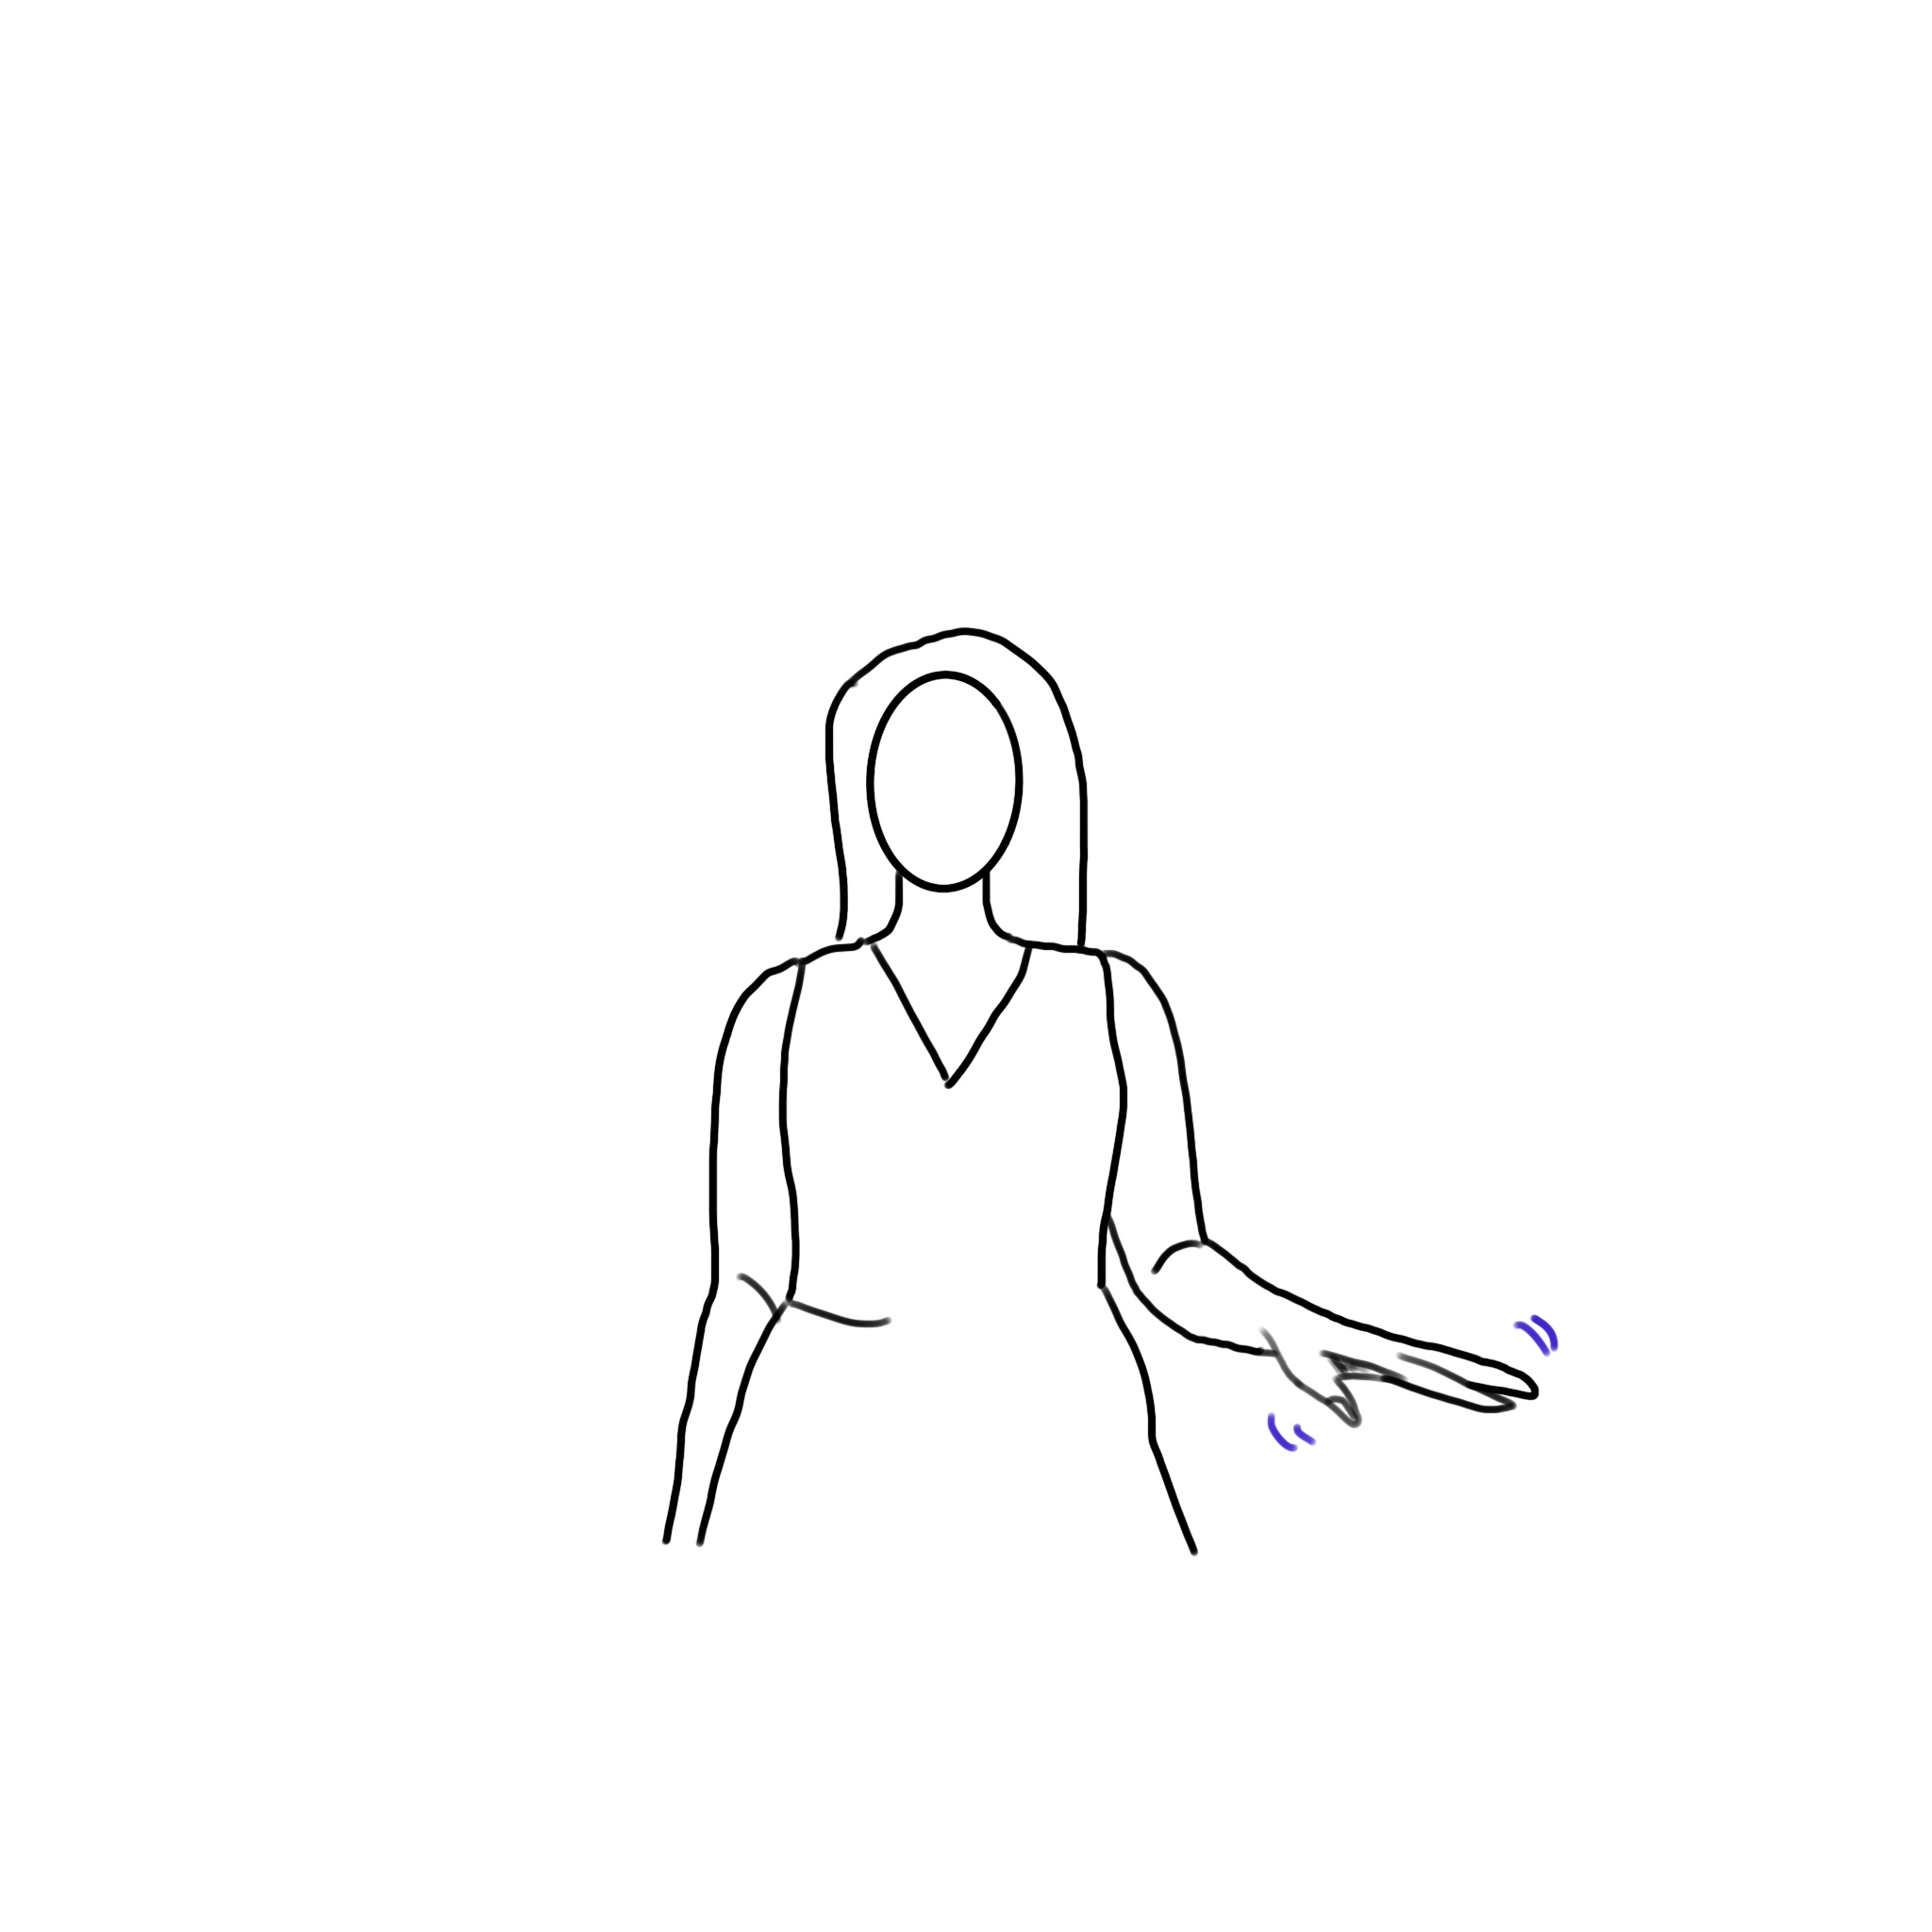
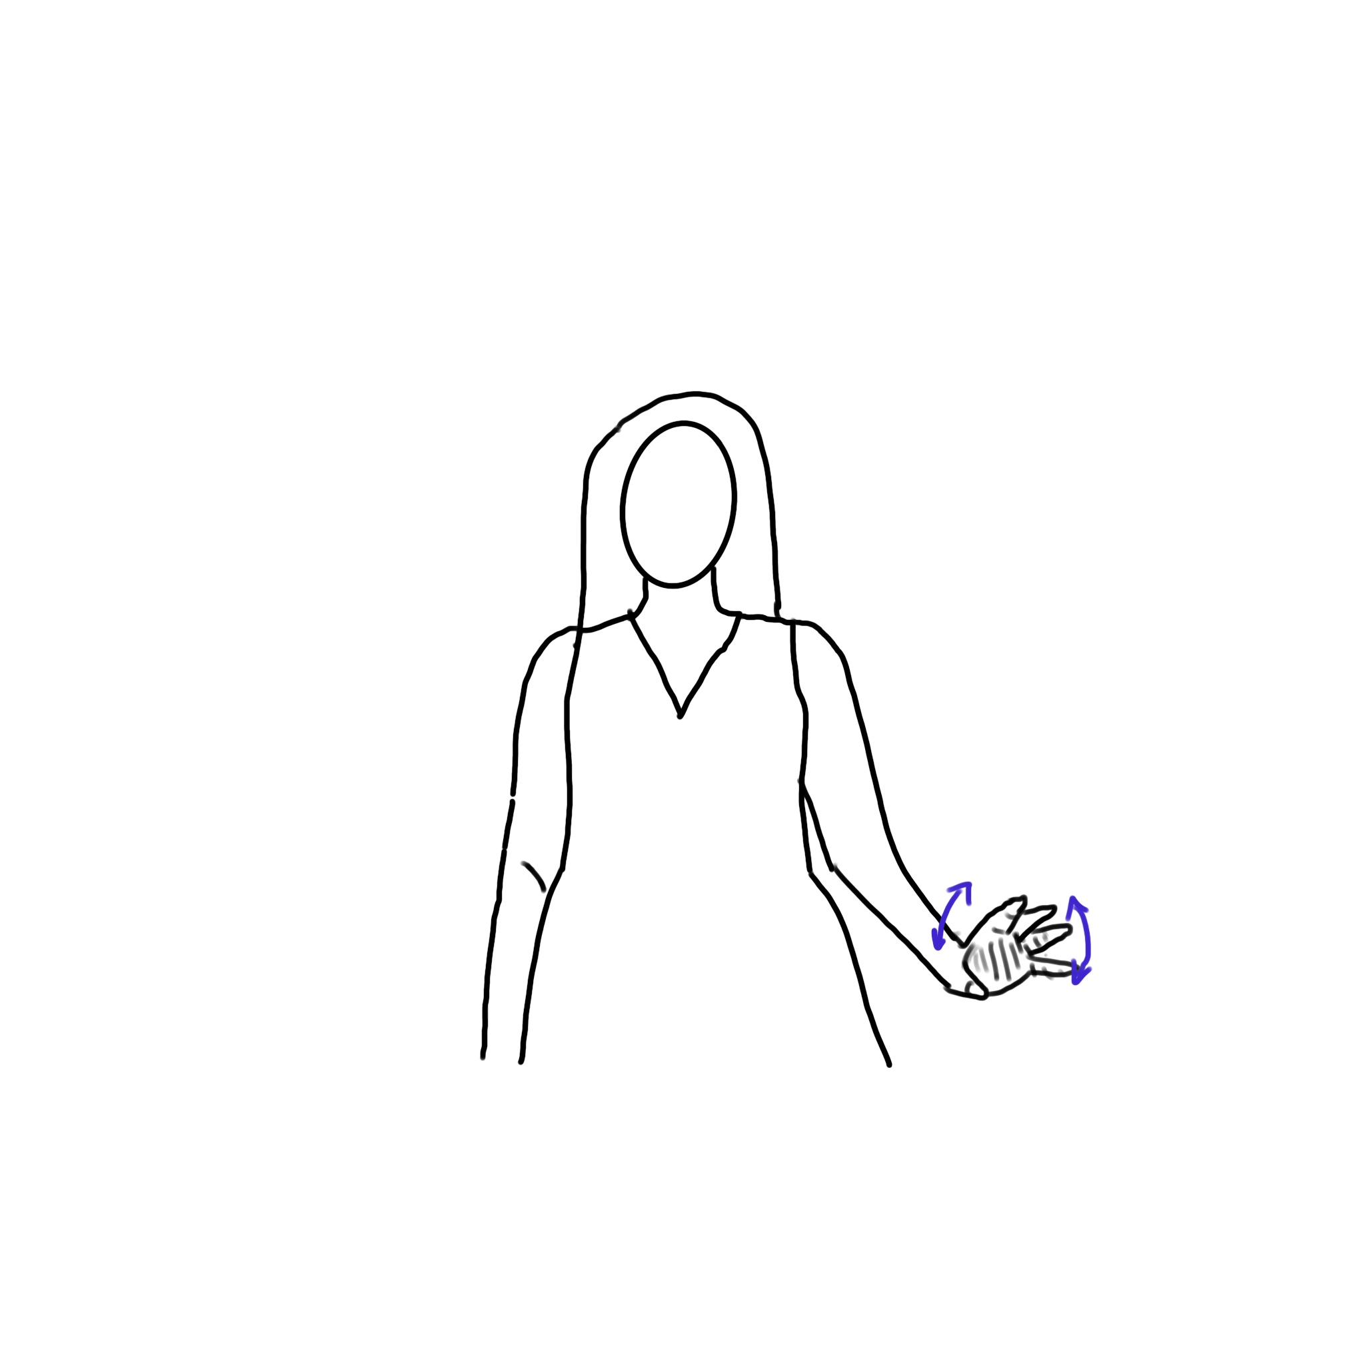
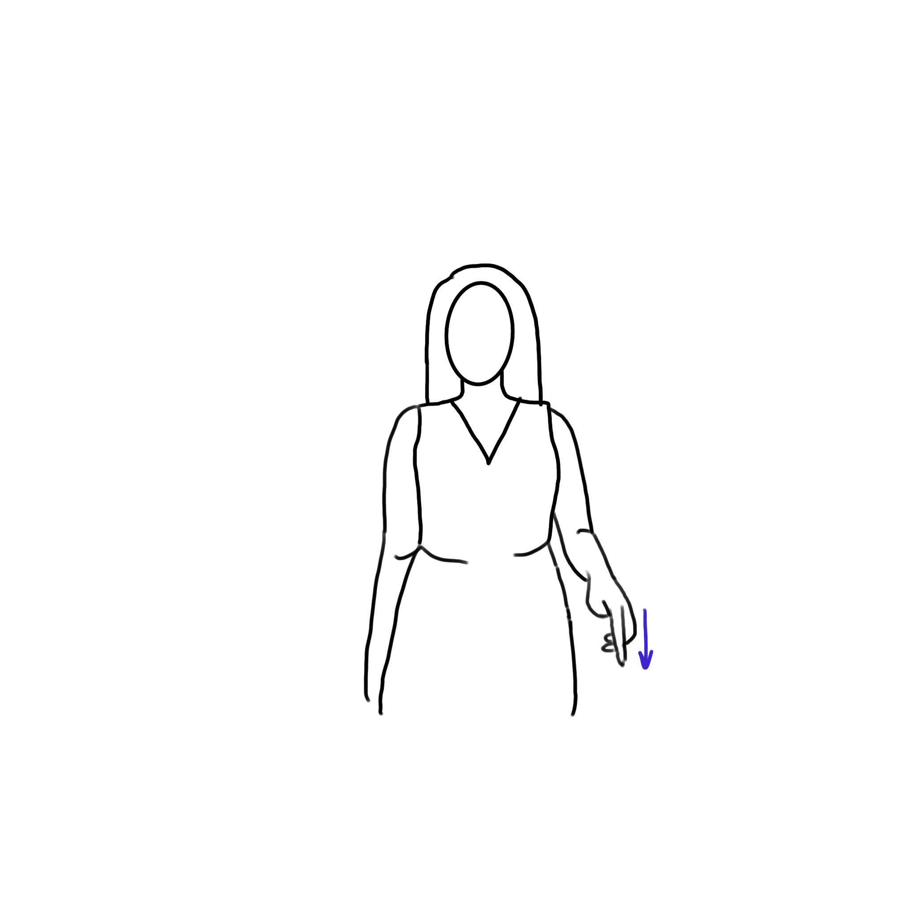
Down
DOWN1
DOWN2
DOWN3

Slide 10
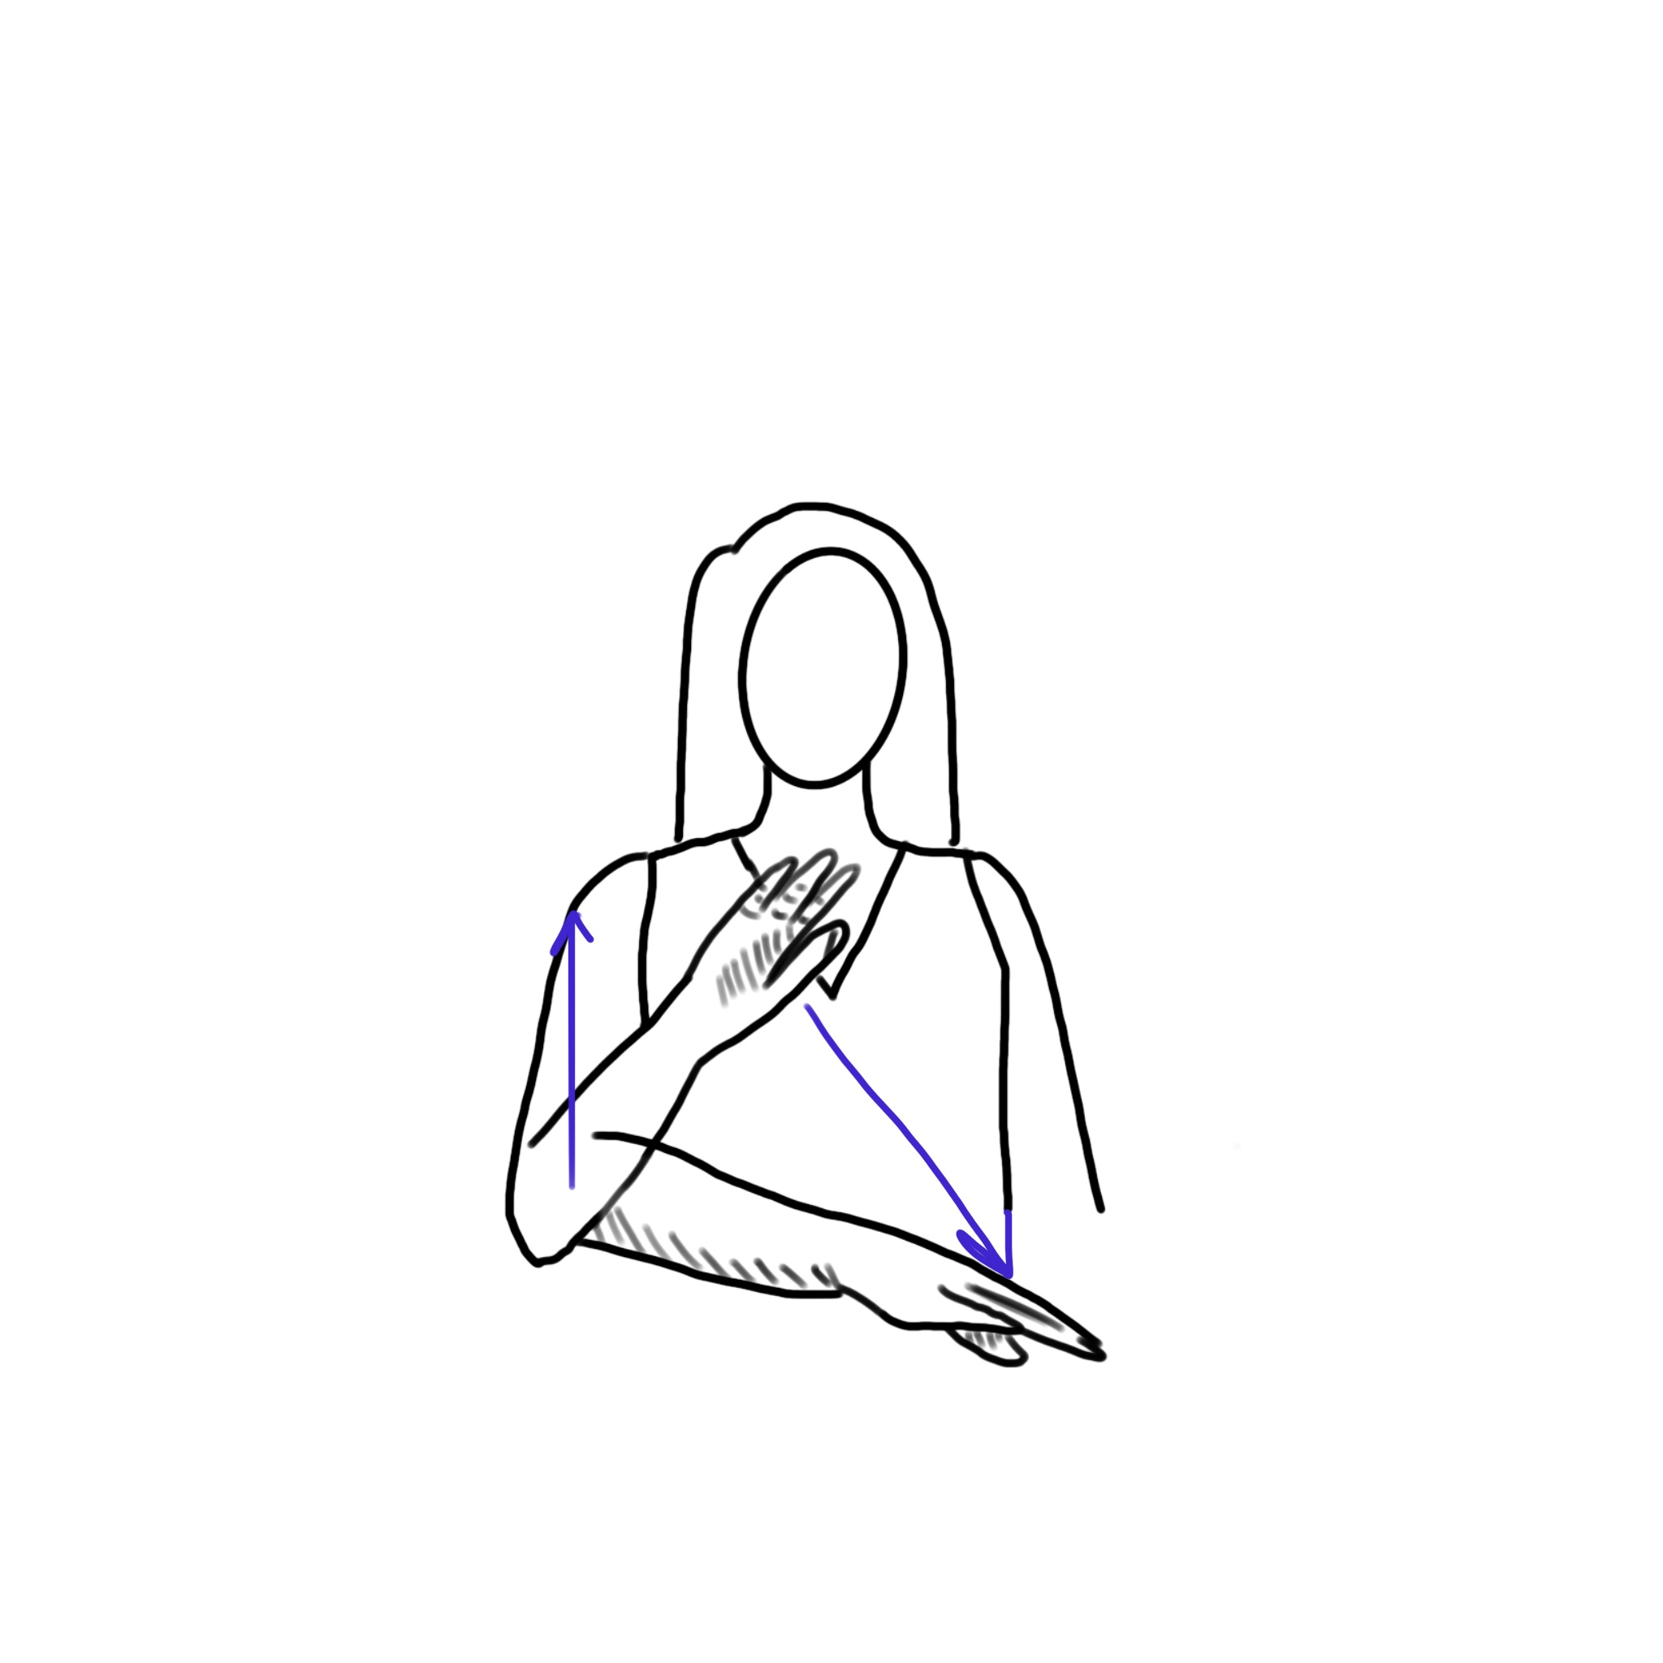
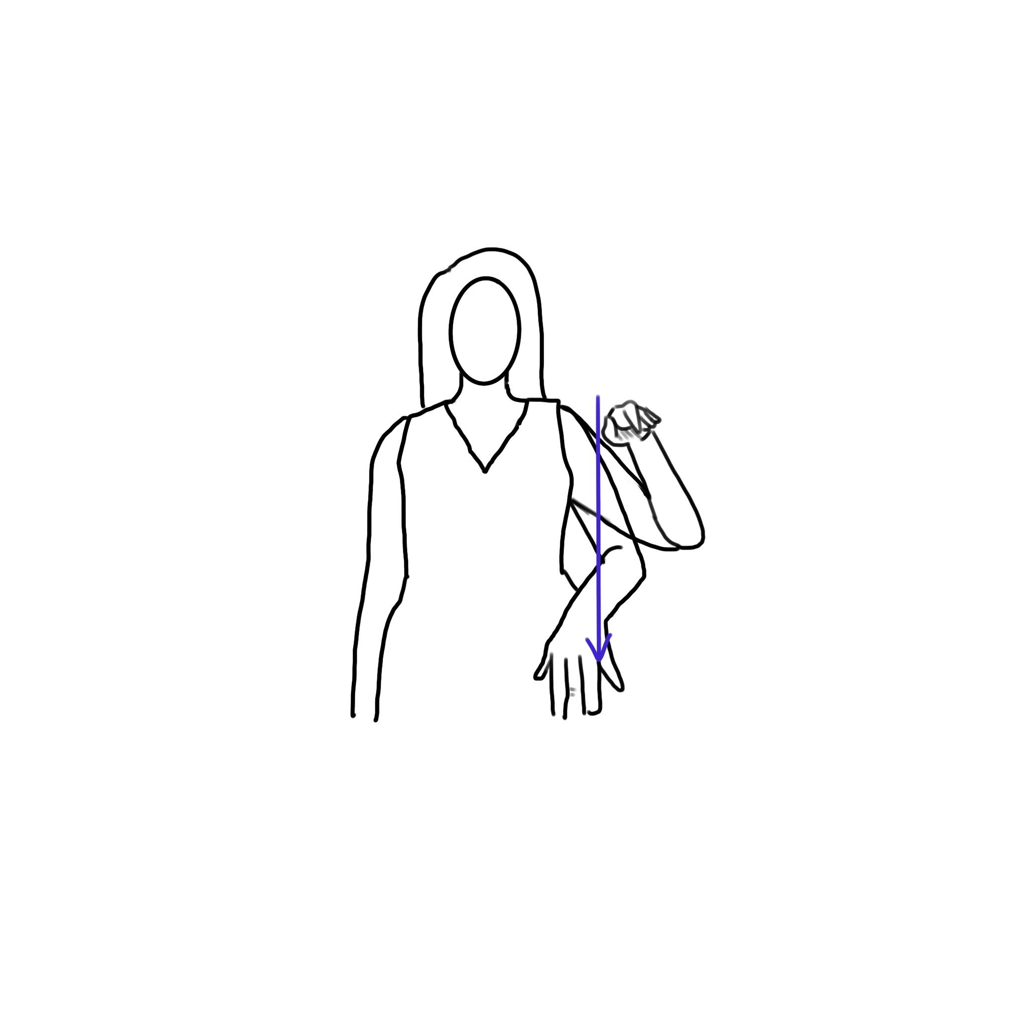
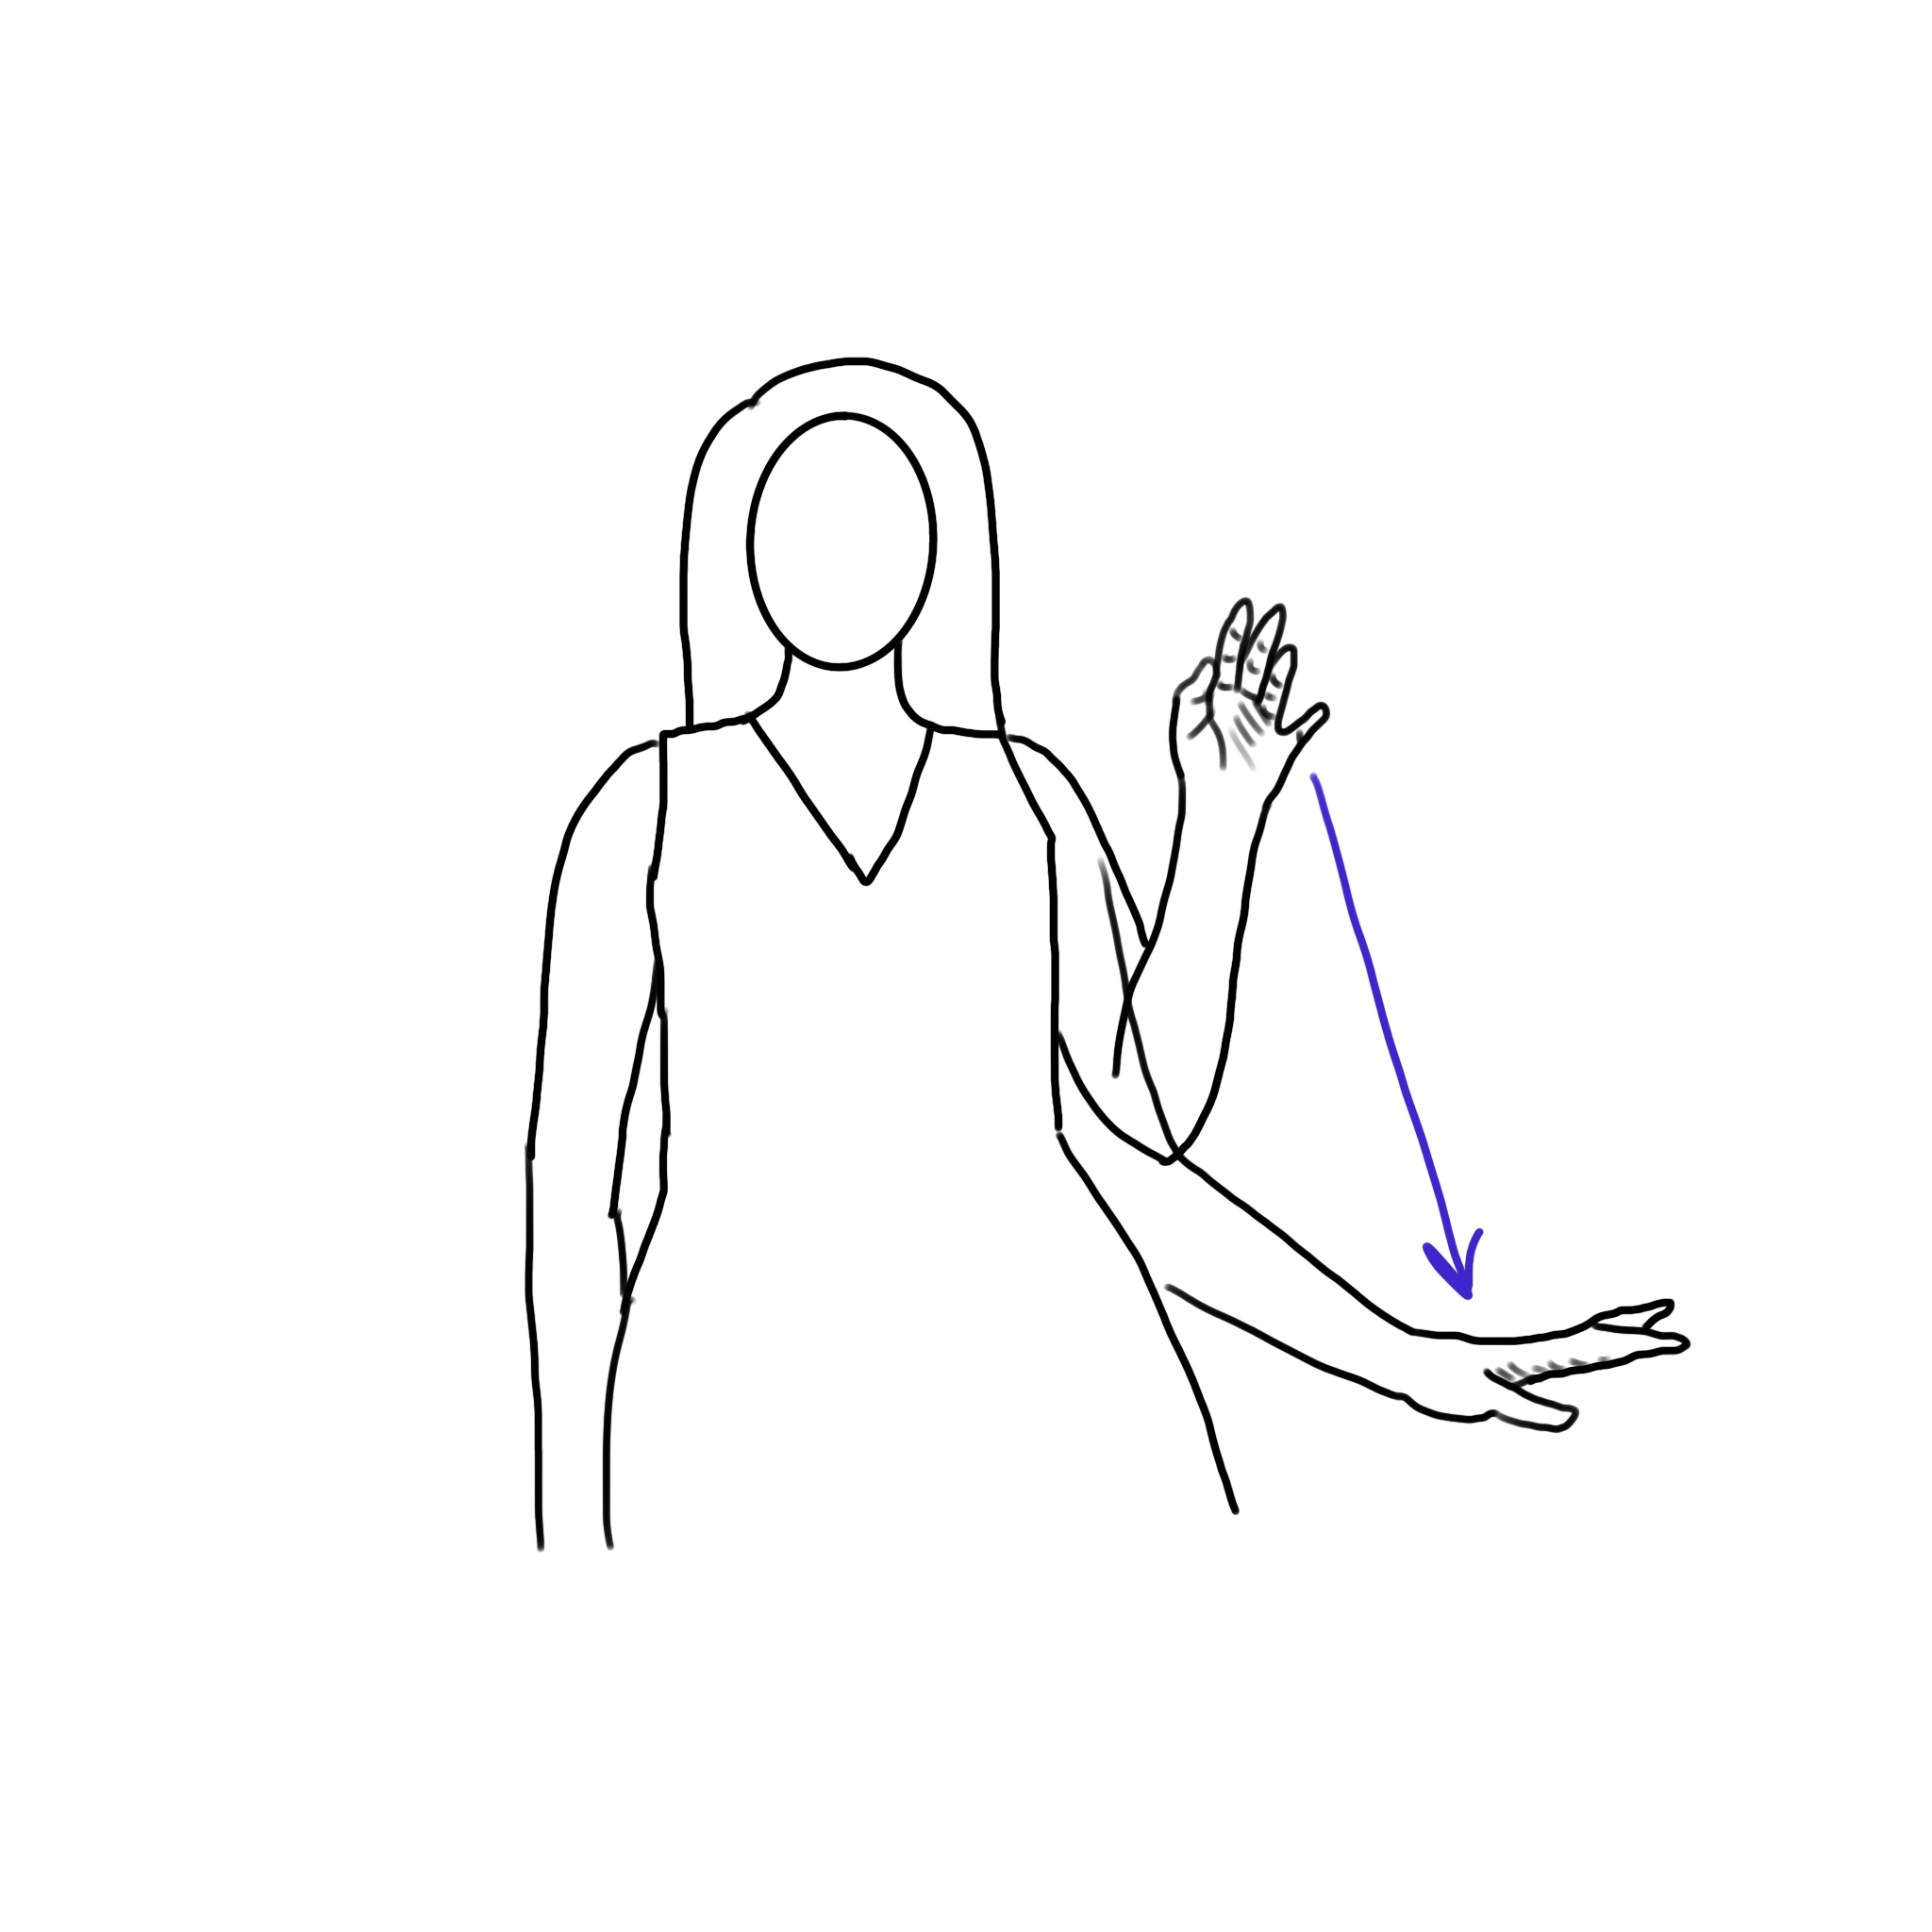
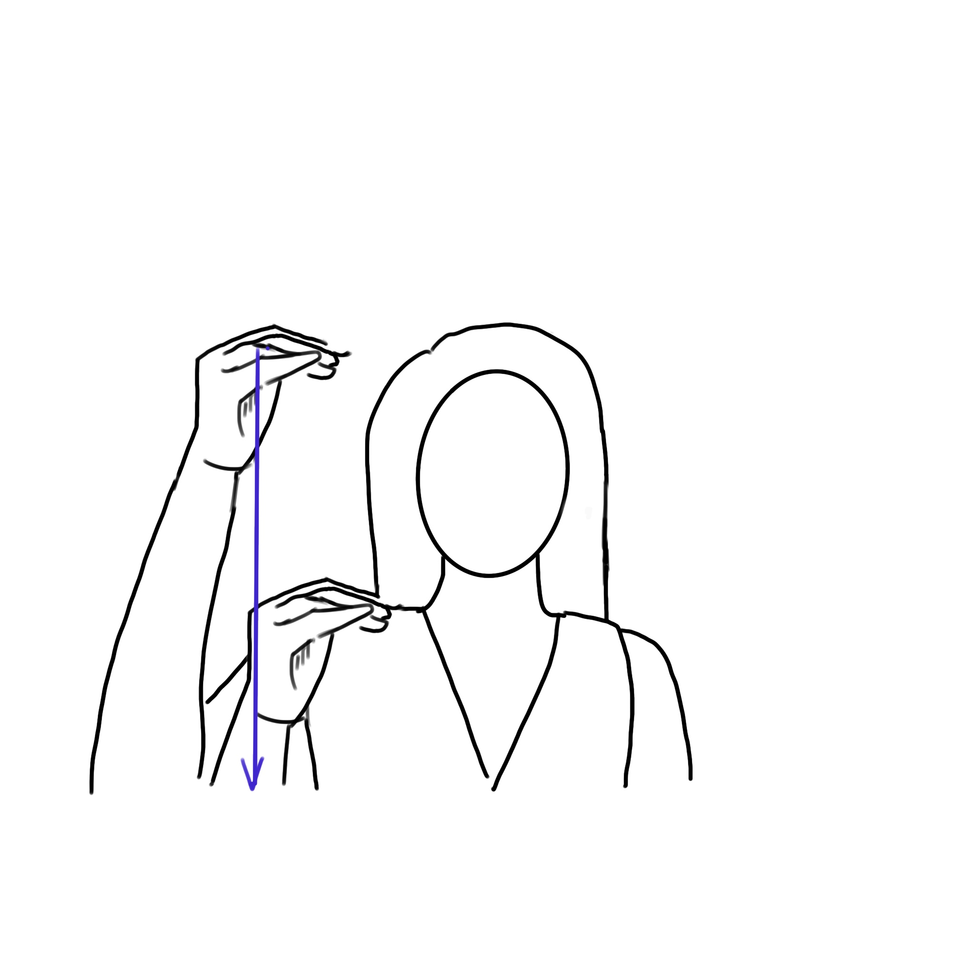
Down(Cont.)
DOWN6
DOWN4
DOWN5
DOWN7

Slide 11
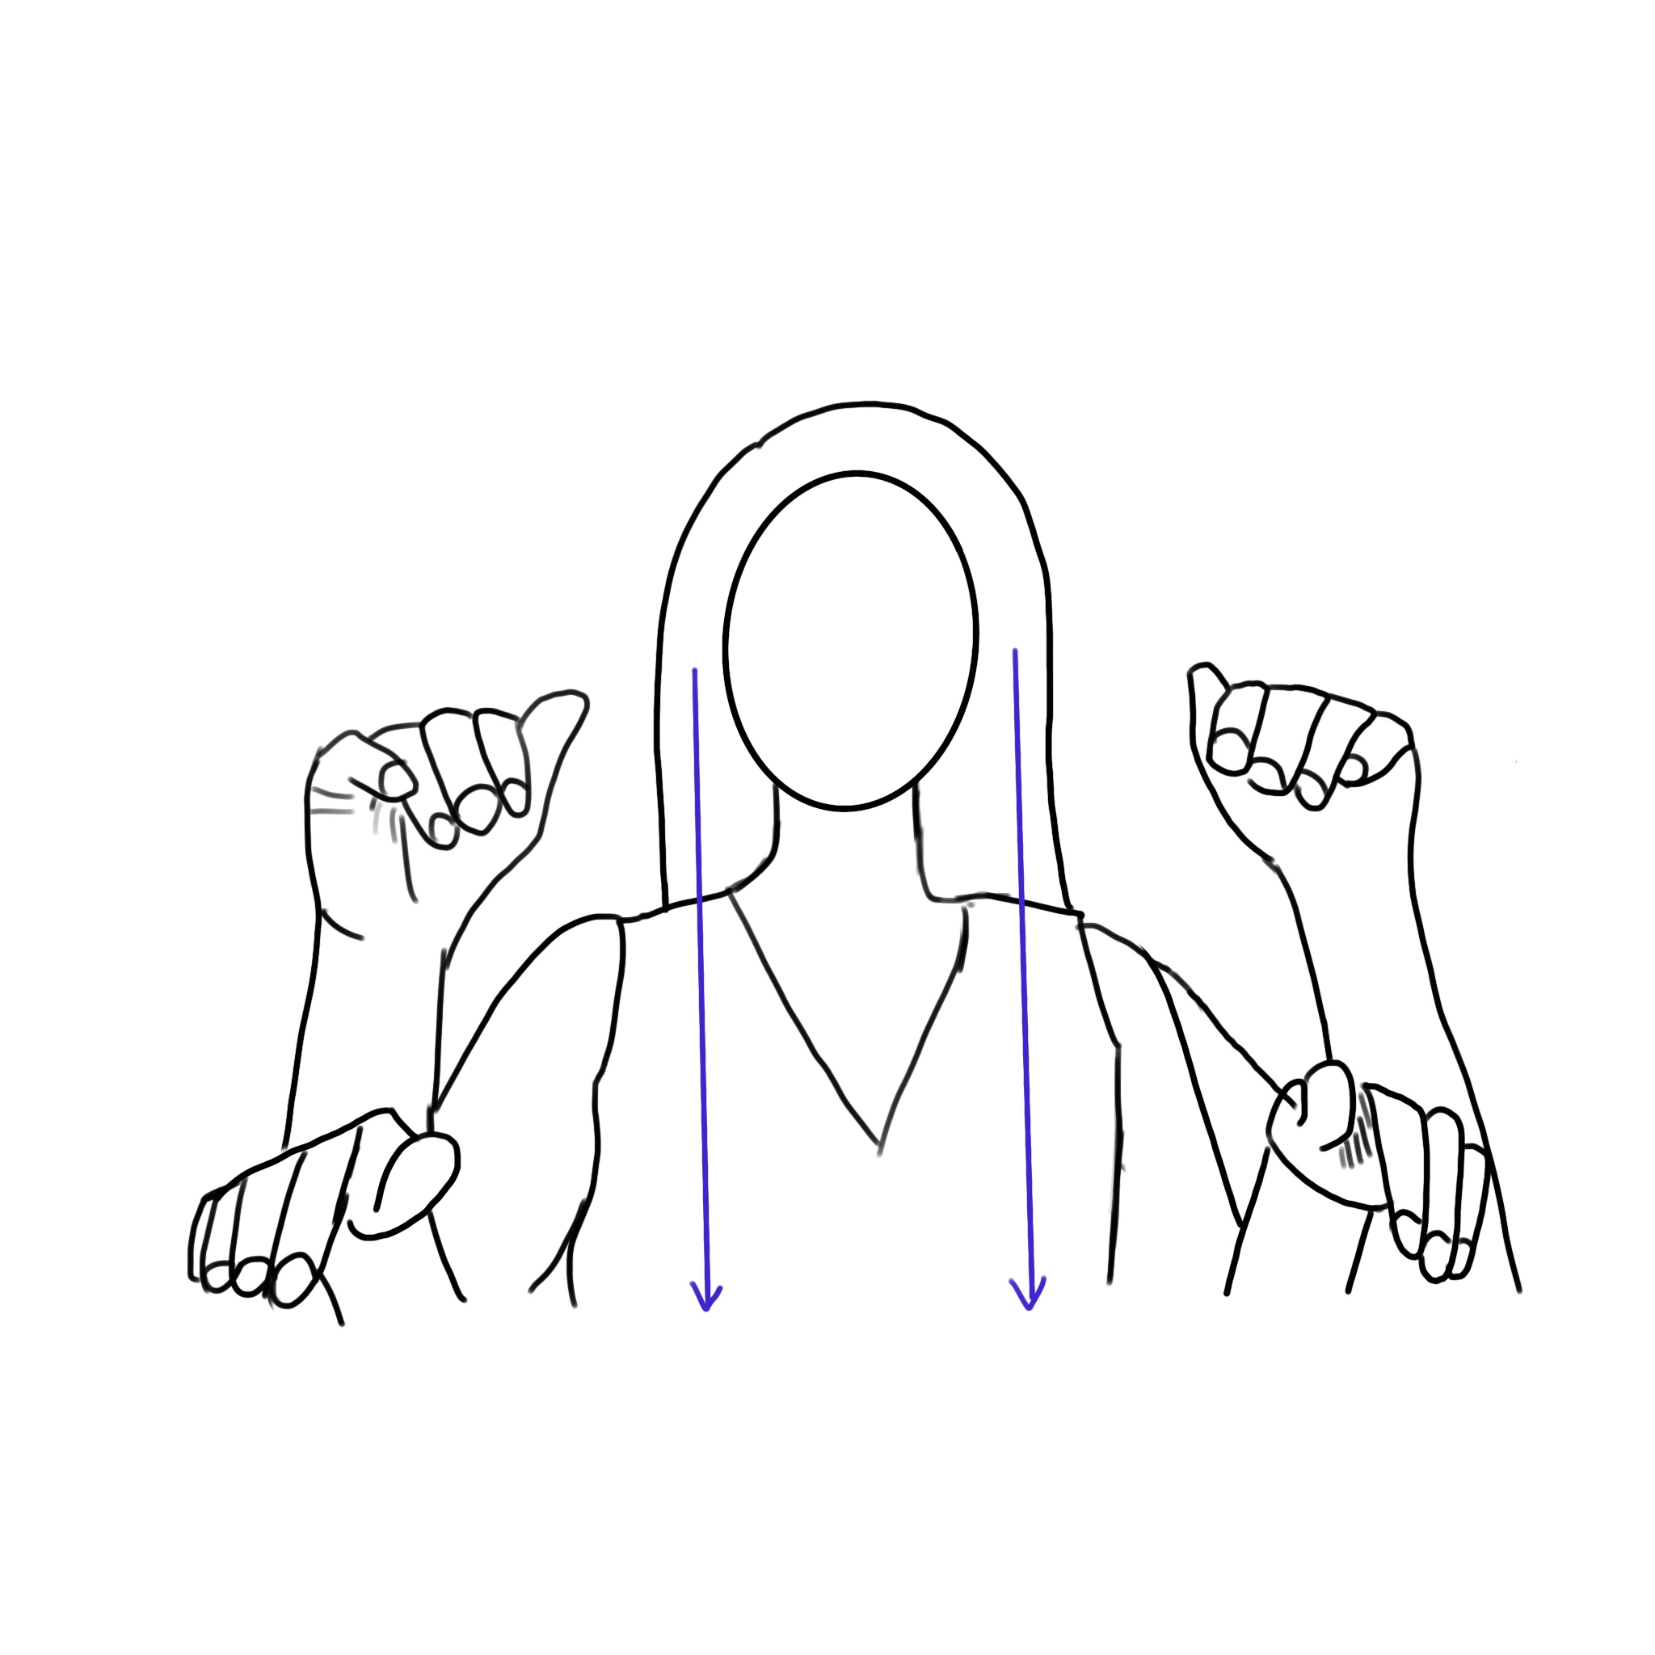
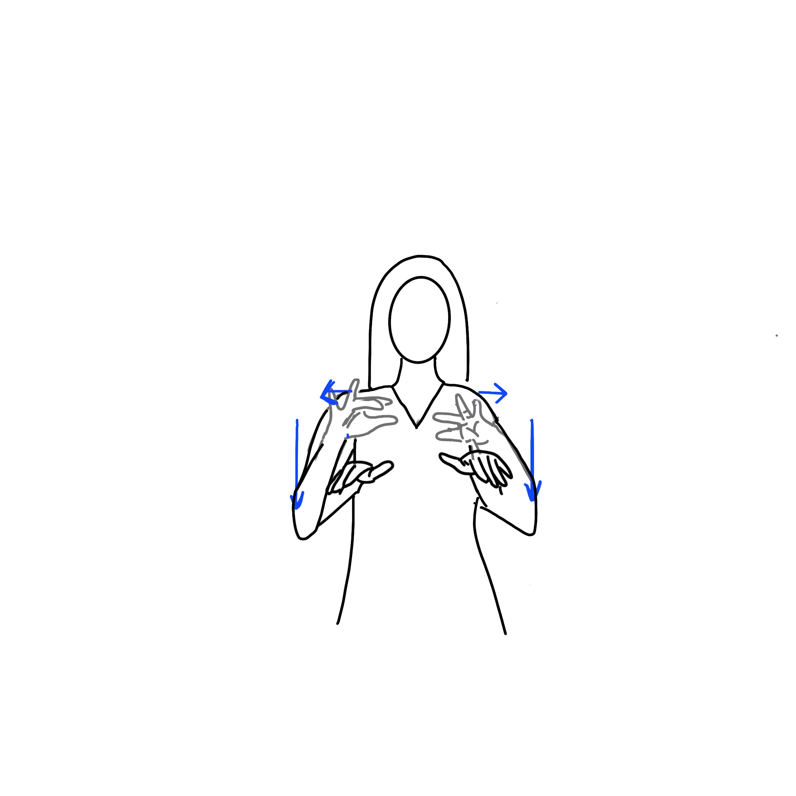
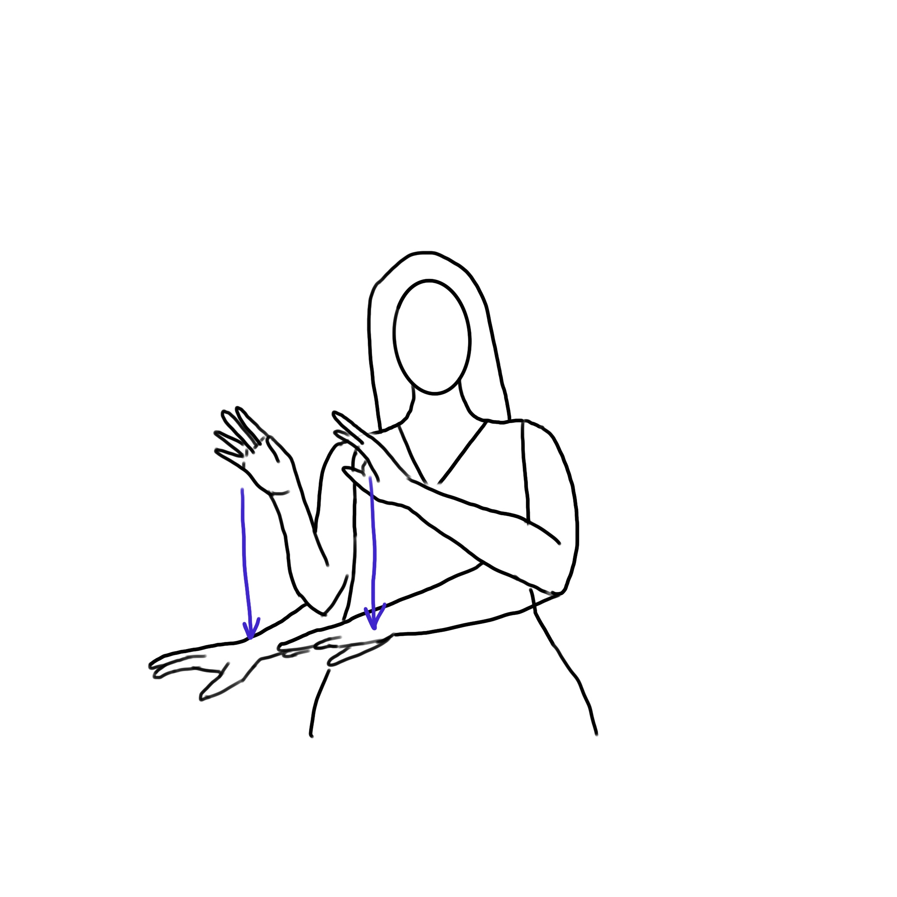
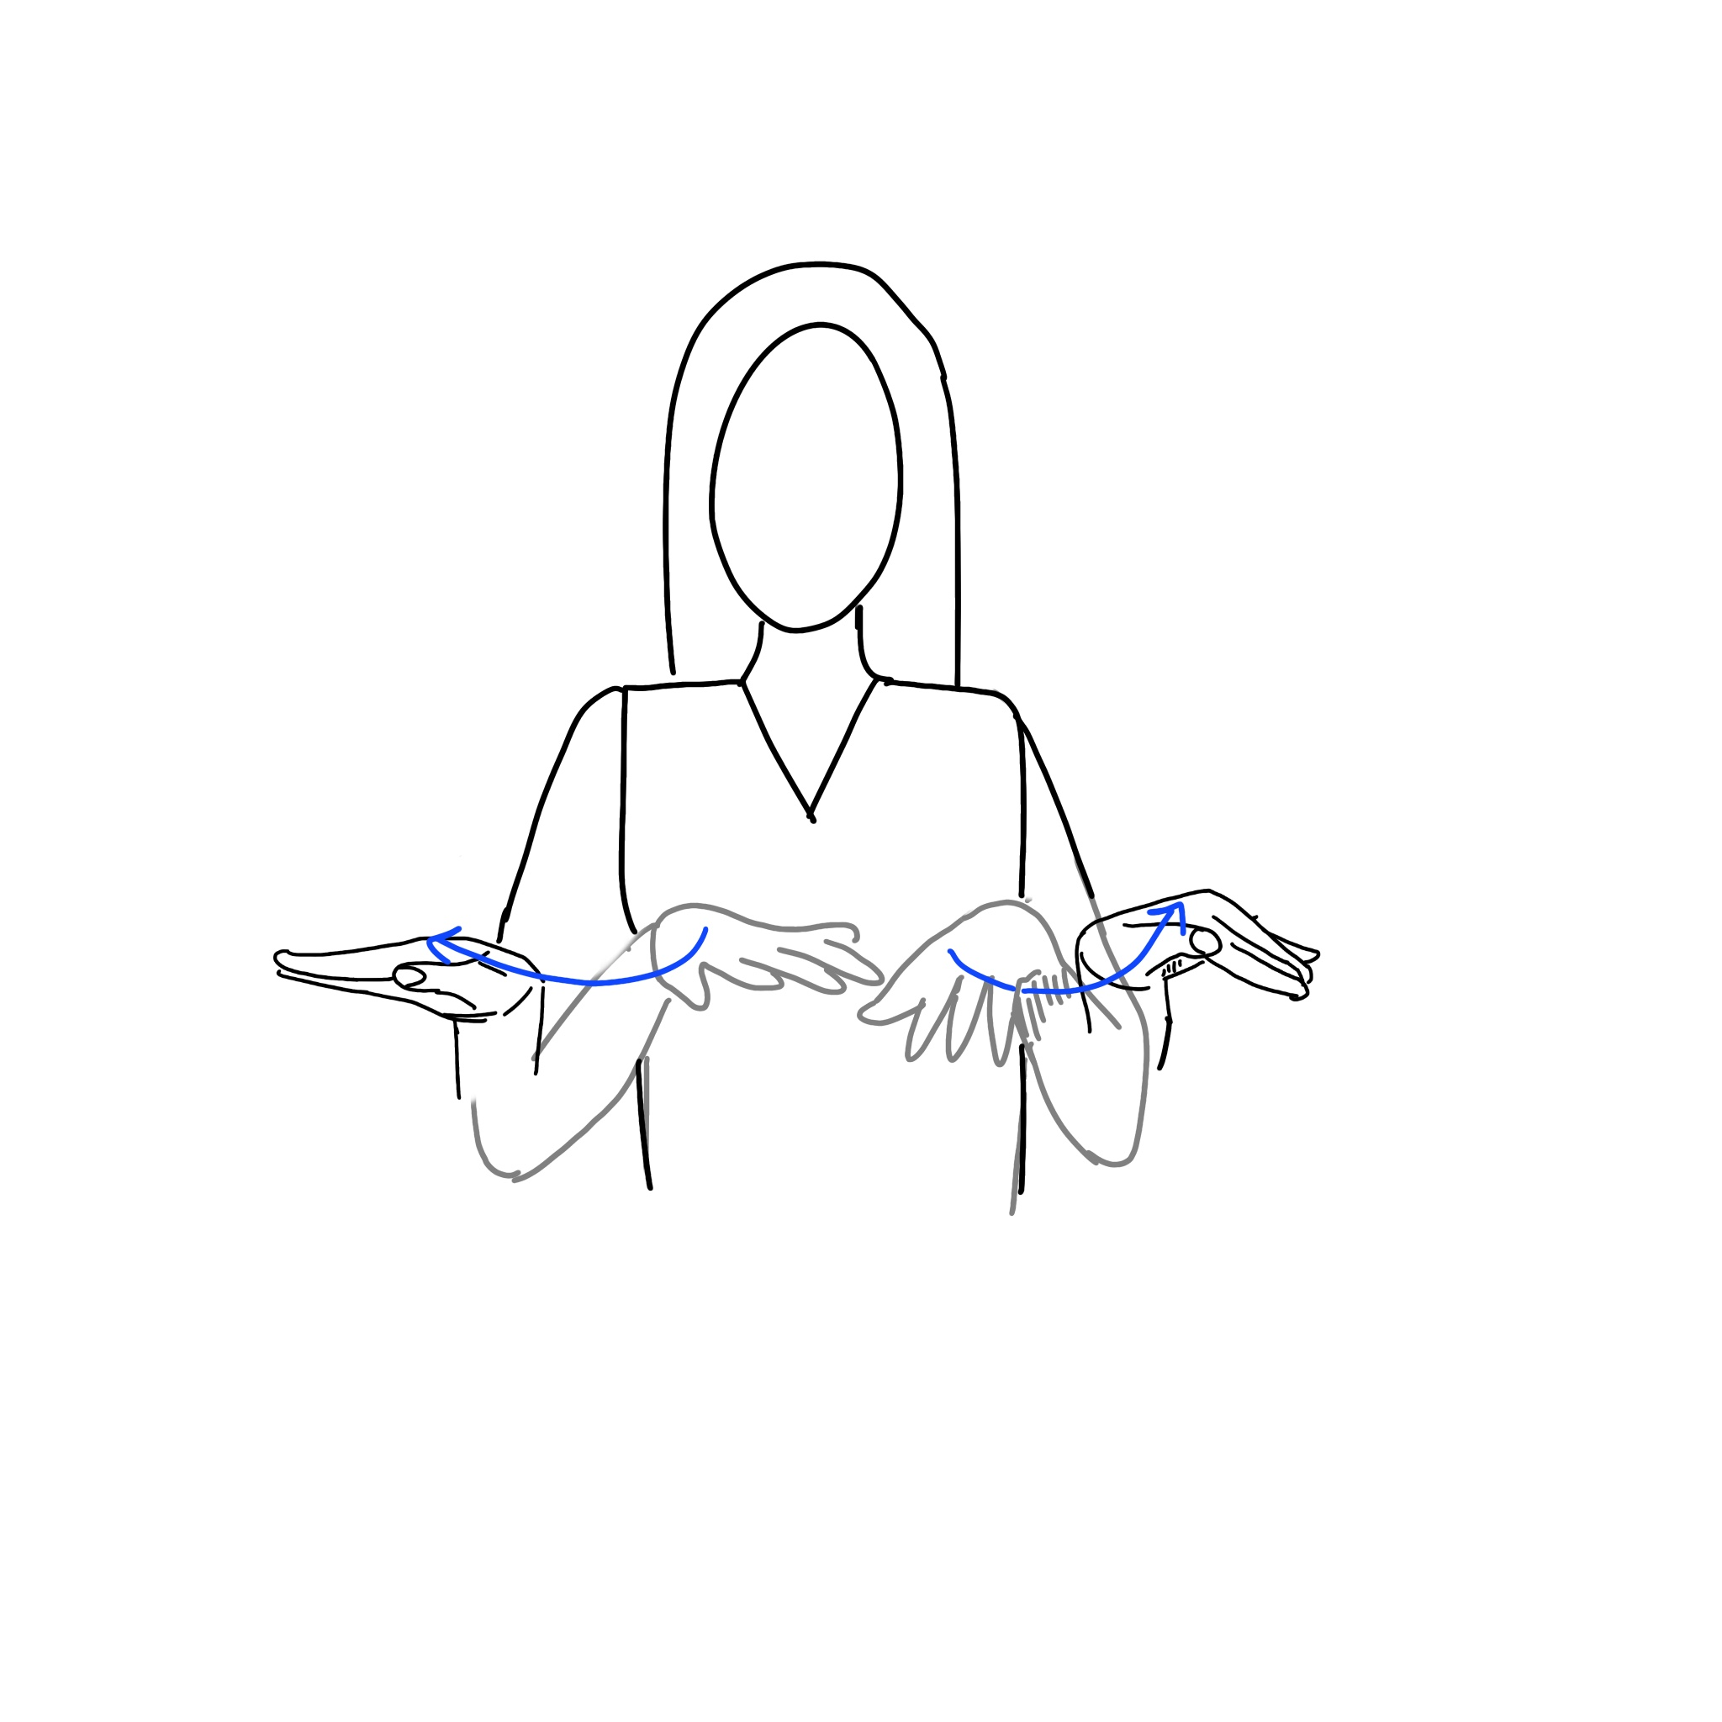
Down(Cont.)
DOWN10
DOWN8
DOWN9
DOWN11

Slide 12
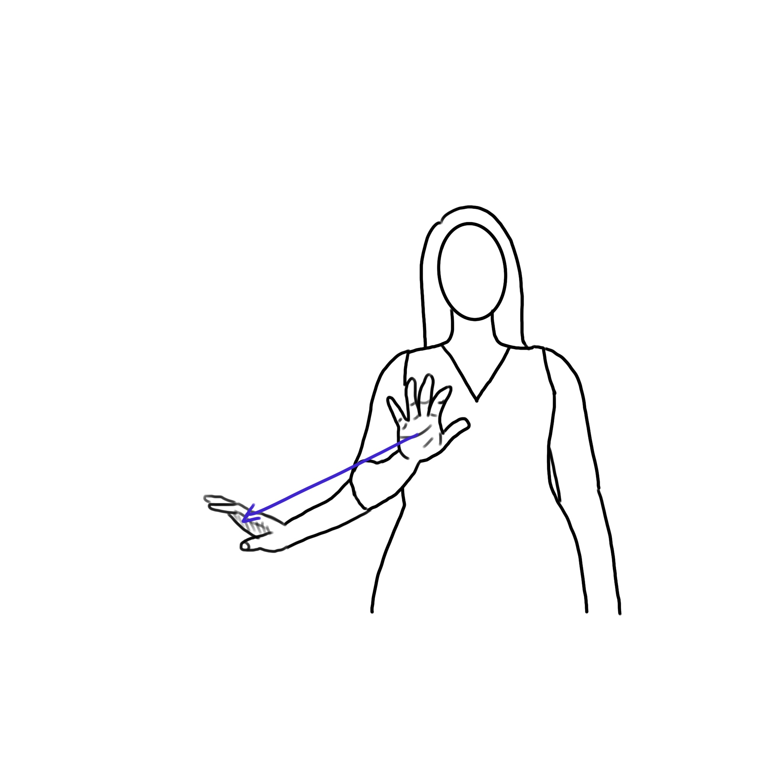
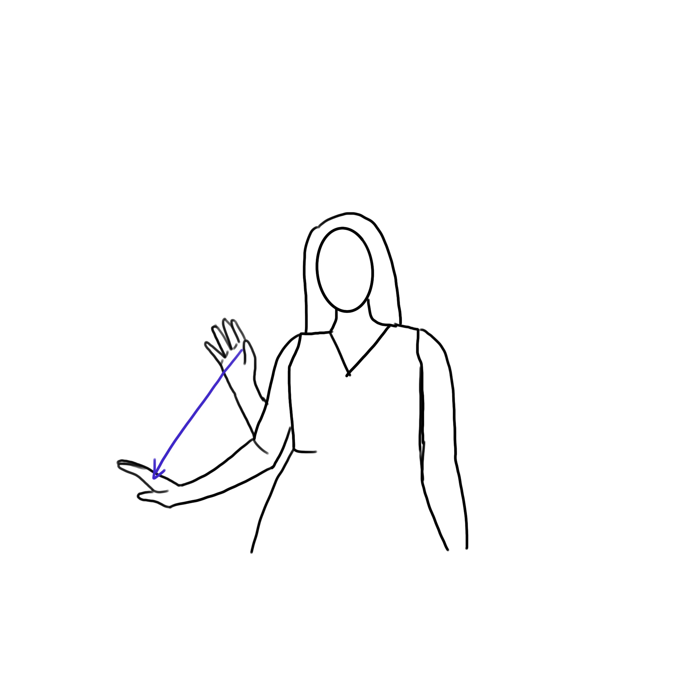
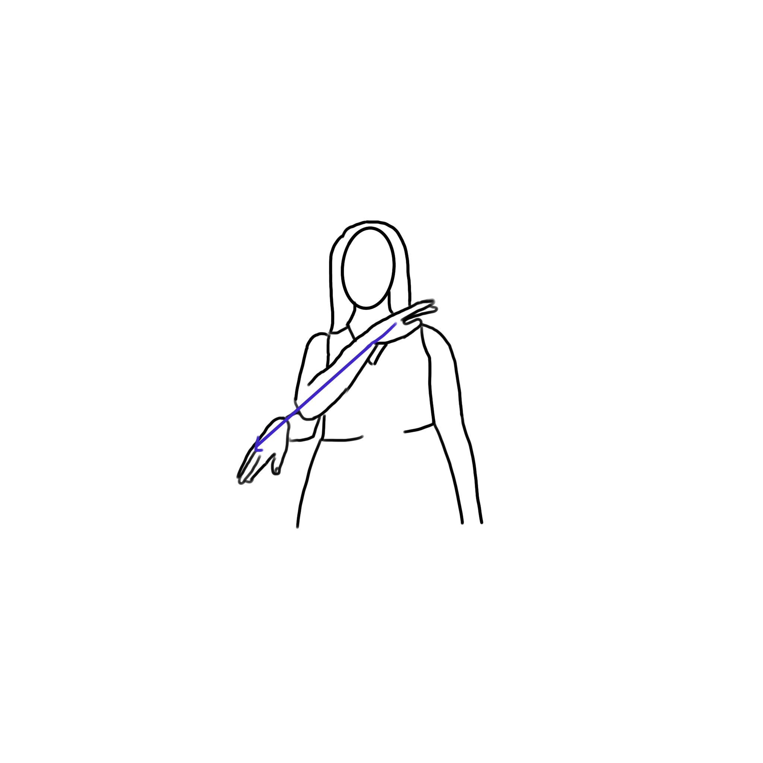
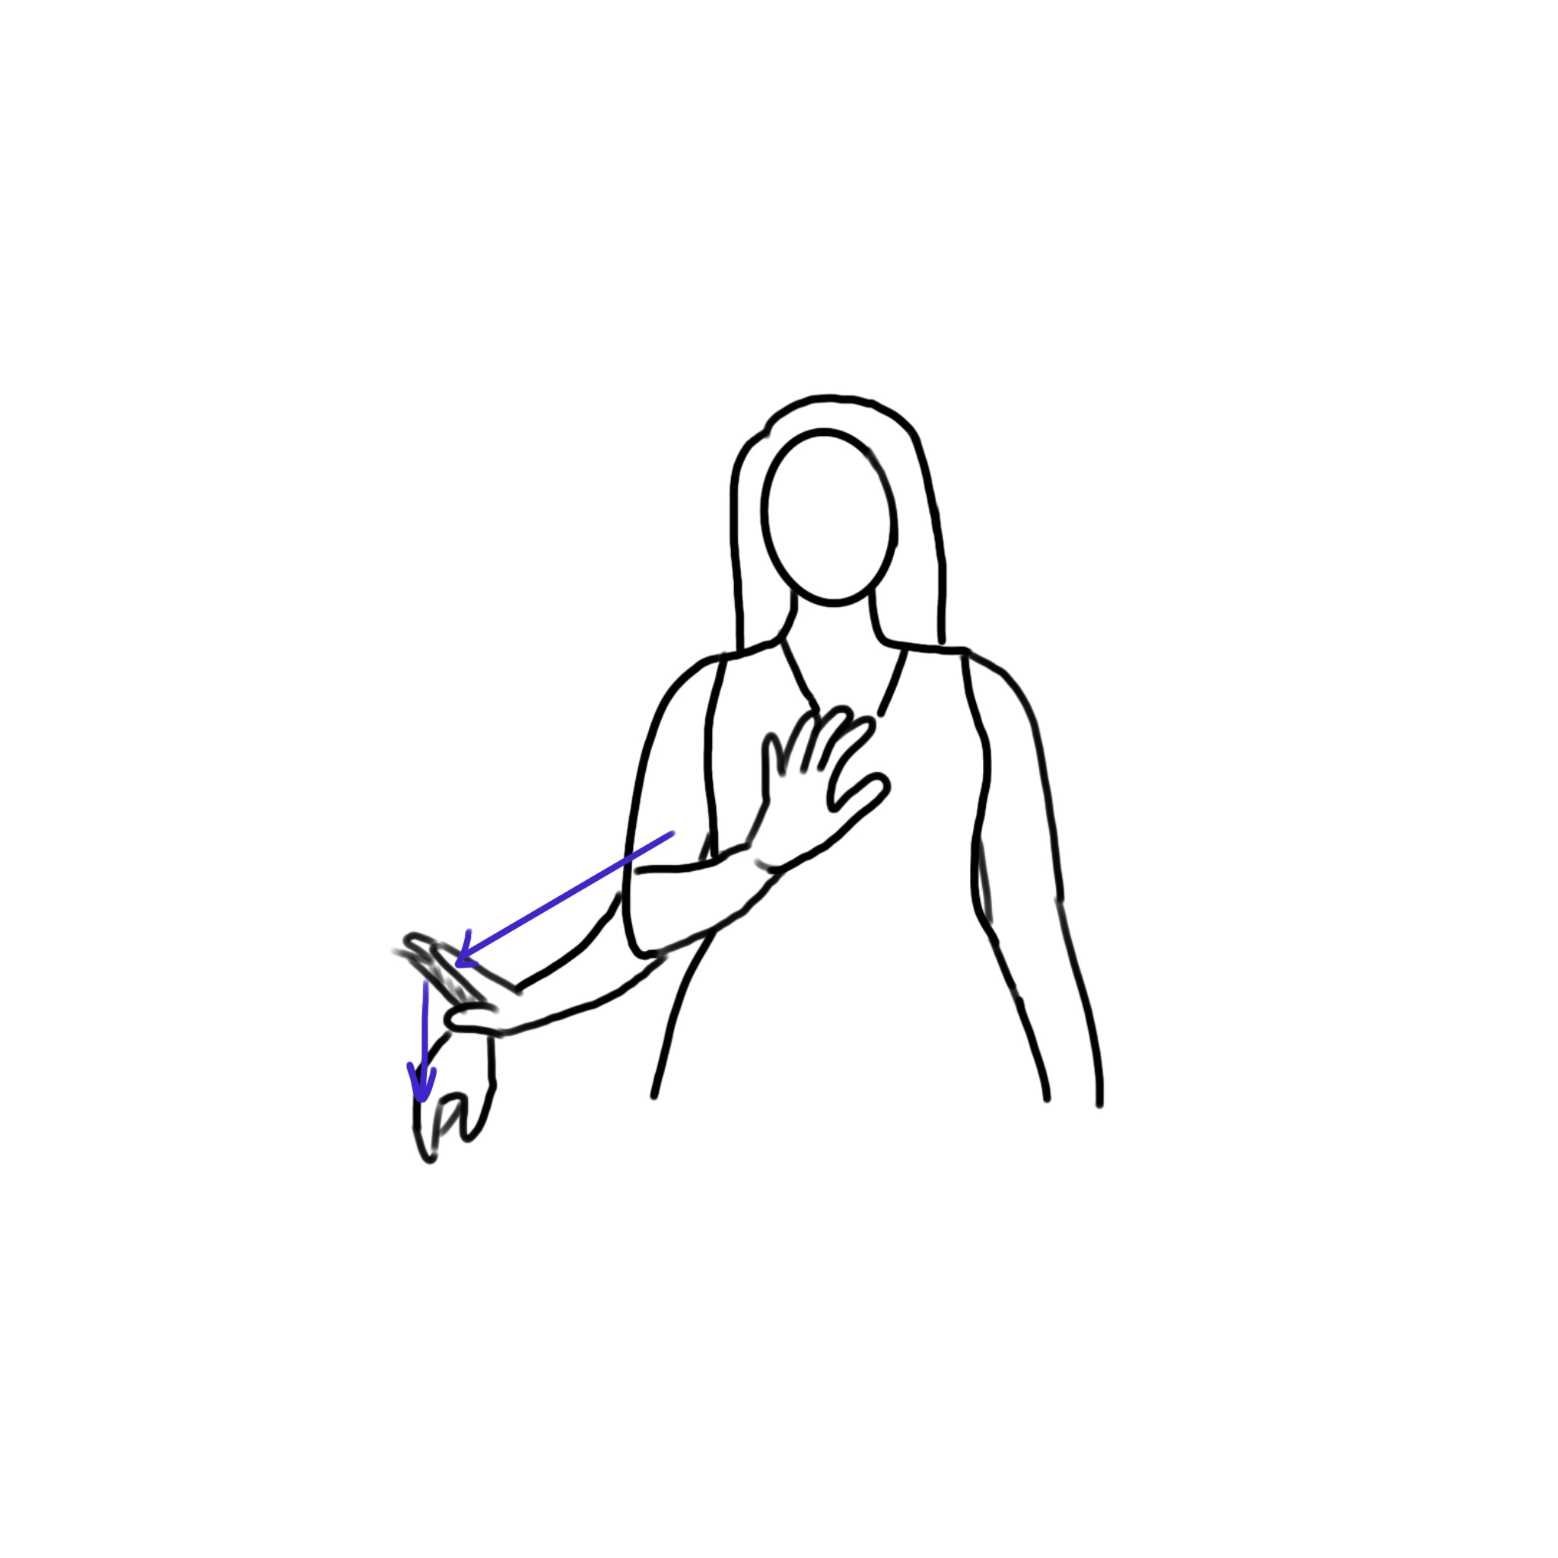
Down(Cont.)
DOWN12
DOWN13
DOWN14
DOWN15

Slide 13
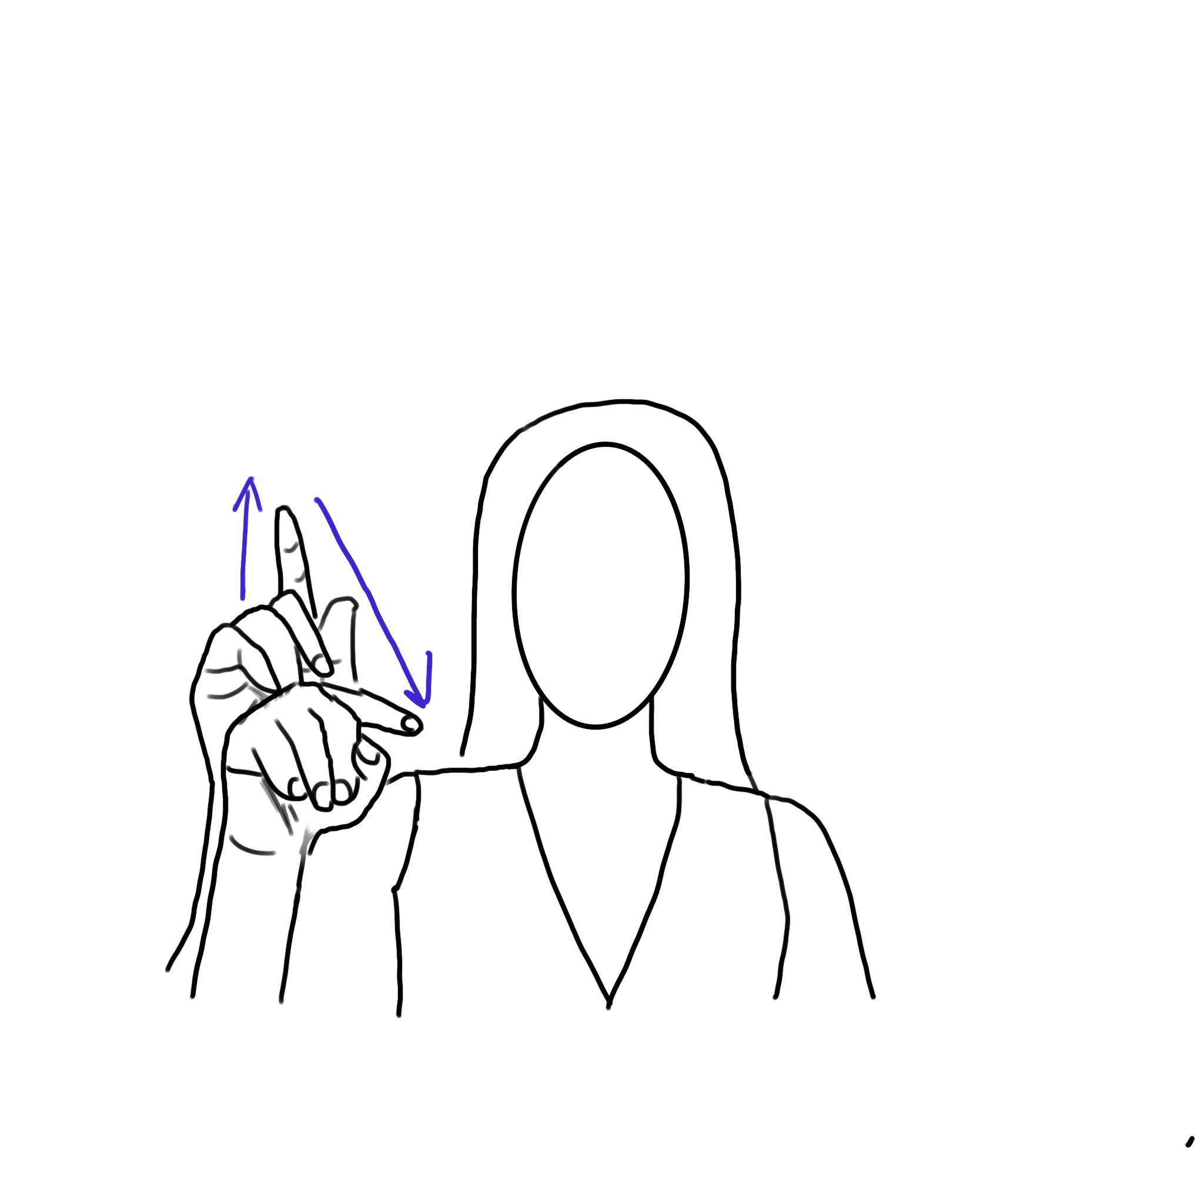
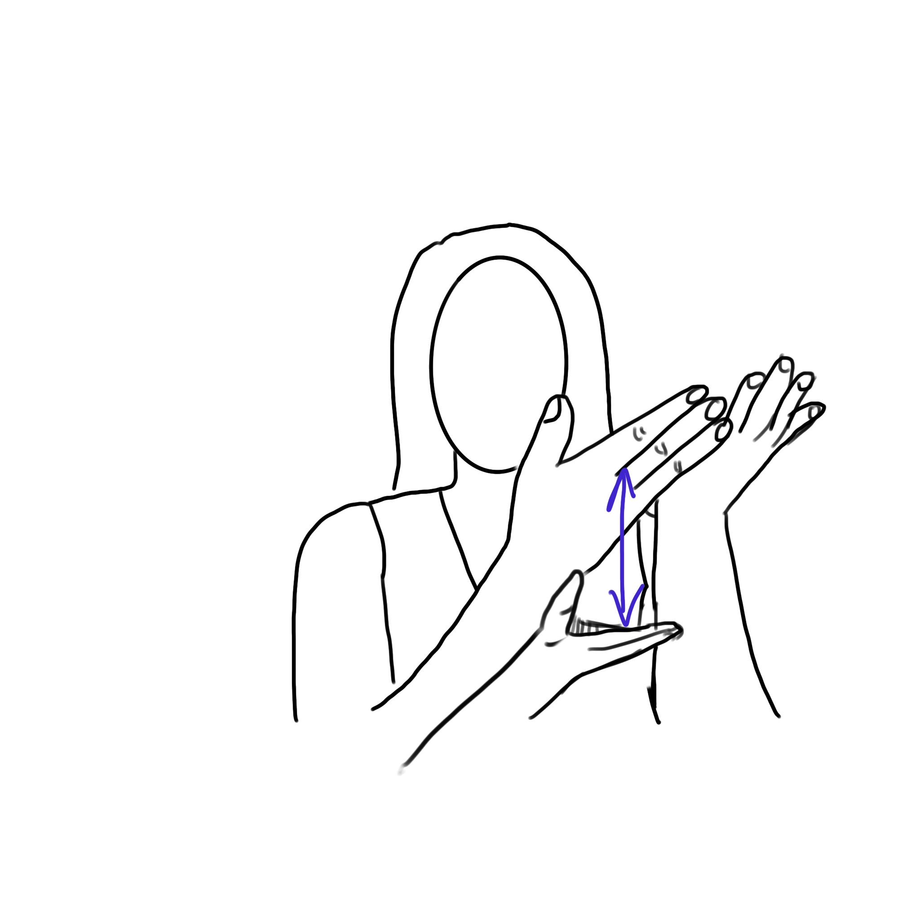
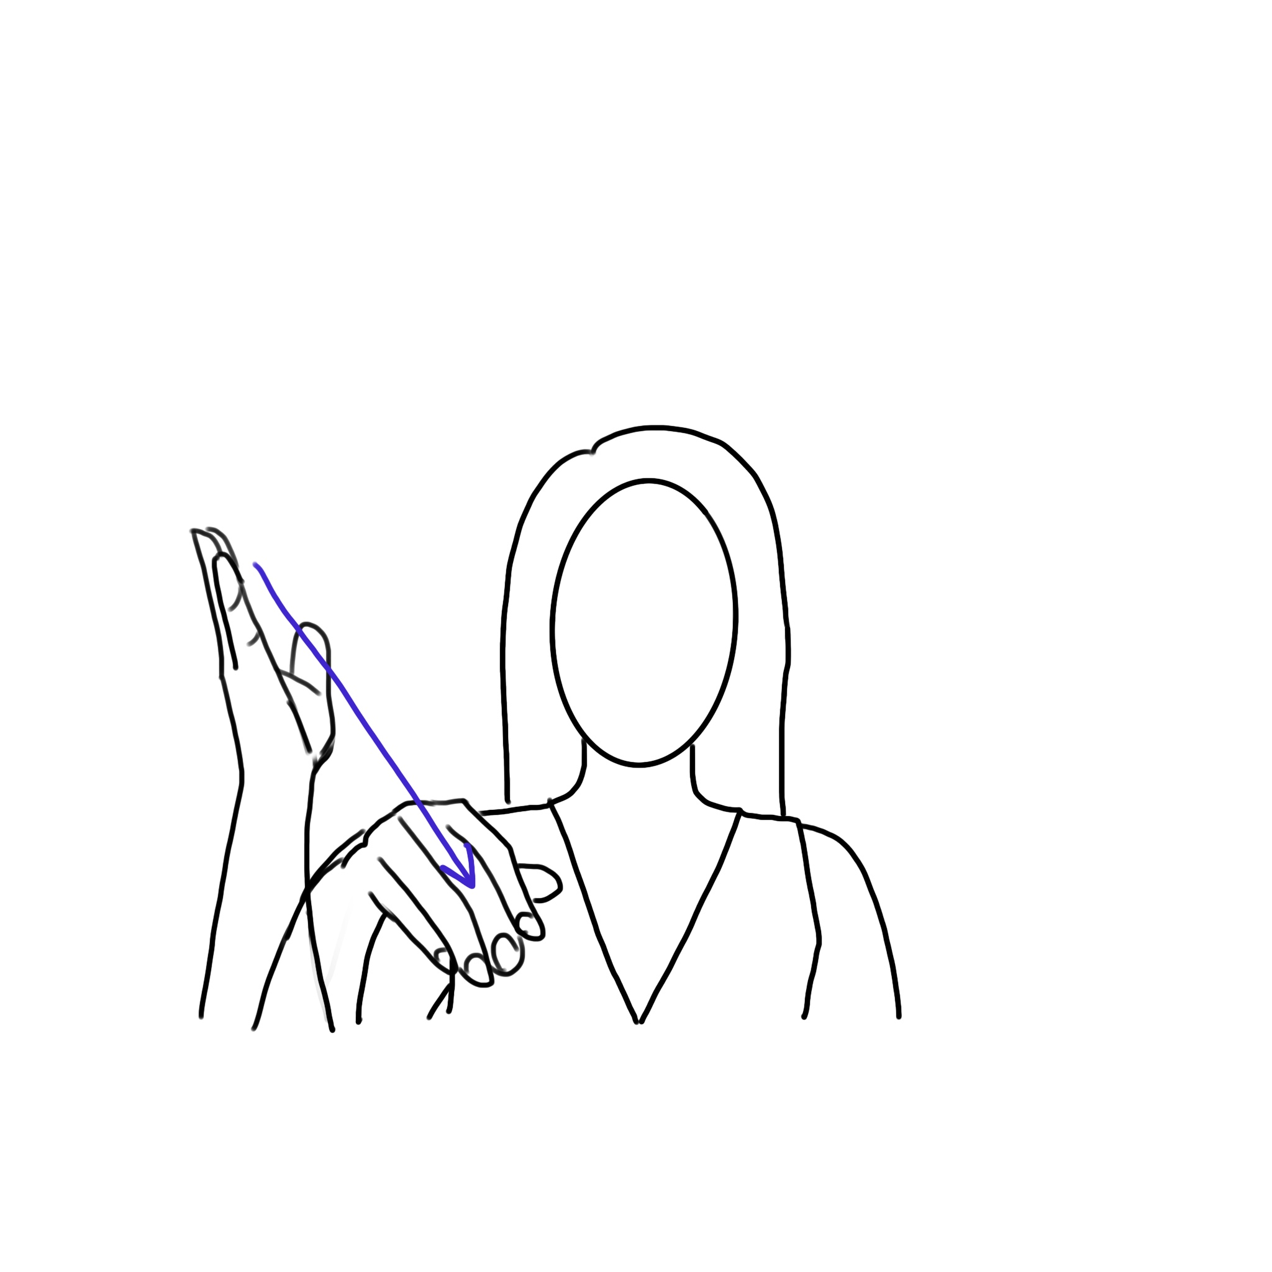
Up and Down
UPANDDOWN1
UPANDDOWN2
UPANDDOWN3

Slide 14
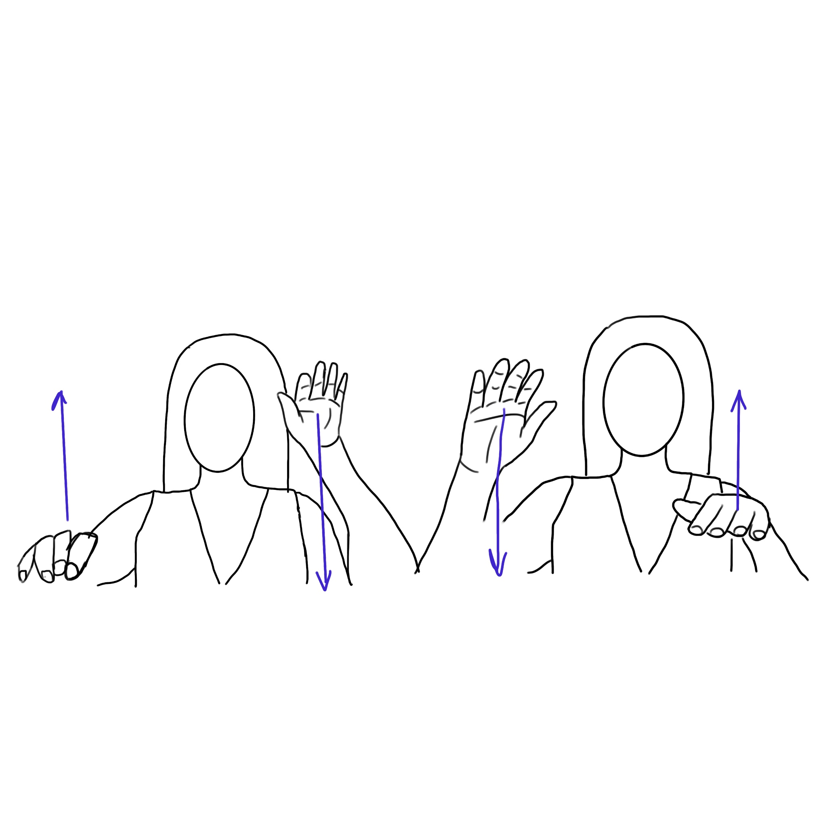
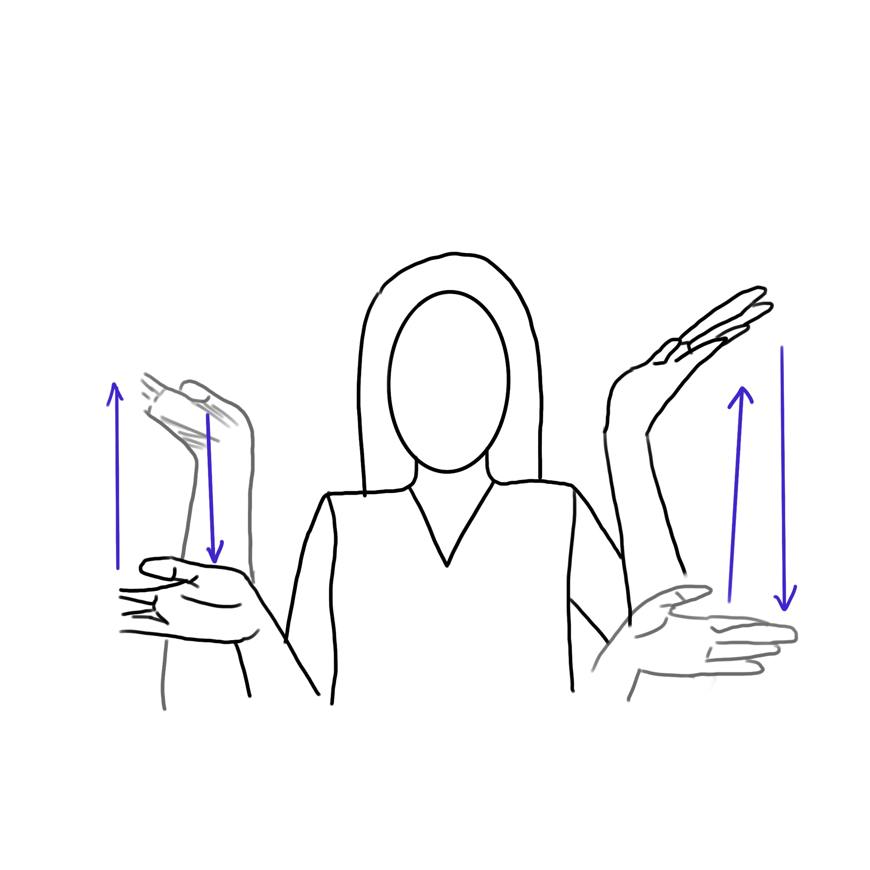
Up and Down(Cont.)
UPANDDOWN4
UPANDDOWN5

Slide 15



Up and Down(Cont.)
UPANDDOWN6
UPANDDOWN7
UPANDDOWN8

Slide 16
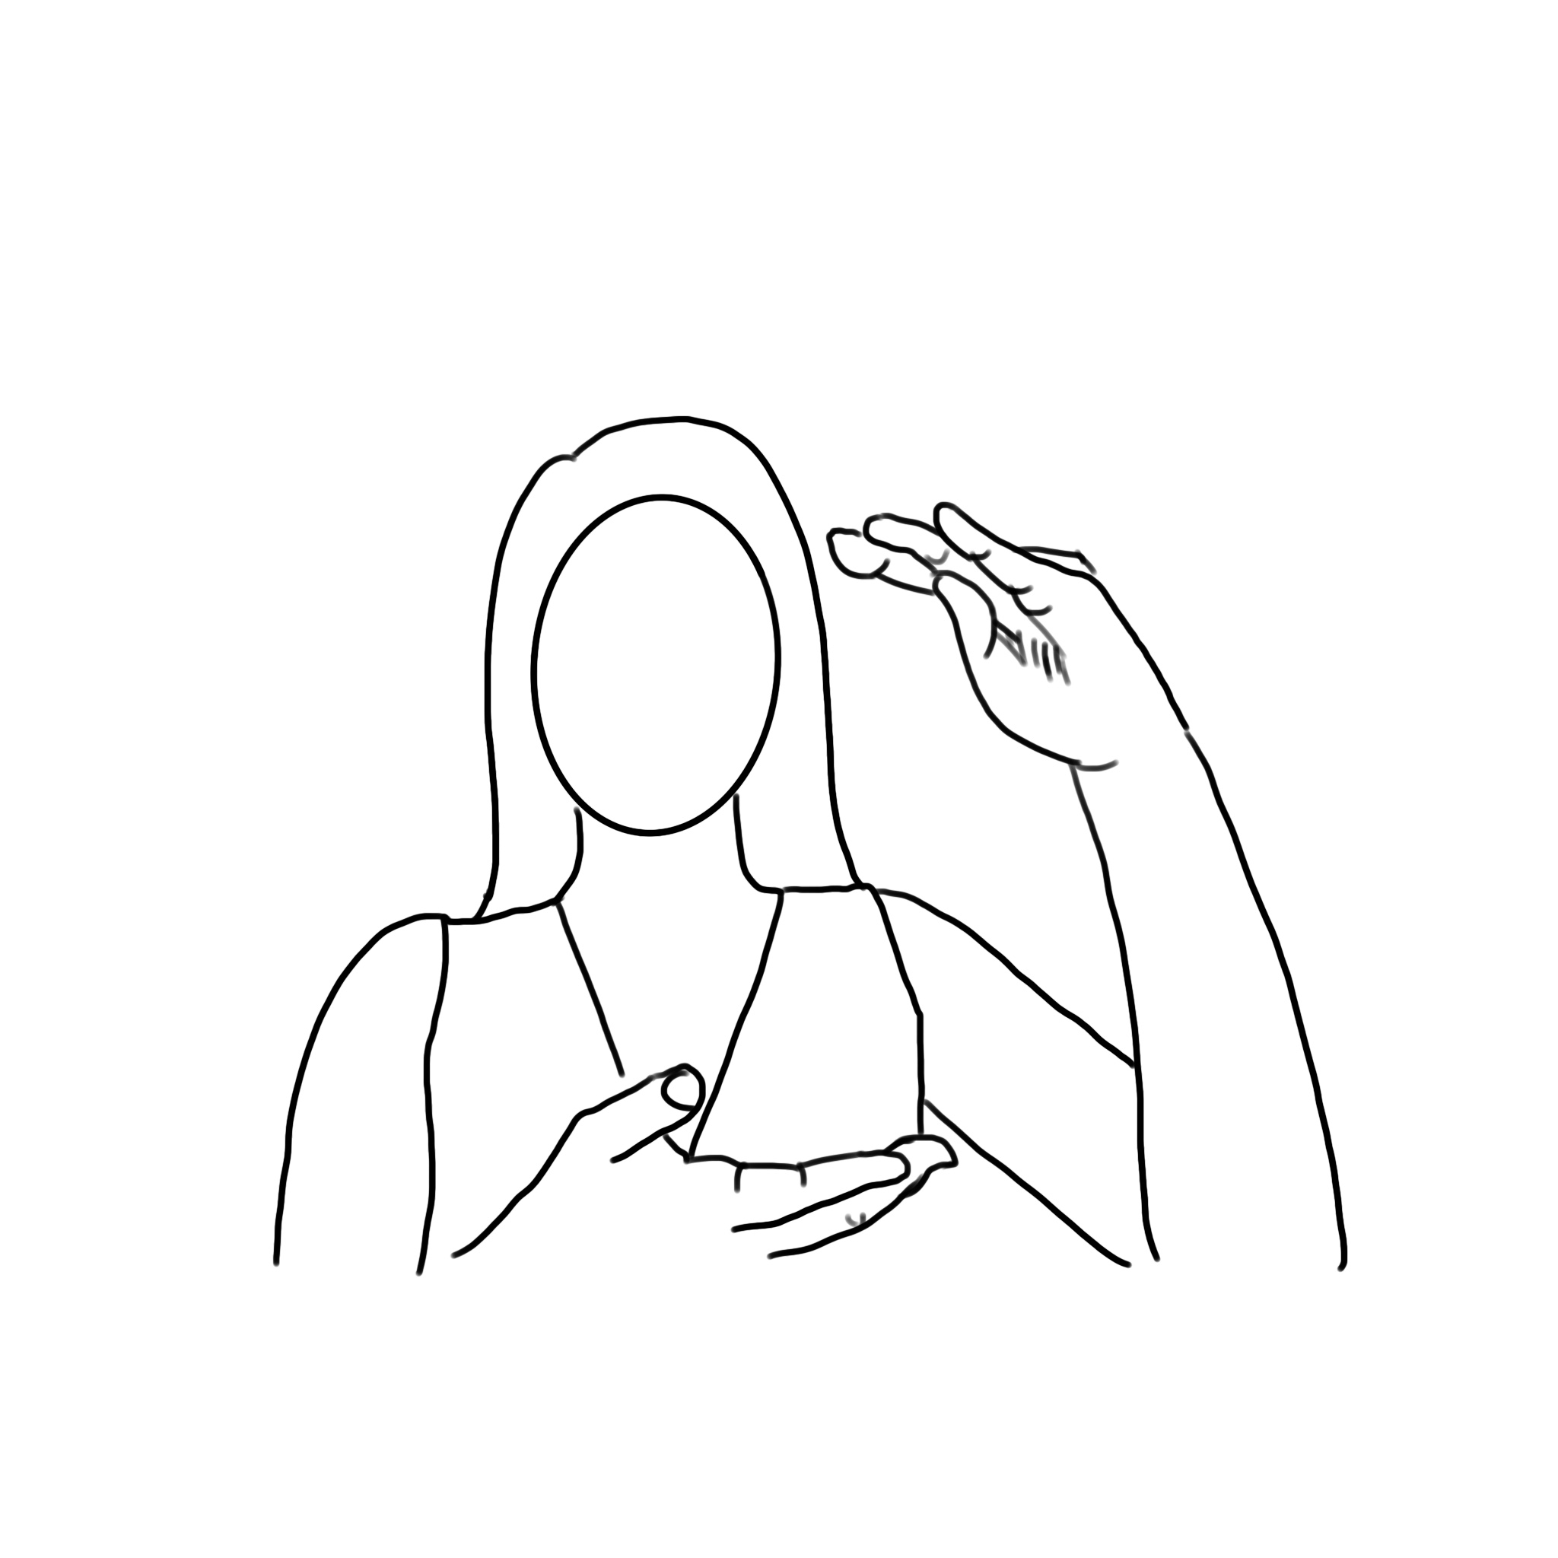





Vertical Distance
VERTICALD1
VERTICALD2
VERTICALD3
VERTICALD4
VERTICALD5
VERTICALD6

Slide 17



Vertical Distance(Cont.)
VERTICALD7
VERTICALD8
VERTICALD9

Slide 18




Left
LEFT1
LEFT2
LEFT3
LEFT4

Slide 19




Right
RIGHT1
RIGHT2
RIGHT3
RIGHT4

Slide 20





Left and right
LEFTANDRIGHT1
LEFTANDRIGHT2
LEFTANDRIGHT3
LEFTANDRIGHT4
LEFTANDRIGHT5

Slide 21





Horizontal Distance
HORIZONTALD1
HORIZONTALD2
HORIZONTALD3
HORIZONTALD4
HORIZONTALD5

